Slide 1
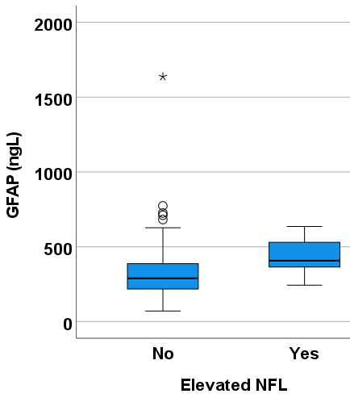
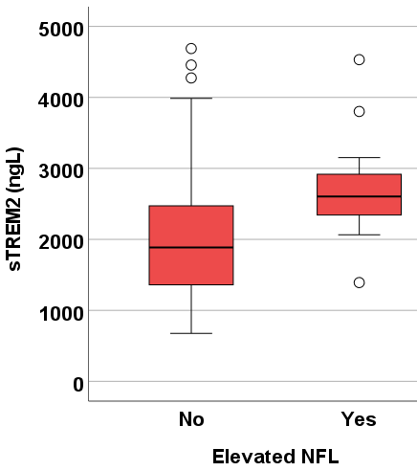
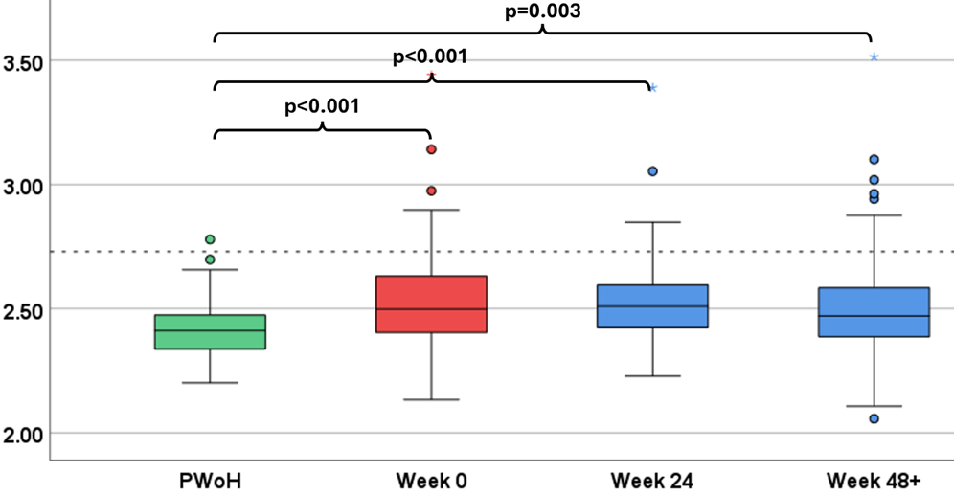
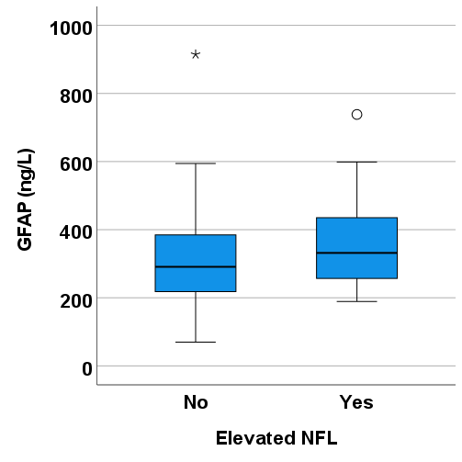
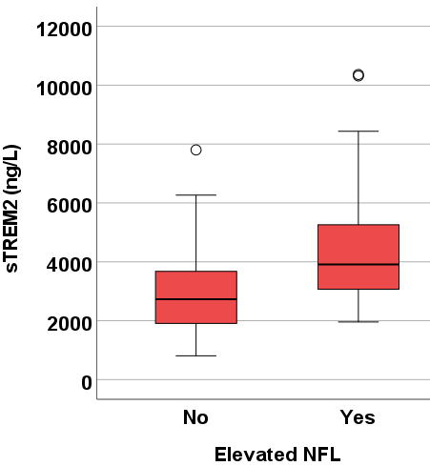
Neuroaxonal injury, evidenced by CSF NFL elevation, was observed in 15% of RV254 participants during AHI & ranged 5-9% during 240 weeks of follow-up, despite immediate ART initiation & subsequent plasma HIV suppression. Early ART alone is likely insufficient to provide complete neuroprotection to all PWH.
Neuronal Injury in a subset of PWH during Acute HIV Infection and up to 5 Years After Immediate ART
Phillip Chan^{1,2}, Suteeraporn Pinyakorn^{3,4}, Carlo Sacdalan^{5,6}, Eugène Kroon⁵, Pathariya Promsena⁵, Donn Colby^{3,4}, Somchai Sriplienchan³, Nittaya Phanuphak⁷, Sandhya Vasan^{3,4}, Robert Paul⁸, Magnus Gisslén^{9,10,11}, Henrik Zetterberg¹², Victor Valcour^{13,14}, Lydie Trautmann^{3,4} , Serena Spudich^{1,2}, on behalf of the RV254 Study Team
Department of Neurology, Yale University School of Medicine, New Haven, CT, USA; 2. Yale Center for Brain and Mind Health, Yale University School of Medicine, New Haven, CT, USA; 3. Military HIV Research Program, CIDR, Walter Reed Army Institute of Research, Silver Spring, MD, USA; 4. Henry M. Jackson Foundation for the Advancement of Military Medicine, Inc., Bethesda, MD, USA; 5. SEARCH Research Foundation, Bangkok, Thailand; 6. Faculty of Medicine, Chulalongkorn University, Bangkok, Thailand; 7. Institute of HIV Research and Innovation (IHRI), Bangkok, Thailand; 8. Faculty of Psychological Sciences, Missouri Institute of Mental Health, University of Missouri-St. Louis, St. Louis, MO, USA; 9.Department of Infectious Diseases, Institute of Biomedicine, Sahlgrenska Academy, University of Gothenburg, Gothenburg, Sweden; 10. Department of Infectious Diseases, Sahlgrenska University Hospital, Region Västra Götaland, Gothenburg, Sweden; 11. Public Health Agency of Sweden, Solna, Sweden; 12.Department of Psychiatry and Neurochemistry, Institute of Neuroscience and Physiology, Sahlgrenska Academy, University of Gothenburg, Gothenburg, Sweden; 13. Global Brain Health Institute (GBHI), University of California, San Francisco, CA, USA; 14. Memory and Aging Center, Department of Neurology, Weill Institute for Neurosciences, University of California, San Francisco, CA, USA
Abstract # 615
BACKGROUND
Neurofilament light chain (NFL) is a sensitive neuronal injury marker. Cerebrospinal fluid (CSF) NFL is elevated in up to 40% of people with HIV during the 1st year of infection & has been reported as normalizing after antiretroviral therapy (ART).
We measured CSF NFL, glial fibrillary acidic protein (GFAP) & soluble triggering receptor expressed on myeloid cells 2 (sTREM2) cross-sectionally during acute HIV infection (AHI) & at longitudinal time points up to 5 years after immediate initiation of ART in an observational study.
METHODS
RV254 AHI cohort participants completed optional lumbar punctures during pre-ART AHI (week 0, n=136) & at post-ART visits (weeks 24, 48, 96 & 240, n=201).
All post-ART sample donors had plasma HIV RNA ≤50 cps/ml.
RV254 participant CSF NFL measurements were compared to 44 people without HIV (PWoH), both adjusted to an age of 30, & also to age-based upper normal limits (UNL) based on published data.
Post-ART
p=0.002
p<0.001
RESULTS
Log₁₀ CSF NFL
SUMMARY OF KEY FINDINGS
RV254 participants demonstrated higher CSF NFL than PWoH during AHI and post-ART visits up to 5 years post-ART.
CSF samples with elevated NFL exhibited higher levels of GFAP and sTREM2 during pre-ART AHI and post-ART visits.
OTHER FINDINGS
During pre-ART AHI, CSF NFL positively correlated with CSF HIV RNA (r=0.206, p=0.016), CD8+ T-cell (r=0.249, p=0.004) & negatively correlated with CD4/CD8 ratio (r=-0.242, p=0.005).
All except one AHI CSF samples with NFL elevation demonstrated detectable levels of CSF HIV RNA.
Two post-ART CSF samples had detectable HIV RNA (316 & 20 cps/ml) and both exhibited NFL elevation.
ACKNOWLEDGMENTS
We would like to thank the study participants who committed so much of their time for this study. The participants were from the RV254/SEARCH 010, which is supported by cooperative agreements (WW81XWH-18-2-0040) between the Henry M. Jackson Foundation for the Advancement of Military Medicine, Inc., and the U.S. Department of Defense (DOD) and by an intramural grant from the Thai Red Cross AIDS Research Centre and, in part, by the Division of AIDS, National Institute of Allergy and Infectious Diseases, National Institute of Health (DAIDS, NIAID, NIH) (grant AAI20052001). Antiretroviral therapy for RV254/SEARCH 010 participants was supported by the Thai Government Pharmaceutical Organization, Gilead Sciences, Merck and ViiV Healthcare. This study was supported by NIH grants focused on neurological and cognitive outcomes in RV254/SEARCH010 including R01 MH113560 and by additional funds contributed by the National Institute of Mental Health.
DISCLAIMER
The views expressed are those of the authors and should not be construed to represent the positions of the U.S. Army, the Department of Defense, the National Institutes of Health, the Department of Health and Human Services, or the Henry M. Jackson Foundation for the Advancement of Military Medicine, Inc. The investigators have adhered to the policies for protection of human subjects as prescribed in AR-70-25
Table 1. Demographics and Clinical Outcomes of the CSF Samples
 | RV304 | RV254
 | PWoH (n=44) | Week 0 (n=136) | Week 24 (n=62) | Week 48+ (n=139)
Age at CSF Sampling | 33 (26,39) | 27 (23,32) | 28 (24, 32) | 30 (27,34)
Male, n (%) | 26 (59) | 135 (99) | 60 (97) | 136 (98)
Fiebig Stage, n (%) I-II III-V | - | 49 (36) 87 (64) | - | -
Plasma HIV RNA, log₁₀ copies/ml | - | 5.99 (5.07, 6.78) | - | -
HIV suppression (≤50 copies/ml), n (%) | - | - | 62 (100) | 139 (100)
CSF HIV RNA, log₁₀ copies/ml | - | 3.22 (1.90, 4.25) | 0 (0, 0) | 0 (0, 0)
Detectable HIV RNA in CSF, n (%) | - | 113 (83) | 1 (1.6) | 1 (0.7)
CD4+ T-cell count, cells/µL | - | 379 (263, 545) | 638 (479,846) | 691 (550,886)
CD8+ T-cell count, cells/µL | - | 525 (348, 863) | 604 (436,789) | 649 (523,859)
CD4/CD8 T-cell ratio | - | 0.73 (0.43, 1.12) | 1.12 (0.81, 1.26) | 1.08 (0.80,1.36)
Median (IQR) were presented unless specified. Week 48+ (Weeks 48, 96 and 240).
Pre-ART AHI
p=0.080
p<0.001
Table 2. Elevated CSF NFL (above upper normal limit), n (%) by visits
RV304 | RV254
PWoH | Week 0 | Week 24 | Week 48 | Week 96 | Week 240
44 (2) | 20/136 (15) | 5/62 (8) | 1/18 (5) | 5/81 (6) | 4/43 (9)
32th Conference on Retroviruses and Opportunistic Infections (CROI 2025) San Francisco, California, USA; March 9-12, 2025
Notes:
Poster Development Guide
Formatting Notes
To Edit In PowerPoint: Click View > Guides to make editing easier. Keep text within guides
If you wish, you may change the background colors, but use a light color or white for the overall background of the poster and a bold color for the main findings section
Author list: Don’t split names onto two lines (e.g., “John [line break] Smith”). If that happens, use a new line. Bold the name of the presenting author
Font Size: Do not drop below font size 36 in the main information sections (Background, Methods, Results, Conclusions). If you have extra space, increase the font size, but maintain some white space to make it easier for attendees to read your text
Use of Color: To keep attendees focused on your main findings and important details in your graphs and figures, do not use color in the sidebars
Print Size: Using this template, the optimal print size is 54 inches (width) x 36 inches (height) or 60 inches x 40 inches (137.2 cm x 91.4 cm or 152.4 cm x 101.6). Printing the poster in a smaller size may save some cost, but the 54” x 36” size will maintain the suggested font size and layout in the final printed version of the poster (and maintain the effectiveness of the poster design).
Poster Board Dimensions: Regardless of whether you use this template, the size of the board for displaying your poster at CROI is 96 inches (width) x 48 inches (height). The maximum size of a poster is 93 inches (width) x 45 inches (height). The minimum size for a poster is 36 inches (width) x 24 inches (height) so attendees can see the poster at a minimum of 10 feet away
Poster Content Requirements
Poster Number: The poster number should be displayed in the upper right corner (0000 in the template). This is not the abstract number you had during submission but a number you will be assigned and sent to you by email which notes the position of the poster in the poster hall. This number will be sent to you after late-breaking abstracts have been accepted in January
Poster Title: The title should be the same as the title submitted with the abstract
QR Codes are not allowed by CROI

