Slide 1
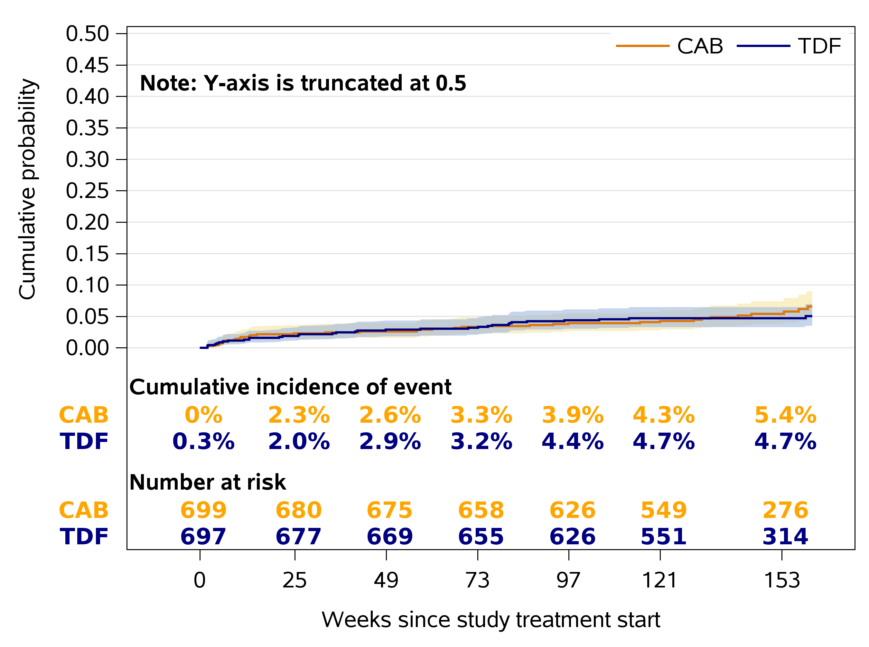
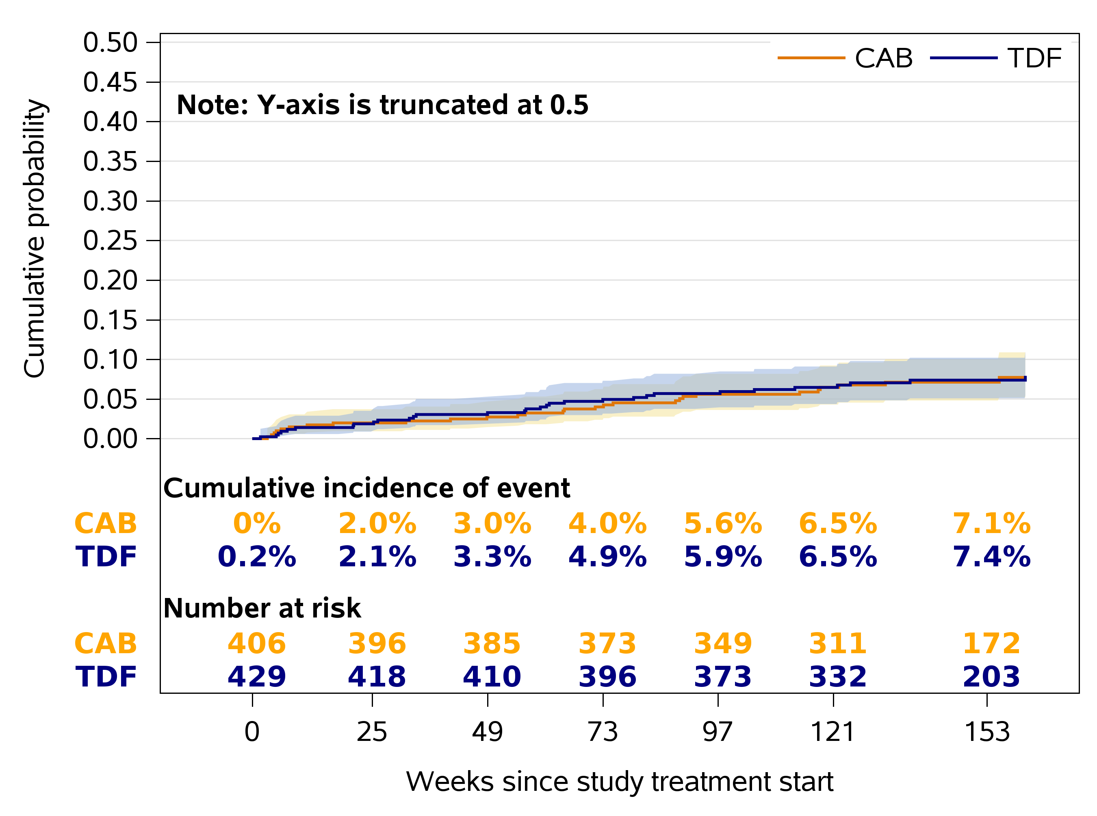
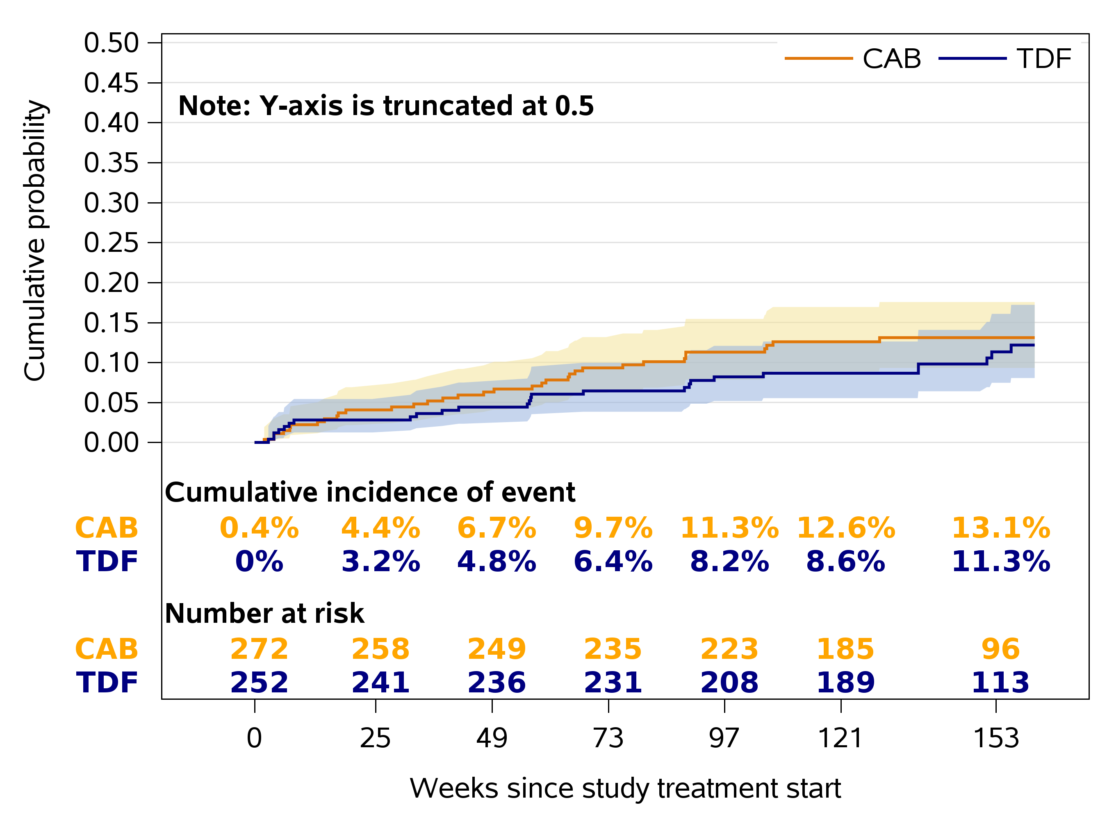
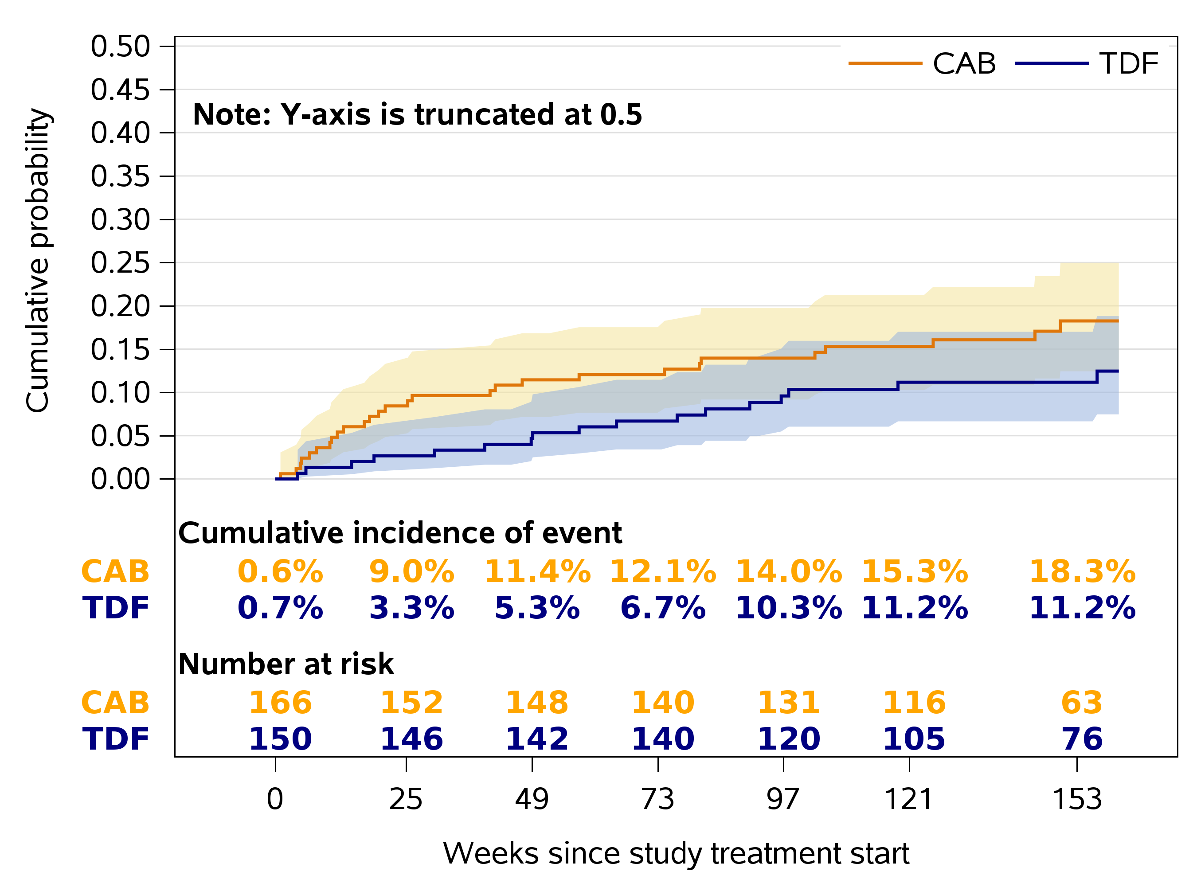
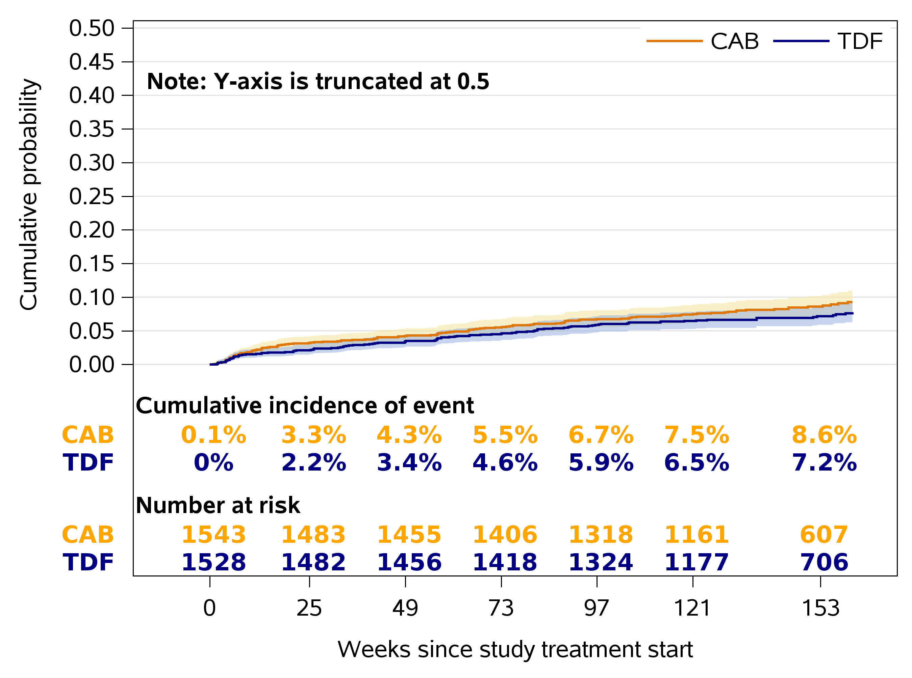
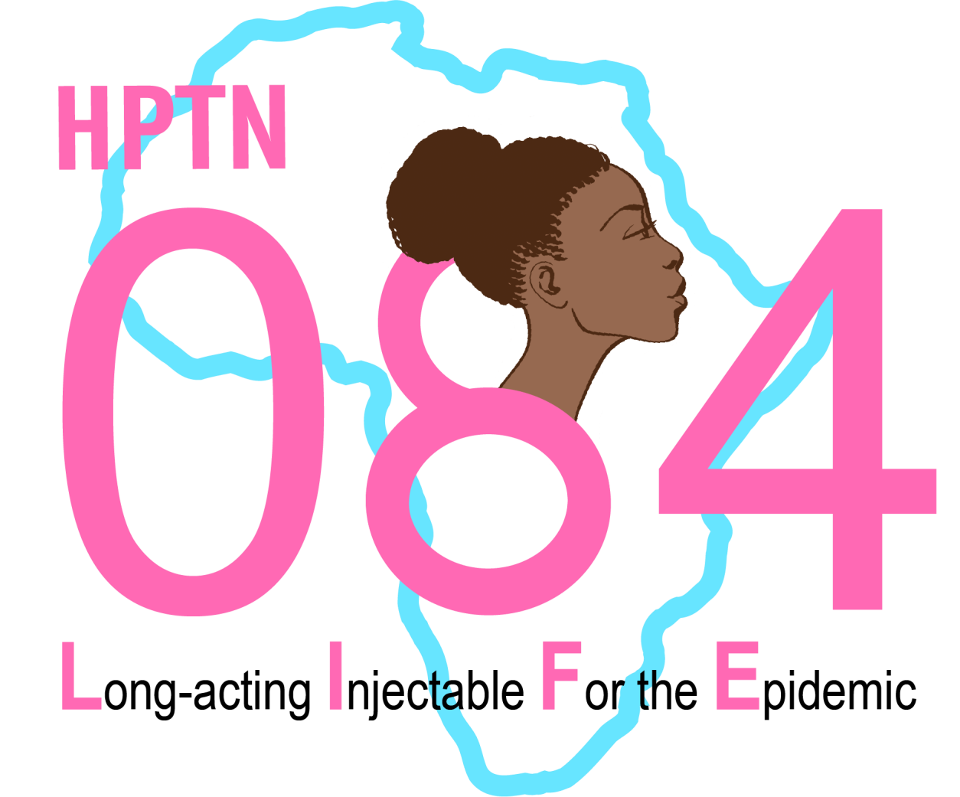
820
No Increased Risk for Hypertension with CAB-LA Compared to TDF/FTC for PrEP: Results from HPTN 084
Sinead Delany-Moretlwe¹, Heather Ribaudo², Younjung Choi², Brett Hanscom³, Nyaradzo Mgodi⁴, Joseph Makhema⁵, Harriet Nuwagaba-Biribonwoha⁶, Scott Rose⁷, Lydia Soto-Torres⁸, James Rooney⁹, Alex Rinehart¹⁰, Raphael Landovitz¹¹, Mina Hosseinipour¹² ¹University of the Witwatersrand, Johannesburg, South Africa, ²Harvard TH Chan School of Public Health, Boston, MA, USA, ³Fred Hutchinson Cancer Center, Seattle, WA, USA, ⁴University of Zimbabwe Clinical Trials Research Centre, Harare, Zimbabwe, ⁵Botswana Harvard AIDS Institute Partnership (BHP), Gaborone, Botswana, ⁶Eswatini Prevention Center, ICAP at Columbia University Mailman School of Public Health, New York, NY, USA, ⁷FHI 360, Washington, DC, USA, ⁸National Institute of Allergy and Infectious Diseases, Baltimore, MD, USA, ⁹Gilead Sciences, Inc, Foster City, CA, USA, ¹⁰ViiV Healthcare, Research Triangle Park, NC, USA, ¹¹University of California Los Angeles, Los Angeles, CA, USA, ¹²University of North Carolina at Chapel Hill, Chapel Hill, NC, USA
BACKGROUND
Several studies, including D2EFT, ADVANCE, and NAMSAL, suggest an increased risk of hypertension (HTN) associated with the initiation of integrase strand transfer inhibitors (INSTIs) for HIV treatment, potentially mediated by weight gain. HPTN 083 found no increased risk of hypertension with CAB-LA compared to TDF/FTC for HIV PrEP in men who have sex with men (MSM) and transgender women (TGW), but little is known about cisgender women.
HPTN 084 randomized HIV-negative individuals born female aged 18-45 years in Sub-Saharan Africa to receive either every-8-week injectable cabotegravir (CAB) or daily oral tenofovir disoproxil fumarate-emtricitabine (TDF-FTC) for HIV pre-exposure prophylaxis (PrEP). The study demonstrated that both CAB and TDF-FTC were highly effective for HIV prevention in this population. A mean weight gain of approximately 2 kg/year was observed in both study arms.
We conducted a post-hoc analysis of the HPTN 084 trial to investigate whether CAB-LA was associated with an increased incidence of HTN.
Hypertension incidence in this population was low, with no difference between women using CAB vs. TDF/FTC PrEP
Figure 1: BMI Change Over Time
Figure 4: Cumulative Incidence of First Hypertension Event by Baseline BMI
RESULTS
A. BMI <25
B. BMI 2-29.9 (Overweight)
The baseline characteristics of participants were balanced between the CAB and TDF groups, with 51% aged 18–24 years and 55% with a BMI ≥ 25 kg/m2. Among the 4% of participants with pre-existing hypertension, a greater proportion were from the Southern African region, particularly Zimbabwe (50% vs. 23% without hypertension), they were older on average (33 years vs. 26 years), and had higher BMI levels, with 73% classified as overweight or obese compared to 55% of those without hypertension.
Over the study period, both groups showed increases in BMI, with median increases of 2.2 kg/m² (CAB) and 2.1 kg/m² (TDF) by week 153. More than 63% of participants in both groups gained over 5% of their baseline weight, with lower baseline BMI associated with higher relative weight gains.
Over 8252 person-years of follow up, 234 (8%) had incident HTN (127/1543 CAB, 107/1528 TDF/FTC). Cumulative HTN incidence over 3 years was 8.6% for CAB and 7.2% for TDF/FTC. In unadjusted analyses, incident HTN was higher with CAB compared to TDF/FTC use (HR 1.20, 95% CI 0.93-1.55, p=0.16) and largely unchanged (HR 1.17, 95% CI 0.91-1.50, p=0.26) after adjustment for enrolment region, age, and baseline BMI.
The hazard for HTN was increased with >10% weight gain (HR 1.58, 95% CI 1.05-2.38), pregnancy (HR 2.20, 95% CI 1.14-4.25), enrolment from the southern Africa region (Botswana, Eswatini, Zimbabwe) (HR 2.24, 95% CI 1.58-3.19), pre-existing obesity (HR 2.35, 95% CI 1.63-3.36), and older age (HR per 10 years 2.50, 95% CI 2.03-3.08).
METHODS
Incident HTN was defined as a new diagnosis of hypertension (systolic blood pressure [BP]≥140mmHg or diastolic BP ≥90mmHg) made during routine clinical assessments after starting study treatment or the initiation of new HTN medications after randomization through 161 weeks of follow up. Time to incident HTN was measured from the start of study treatment to the first HTN-defining event.
Of 3,224 enrolled participants, 3,071 with study drug exposure and without pre-existing HTN were included in the analysis. The primary analysis used Cox regression analysis to estimate the cause-specific hazard ratio for incident hypertension in the CAB group as compared with the TDF group with 95% confidence intervals; P-values are based on the Wald statistics. The analysis adjusted for baseline age, baseline BMI, and region. Modelling also evaluated time-updated risk factors for HTN including percentage weight change from baseline (TUWC), incident pregnancy, and contraceptive method.
Figure 2: Percent Weight Gain from Baseline Over Time
C. BMI 30-34.9 (Obese)
D. BMI >35 (Extreme)
Table 1: Baseline Characteristics of Analysis Population
 | CAB (N=1543) | TDF (N=1528) | Total (N=3071)
Region
East Africa | 432 (28%) | 422 (28%) | 854 (28%)
South Africa | 624 (40%) | 634 (41%) | 1258 (41%)
Southern Africa | 487 (32%) | 472 (31%) | 959 (31%)
Gender Identity
Female | 1541 (100%) | 1525 (100%) | 3066 (100%)
Non-Female | 2 (0%) | 3 (0%) | 5 (0%)
Age (years)
Median (Q1, Q3) | 24 (22, 29) | 24 (21, 29) | 24 (22, 29)
Weight (kg)
Median (Q1, Q3) | 65 (56, 78) | 64 (55, 76) | 65 (56, 77)
BMI (kg/m²)
Median (Q1, Q3) | 25.6 (22.3, 30.8) | 25.5 (22.1, 30.1) | 25.6 (22.2, 30.4)
Contraception Type
IUD | 64 (4%) | 64 (4%) | 128 (4%)
Implant | 474 (31%) | 470 (31%) | 944 (31%)
DMPA | 776 (50%) | 748 (49%) | 1524 (50%)
NET-EN | 156 (10%) | 179 (12%) | 335 (11%)
Oral | 54 (3%) | 55 (4%) | 109 (4%)
Figure 3: Cumulative Incidence of First Hypertension Event
Figure 5: Adjusted Hazard Ratios
CONCLUSIONS
CAB vs. TDF/FTC
In HPTN 084, HTN incidence in this population without HIV was low. Observed HTN incidence was higher in the CAB compared to TDF/FTC group, this was not statistically significant and was not apparent after adjustment for key risk factors. Higher age, obesity, excessive weight gain, and incident pregnancy appear to be more important drivers of incident HTN in this population.
Southern Africa vs. South Africa
East Africa vs. South Africa
Age in 10-year increments
Overweight vs. Normal/Underweight
Obese vs. Normal/Underweight
Extreme vs. Normal/Underweight
Weight gain 5-10% vs. <5%
Weight gain >10% vs. <5%
Confirmed pregnancy vs. No pregnancy
IUD vs. DMPA
Implant vs. DMPA
NET EN vs. DMPA
Oral vs. DMPA
1
2
3
4
ACKNOWLEDGMENTS
Hazard Ratio (95% CI)
Adjusted model controls for baseline age, region of enrollment, baseline BMI, and time-updated covariates (percent increase in weight from baseline as a categorical variable, pregnancy status, and contraception use).
We thank Ryan Koffron for his assistance with this presentation. We acknowledge the HPTN 084 participants, their communities and the study staff; HPTN Leadership and Operations Center (FHI360); HPTN Laboratory Center (Johns Hopkins); HPTN Statistical and Data Management Center, Fred Hutchison Cancer Research Center; ViiV Healthcare and the Bill & Melinda Gates Foundation for financial support to the trial; and ViiV Healthcare and Gilead Sciences for pharmaceutical support. The study was sponsored by the Division of AIDS at the US National Institute of Allergy and Infectious disease (NIAID)
Presented at the Conference on Retroviruses and Opportunistic Infections
San Francisco, California
March 9 – 12 2025

