Slide 1
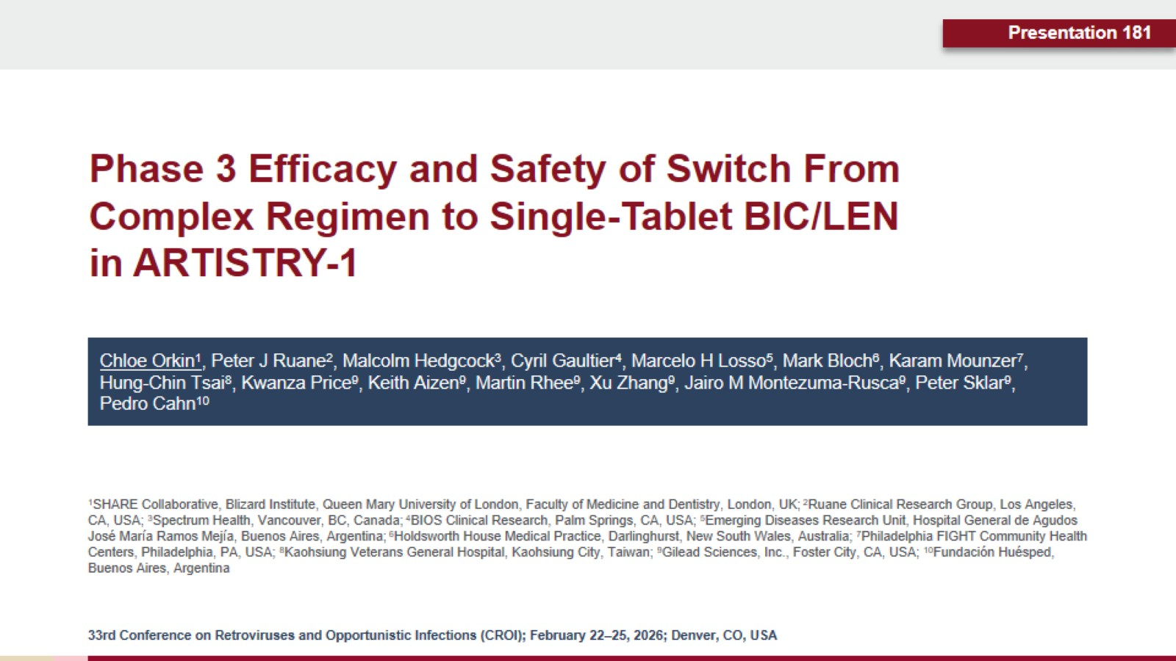
Phase 3 Efficacy and Safety of Switch From Complex Regimen to Single-Tablet BIC/LEN in ARTISTRY-1

Slide 2
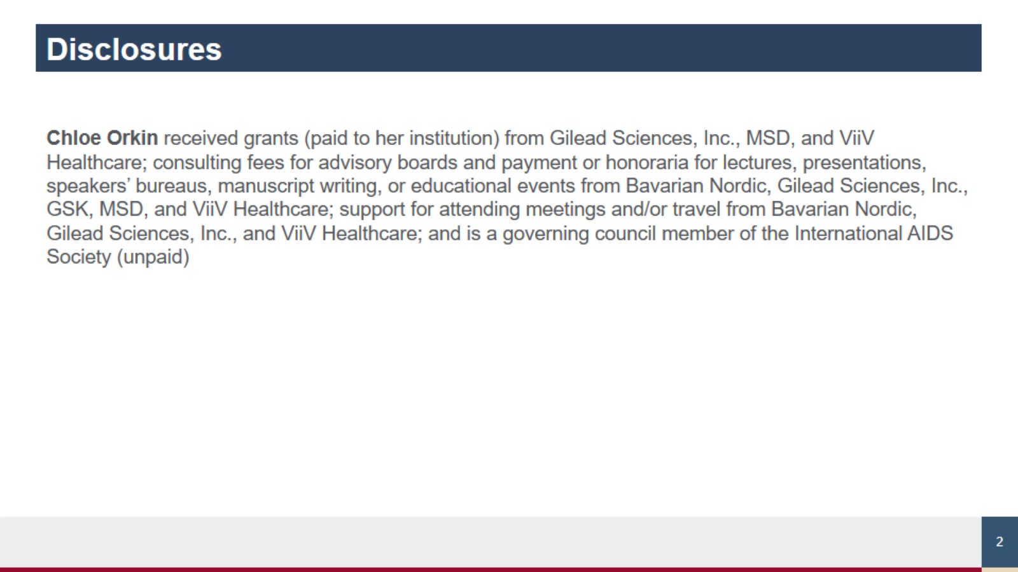
Disclosures

Slide 3
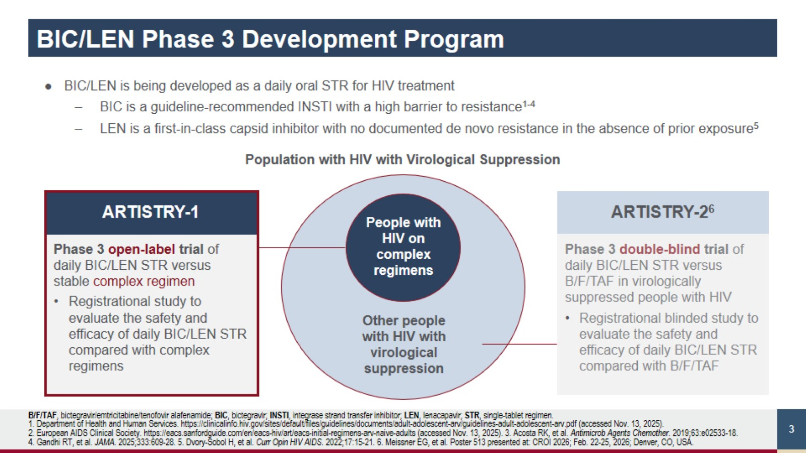
BIC/LEN Phase 3 Development Program

Slide 4
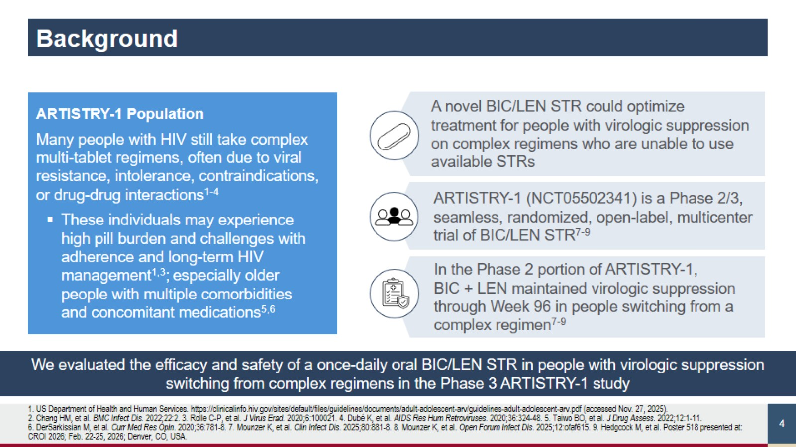
Background

Slide 5
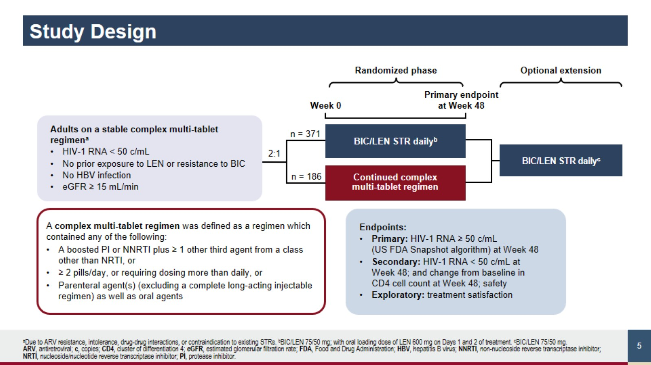
Study Design

Slide 6
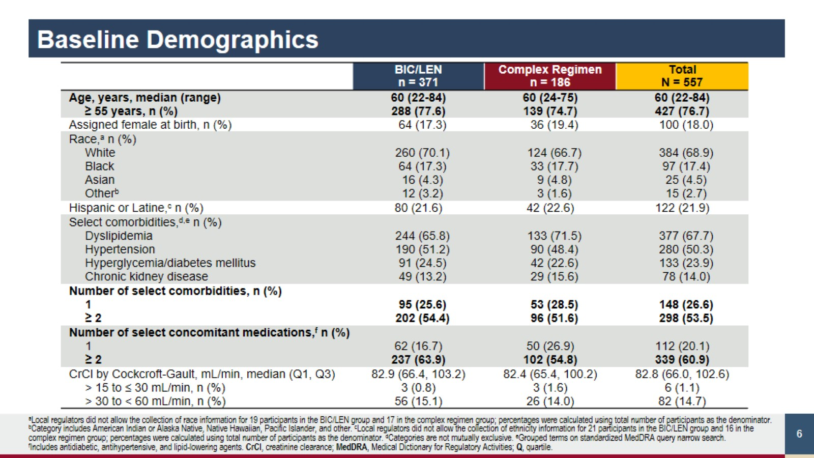
Baseline Demographics

Slide 7
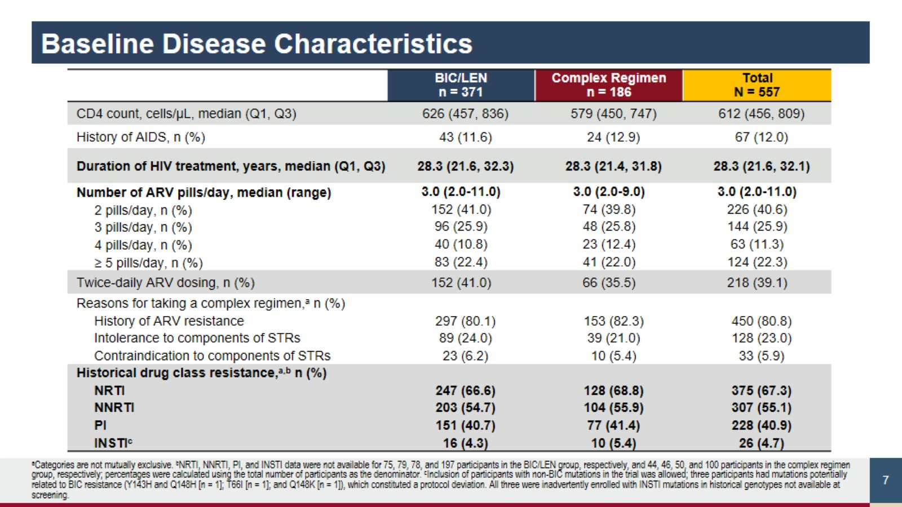
Baseline Disease Characteristics

Slide 8
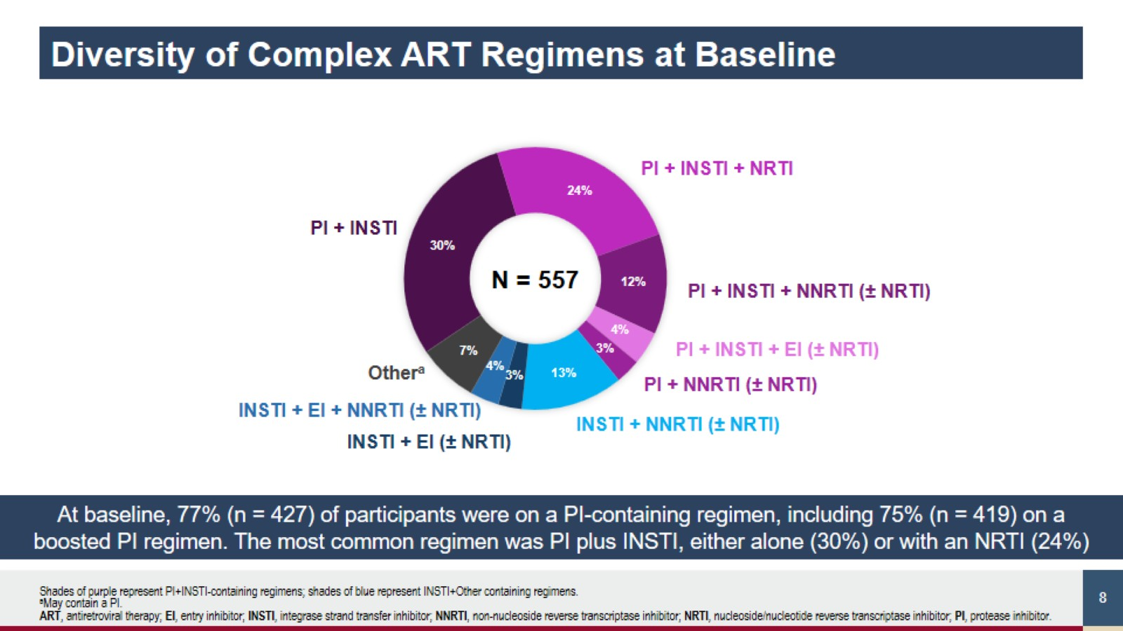
Diversity of Complex ART Regimens at Baseline

Slide 9
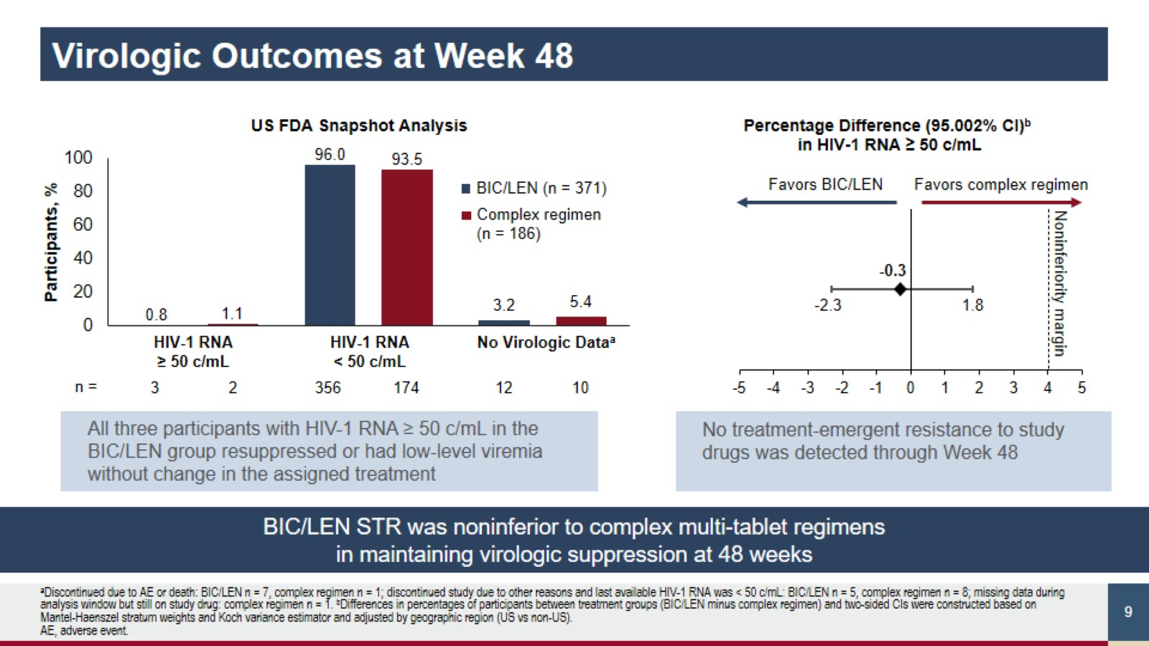
Virologic Outcomes at Week 48

Slide 10
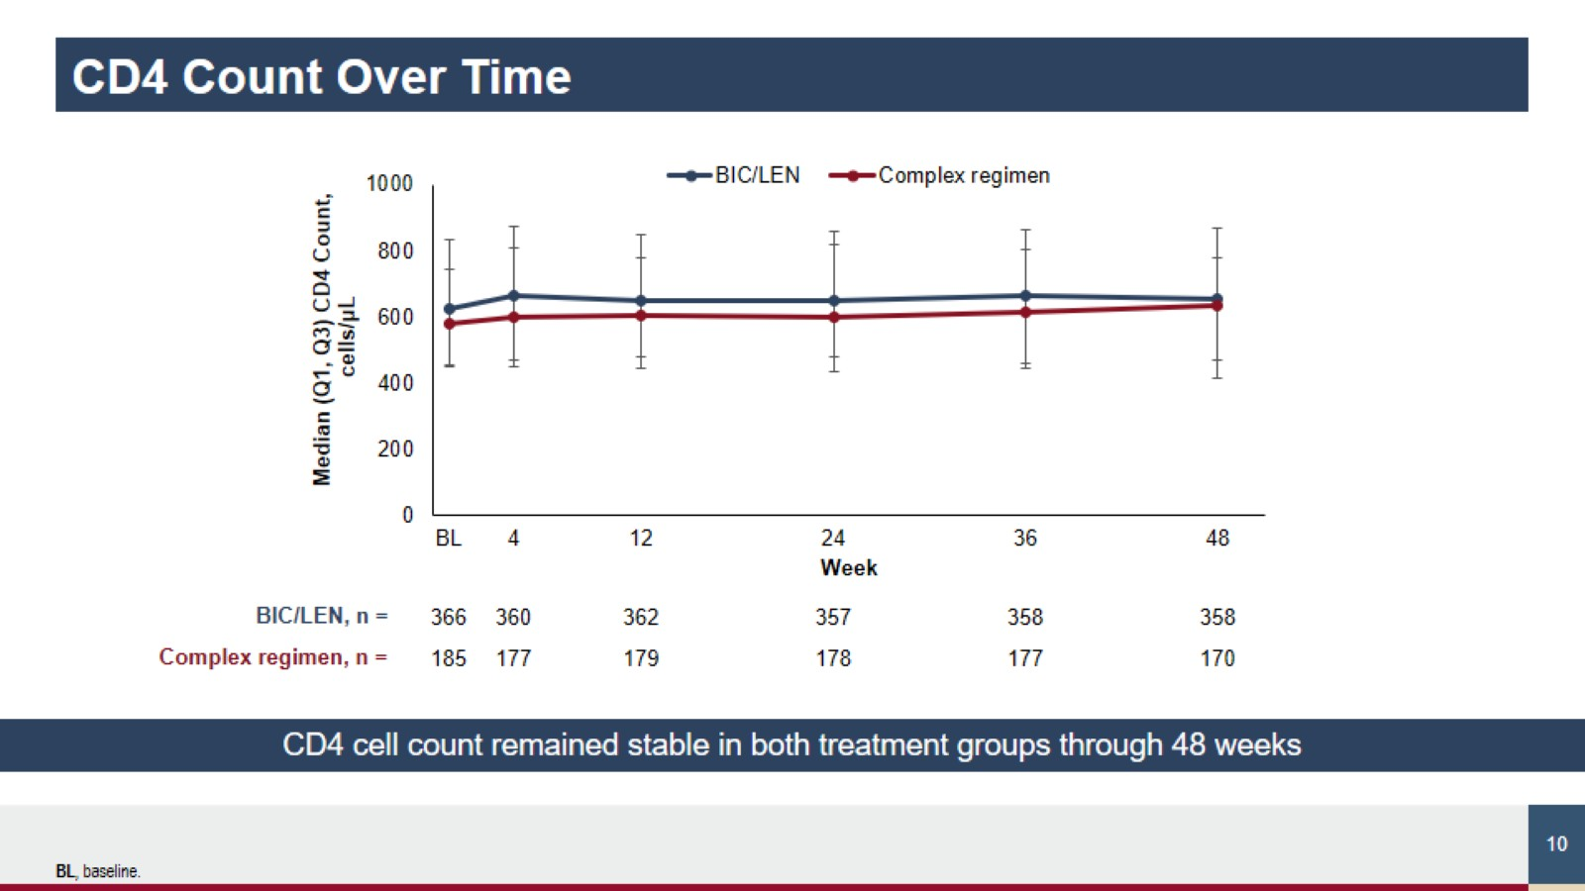
CD4 Count Over Time

Slide 11
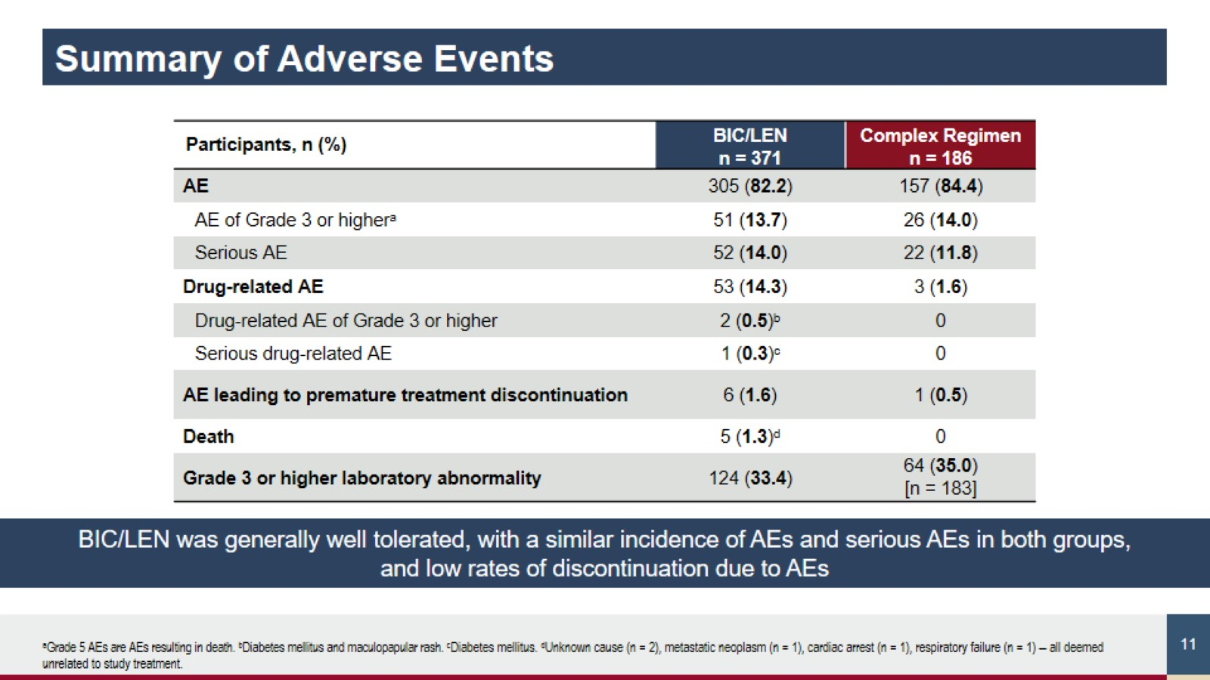

Slide 12
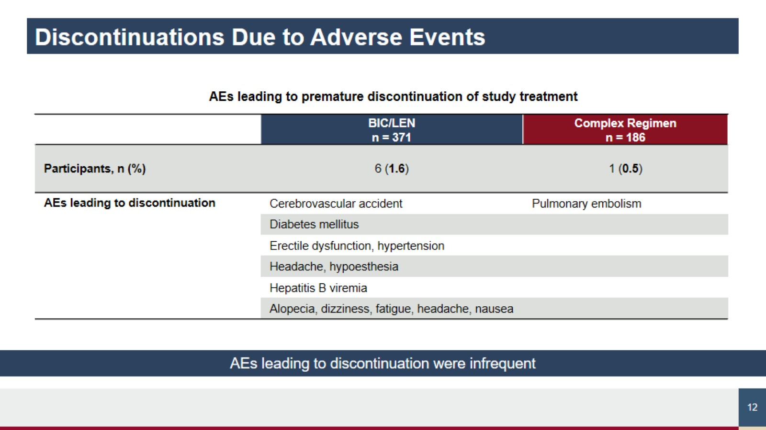

Slide 13
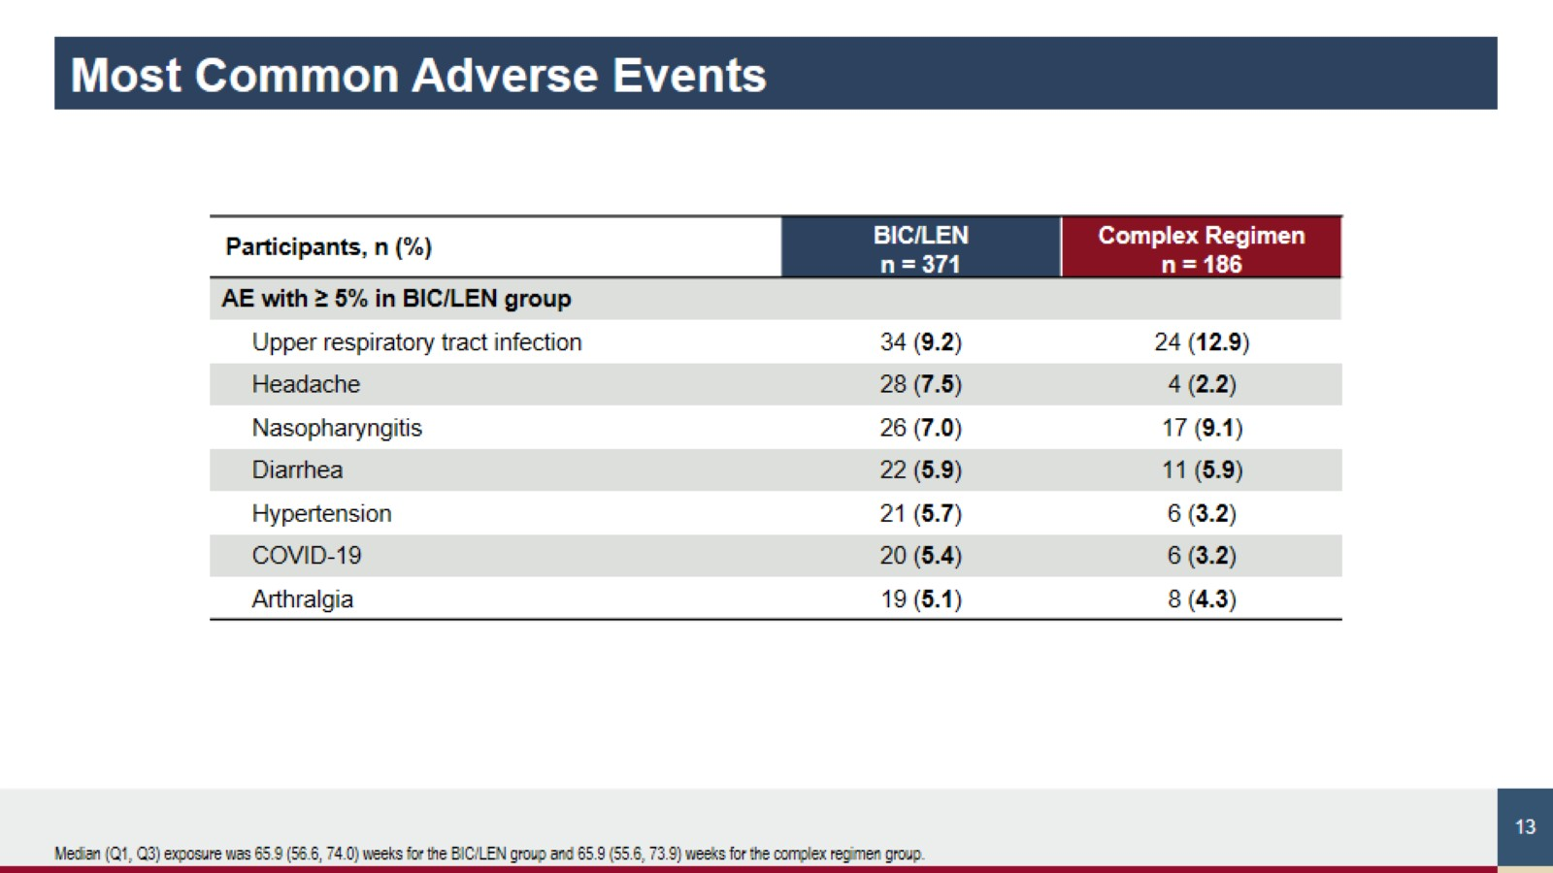

Slide 14
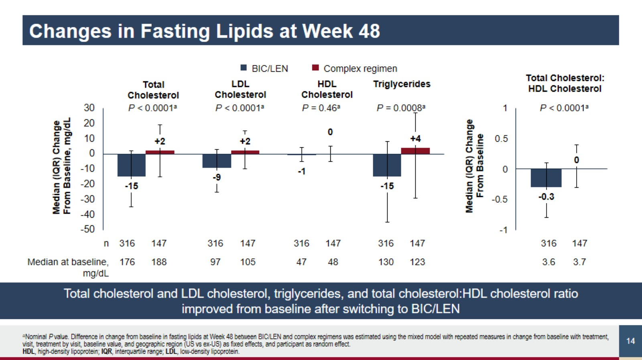

Slide 15
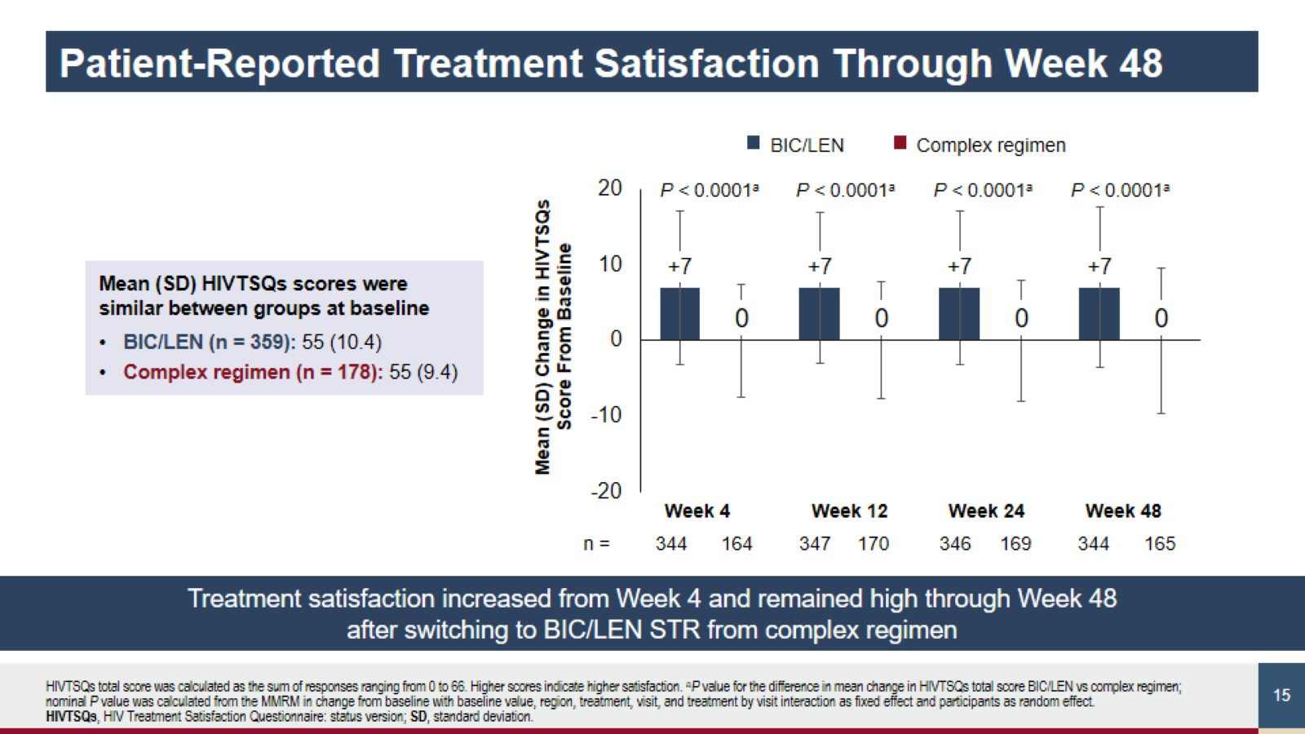
Patient-Reported Treatment Satisfaction Through Week 48

Slide 16
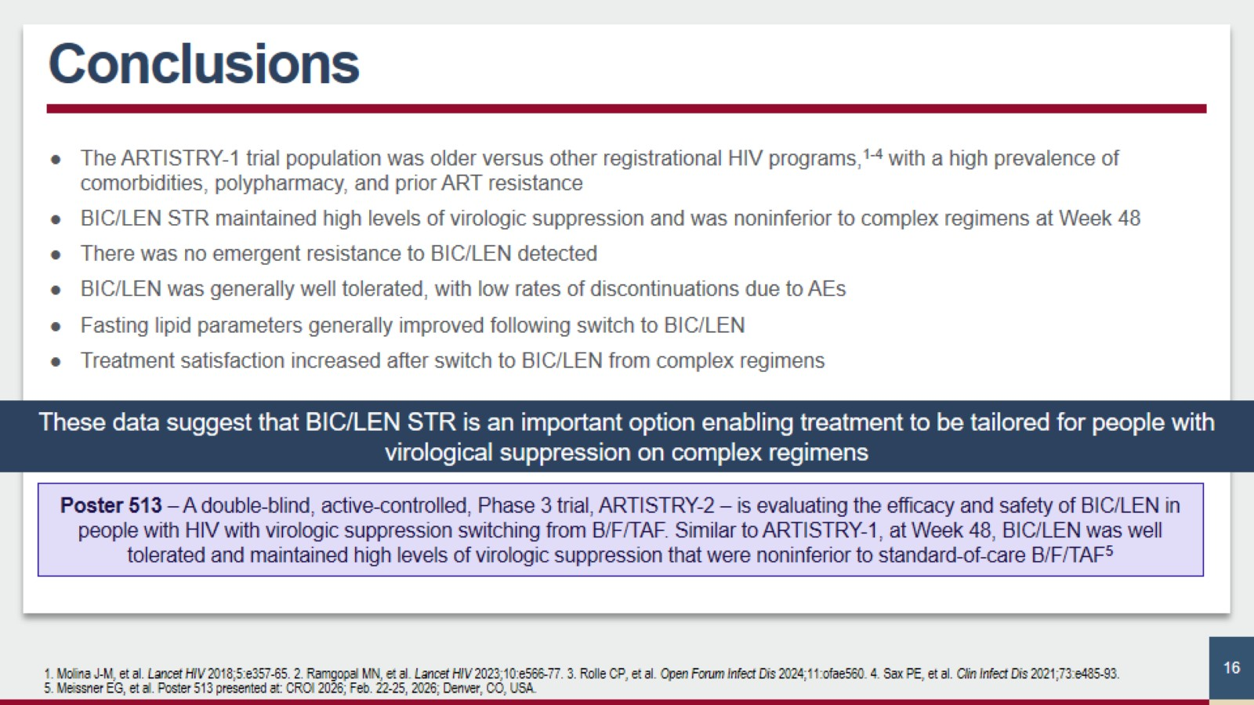
Conclusions

Slide 17
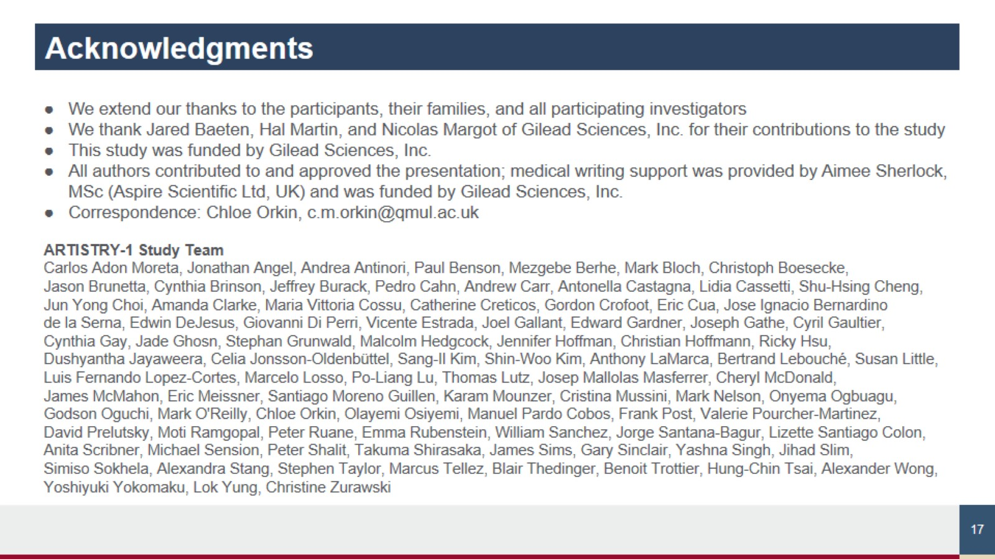
Acknowledgments

Slide 18
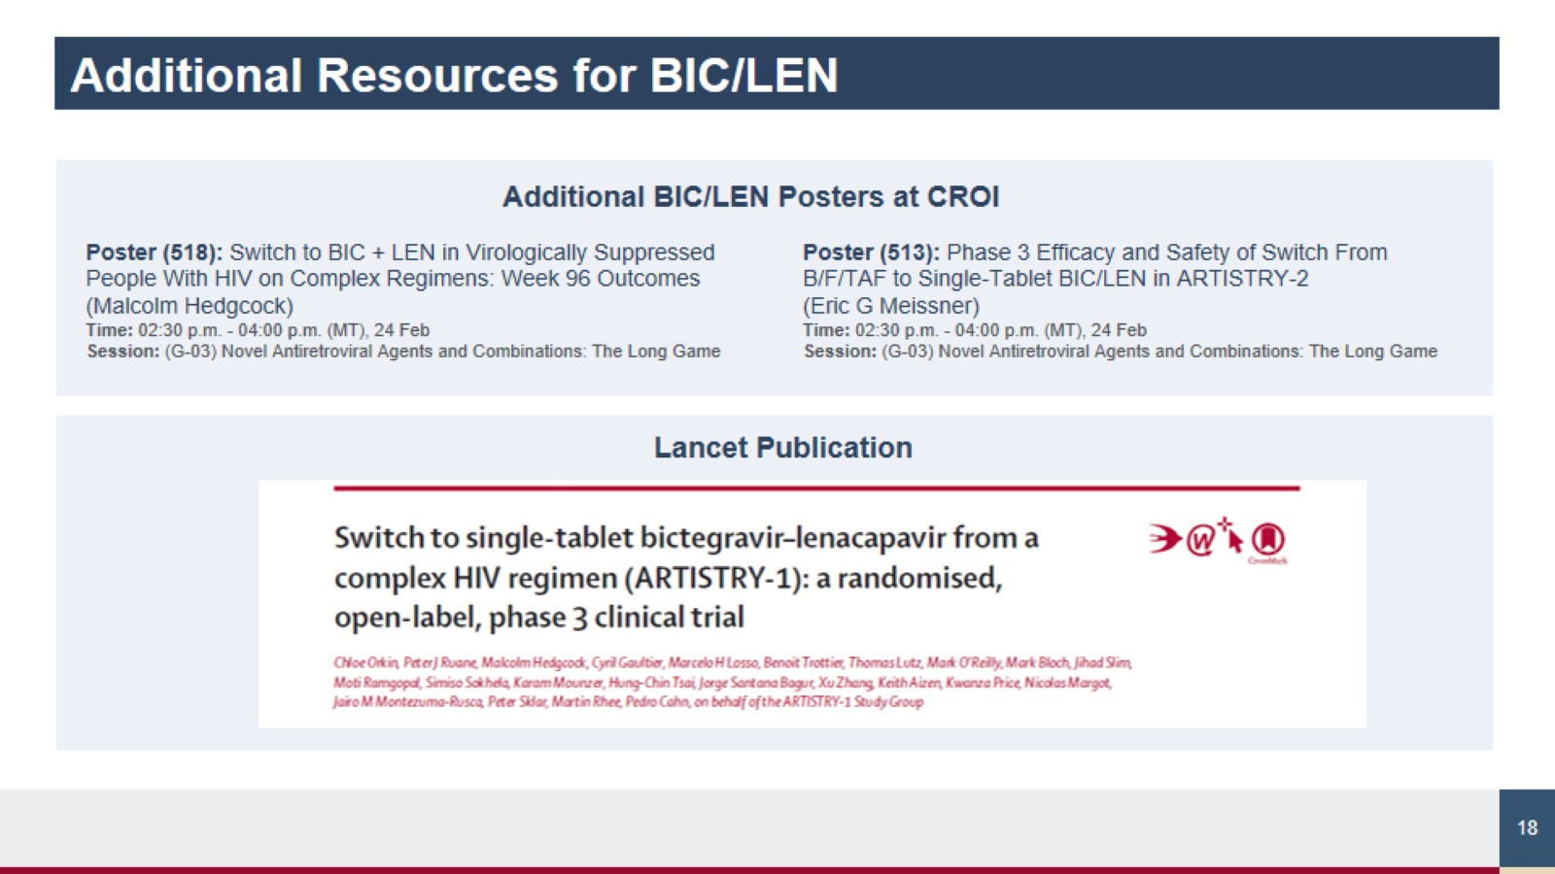
Additional Resources for BIC/LEN

