Slide 1
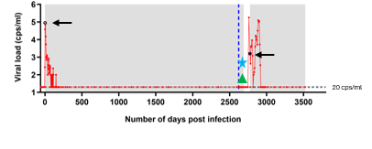
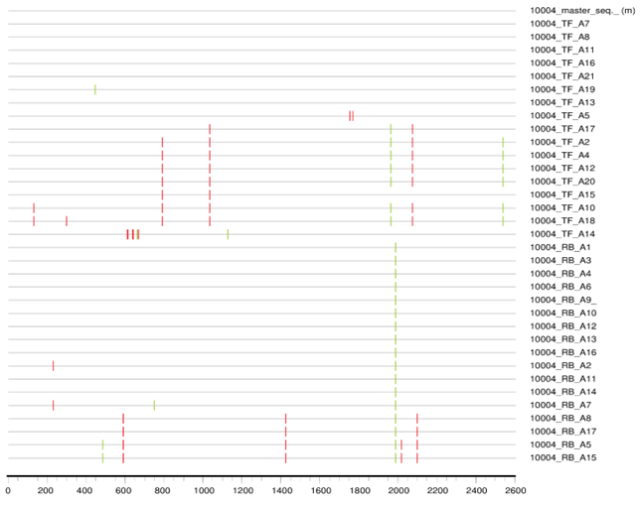
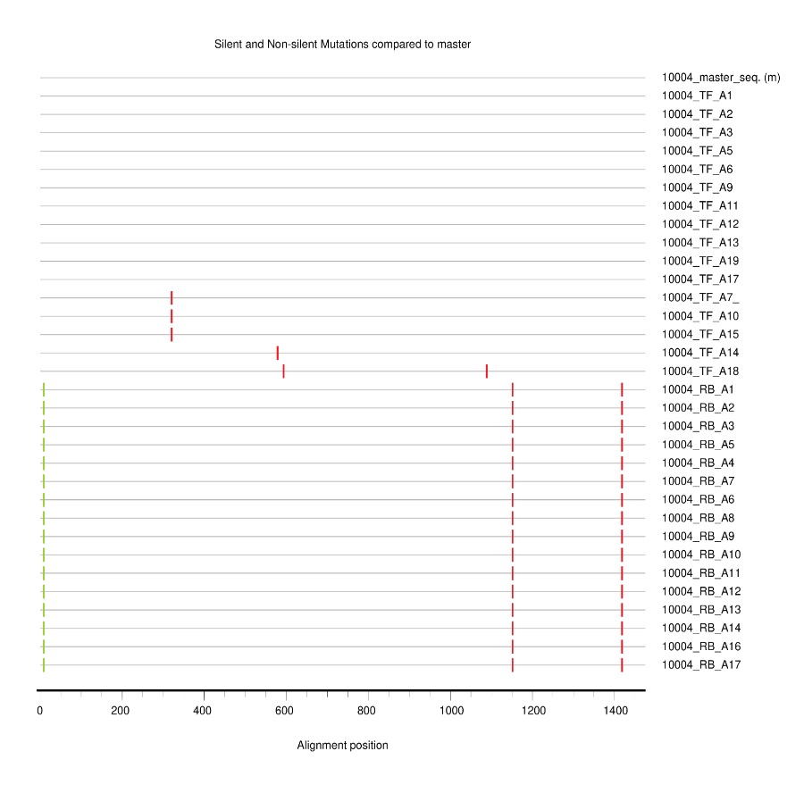
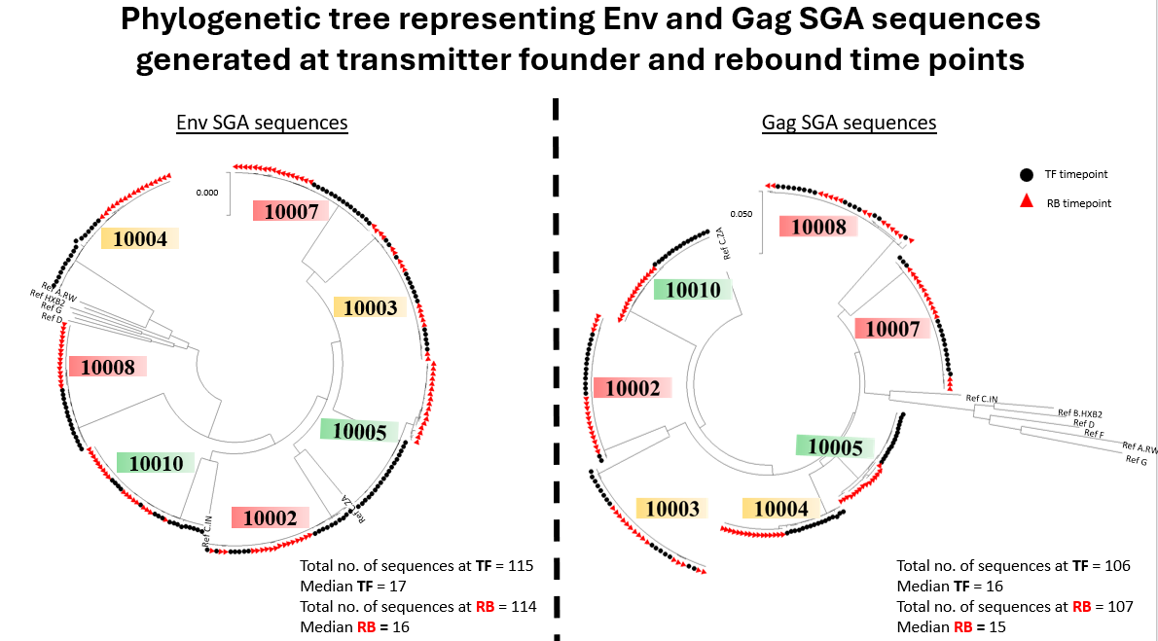
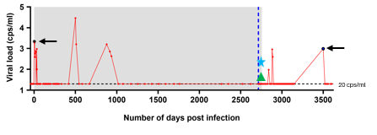
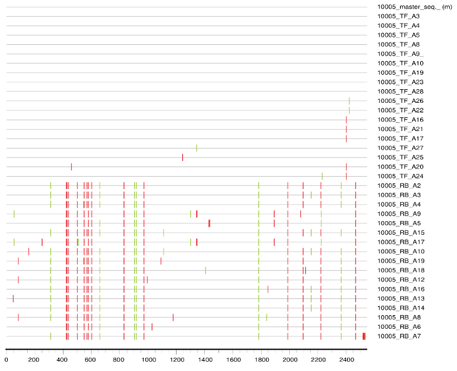
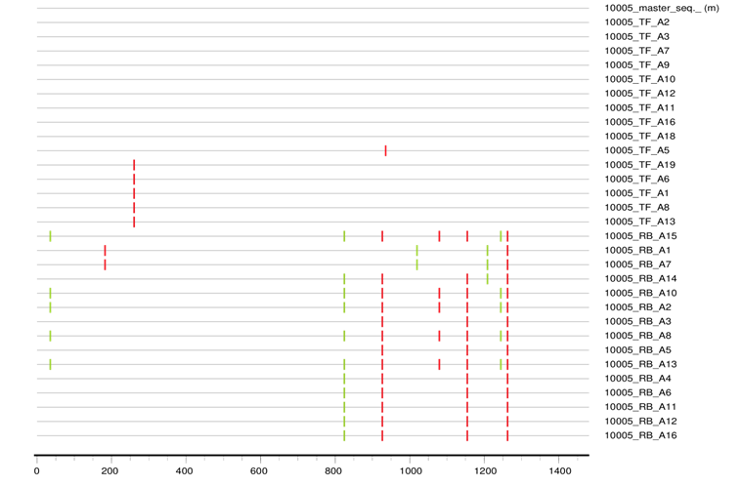
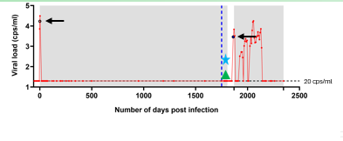
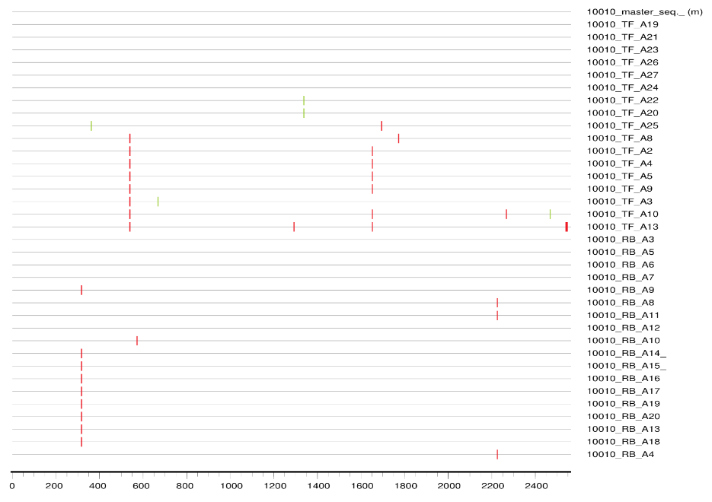
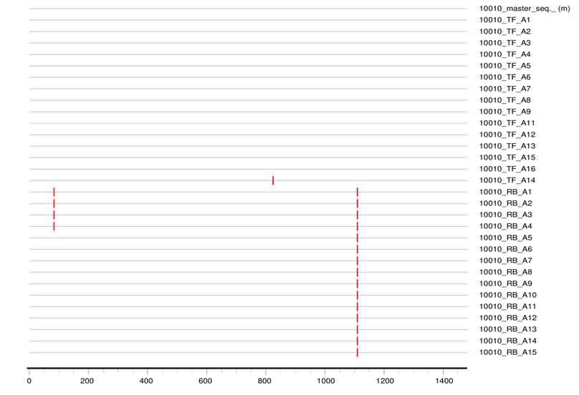
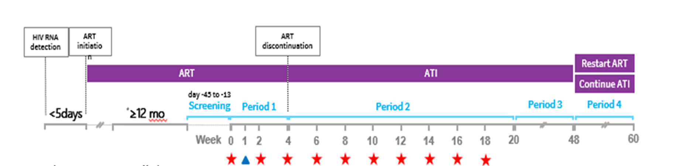
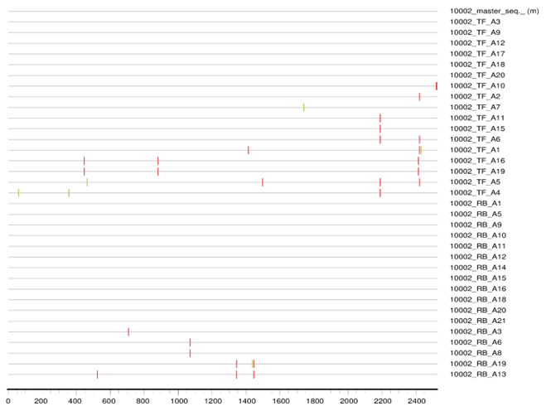
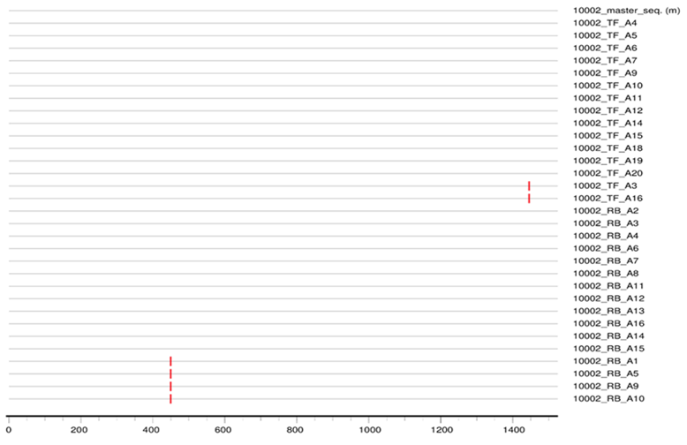
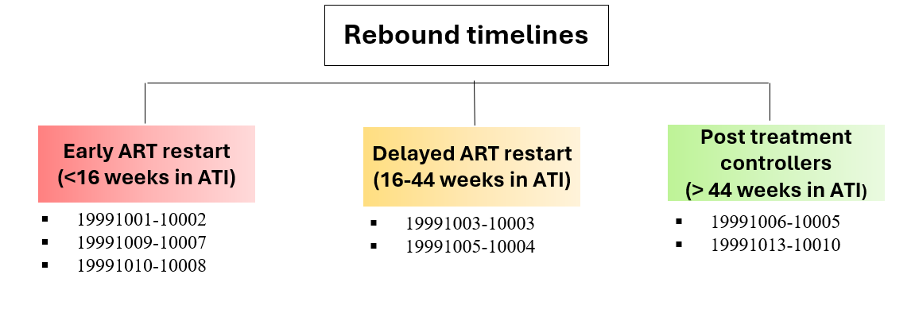
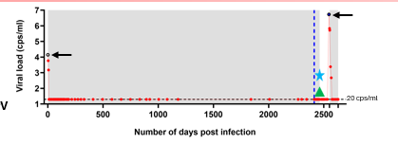
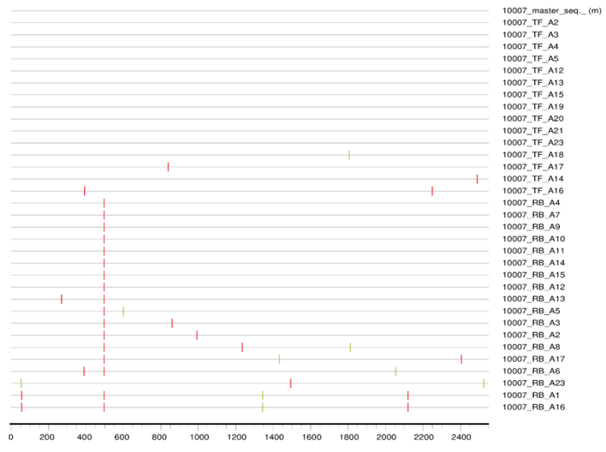
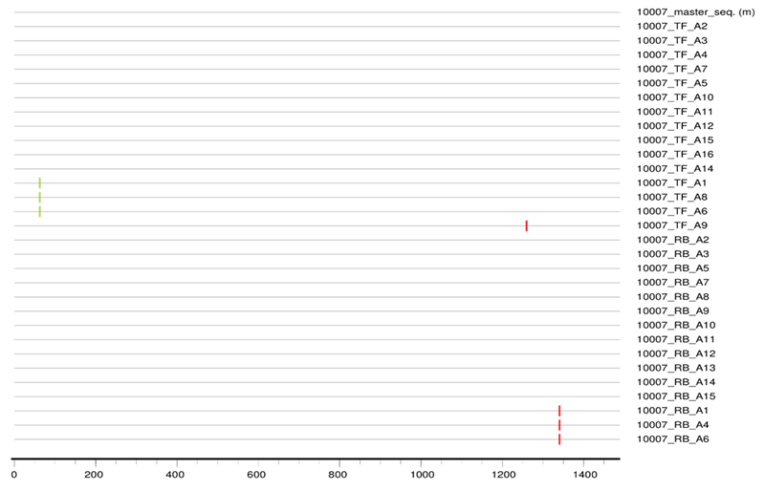
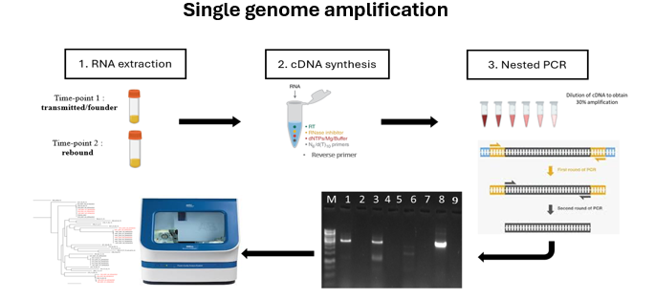
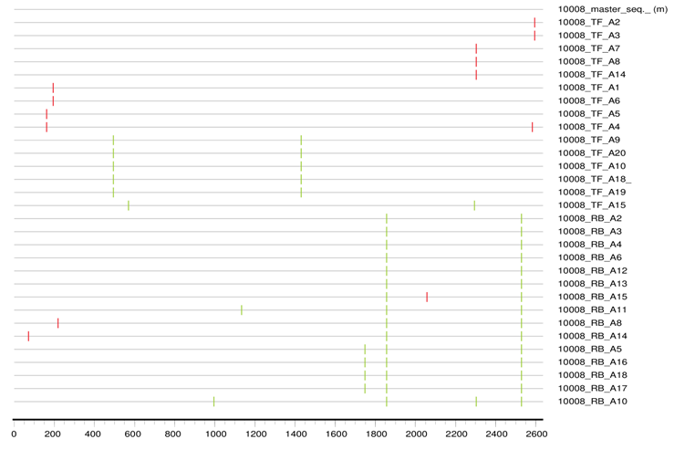
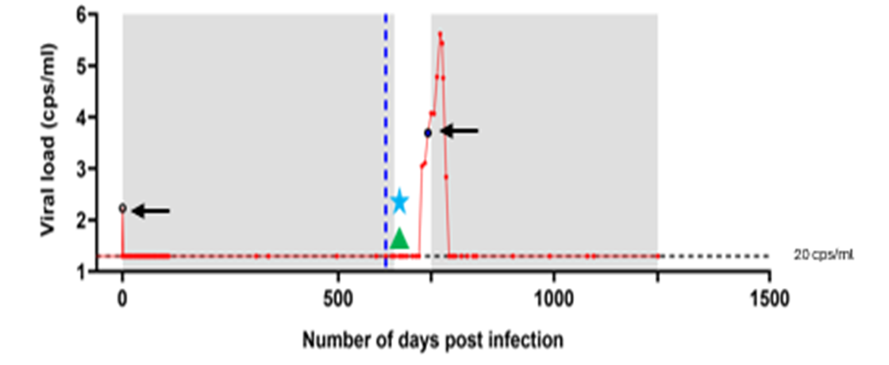
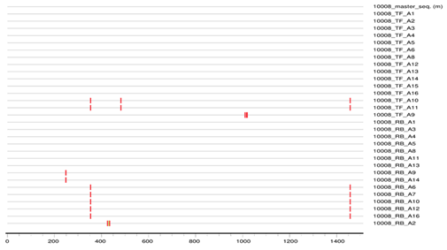
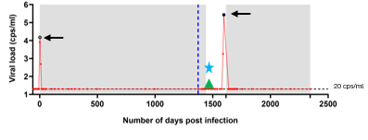
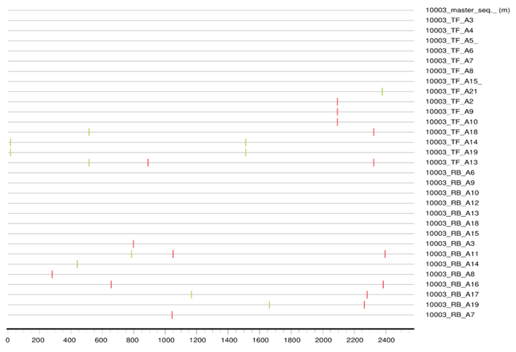
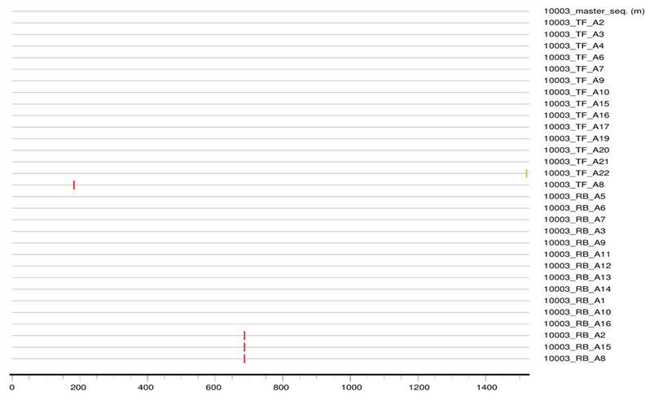





The viral rebound following ATI was not as a result of emergence of bNAb resistance or CTL escape
Title:
Genetic characterization of HIV-1 subtype C Gag and Env sequences derived from transmitted/founder and rebound viruses from participants in a treatment interruption clinical trial
D-12
N. Gumede¹, T. Ndung’u^{1,2,3,4}, K. L. Dong³, B. Ndlovu¹ , K. Gounder^{1,2,4}, J. Mann¹
1.HIV Pathogenesis Programme, 1st floor Doris Duke Medical Research Institute, Nelson R Mandela School of Medicine, University of KwaZulu-Natal, Durban 4001, South Africa, 2. Africa Health Research Institute, Nelson R. Mandela School of Medicine 3rd Floor, K-RITH Tower Building 719 Umbilo Road Durban., 3. Ragon Institute of Massachusetts General Hospital, Massachusetts Institute of Technology and Harvard University, Cambridge, Massachusetts, United States of America., 4. Division of Infection and Immunity, University College London, London, United Kingdom.
BACKGROUND
Combination approaches using antiretroviral therapy (ART) and immunological interventions such as broadly neutralizing antibodies (bNAbs) are showing promise in inducing antiretroviral-free HIV control, but the underlying mechanisms are not well understood. This study aimed to investigate the diversity and immune-driven evolution of Env and Gag sequences in rebound viruses from participants who initiated ART during acute infection and subsequently underwent an analytical treatment interruption (ATI) after receiving an immunotherapeutic intervention with two bNAbs.
METHODS
Virus sequences were analysed from 7 of 20 early treated South African women enrolled in an ATI-inclusive clinical trial that assessed two bNAbs (VRC07-523LS and CAP256V2LS) plus vesatolimod (NCT05281510). Full-length HIV-1 env and gag single genome amplicon (SGA) sequences were generated from plasma collected at TF and viral rebound during ATI. Rebound virus was obtained within 18 days of initial viremia, with the exception of participant 10005 from whom virus was obtained 336 days post-rebound.
19991005-10004
1-day DPOPV
RESULTS
~ 90 days post ATI
(~ 2760 days DPOPV)
Figure 1: Phylogenetic tree representing env and gag SGA sequences generated at transmitter found and rebound time points
19991006-10005
1-day DPOPV
413 days post ATI
(~ 2896 days DPOPV
19991013-10010
~2 days DPOPV
Clinical trial study design
~ 49 days post ATI
(~ 2567 days DPOPV)
Env nucleotide sequence alignment
Gag nucleotide sequence alignment
Genetic diversity was limited between TF and rebound viruses with few Env amino acid differences observed overall (median=1.5). Similarly, Gag sequences at TF and rebound were nearly identical. The virus from participant 10005 was obtained 336 days post-rebound and had diversified notably from the TF timepoint.
Table 1 and 2 : Bioinformatic analysis on the two bNAb epitopes
V1V2 region- CAP256-V2LS
CD4bs region- VRCO7-523LS
Timepoint | 156 NXT | 160 NXT | R166G/T | D167T | K169E/V | Q170K | K171E/R
Cons. | N | N | R | D | K | Q | K
TF RB | N N | . . | . . | . . | R R | K K | . .
TF RB | N N | . . | . . | . . | . . | K K | . V
TF RB | N N | . . | . . | . . | E E | R R | . .
TF RB | . . | . . | . . | . . | . . | . . | . .
TF RB | N N | . . | . . | . . | R R | R R | T T
TF RB | N N | . . | . . | . . | . E | . . | . .
TF RB | N N | . . | . . | . . | . . | . . | . .
Timepoint | 197 NXT | 234 NXT | 276 NXT | N279D | R456D | R4766A
Cons | N | N | N | D | R | K
TF RB | . . | . . | . . | N N | . . | . .
TF RB | N N | . . | . . | N N | . . | R R
TF RB | N N | . . | . . | . . | . . | R R
TF RB | . . | S S | . . | N N | . . | R R
TF RB | . . | . . | . . | N N | . . | . .
TF RB | . . | M M | . . | . N | . . | . .
TF RB | . . | . . | . . | N N | . . | . .
Env SGA sequences
Gag SGA sequences
10002
19991001-10002
1-day DPOPV
10007
10008
10003
~ 75 days post ATI
(~1365 days DPOPV)
10004
19991009-10007
10005
2 days DPOPV
10010
CONCLUSIONS
Six participants were infected with a subtype C variant, while participant 10004 is infected with a recombinant strain of subtype A and C.
In participant 10005, an amino acid change associated with resistance in the V1V2 antibody binding region was observed in the rebound virus present 1 year after rebound.
We have identified few amino acid changes in the rebound viruses that are not well characterized– these would require further experiments to confirm their influence on the virus's sensitivity to these two antibodies that were administered in the clinical trial.
In most participants there was no amino acid changes between the two timepoints. CTL scape mutations were conserved between the two timepoints, except for participant 10010.
77 days post ATI
(~ 2745 days DOPPV)
19991010-10008
2 days DPOPV
42 days post ATI
(~ 2486 days DPOPV)
PLAIN SUMMARY
The virus at the rebound is the same as the virus at pre-ART.
There were no mutations that were associated with the bNAbs that were administered during the clinical trial.
19991003-10003
~3 days DPOPV
140 days post ATI
(~2306 days DPOPV)
Contact information : gumedeN2@ukzn.ac.za/ 27+ 60 830 6965
Env nucleotide sequence alignment
Gag nucleotide sequence alignment
Notes:
Poster Development Guide
Formatting Notes
To Edit In PowerPoint: Click View > Guides to make editing easier. Keep text within guides
If you wish, you may change the background colors, but use a light color or white for the overall background of the poster and a bold color for the main findings section
Author list: Don’t split names onto two lines (e.g., “John [line break] Smith”). If that happens, use a new line. Bold the name of the presenting author
Font Size: Do not drop below font size 36 in the main information sections (Background, Methods, Results, Conclusions). If you have extra space, increase the font size, but maintain some white space to make it easier for attendees to read your text
Use of Color: To keep attendees focused on your main findings and important details in your graphs and figures, do not use color in the sidebars
Print Size: Using this template, the optimal print size is 54 inches (width) x 36 inches (height) or 60 inches x 40 inches (137.2 cm x 91.4 cm or 152.4 cm x 101.6). Printing the poster in a smaller size may save some cost, but the 54” x 36” size will maintain the suggested font size and layout in the final printed version of the poster (and maintain the effectiveness of the poster design).
Poster Board Dimensions: Regardless of whether you use this template, the size of the board for displaying your poster at CROI is 96 inches (width) x 48 inches (height). The maximum size of a poster is 93 inches (width) x 45 inches (height). The minimum size for a poster is 36 inches (width) x 24 inches (height) so attendees can see the poster at a minimum of 10 feet away
Poster Content Requirements
Poster Number: The poster number should be displayed in the upper right corner (0000 in the template). This is not the abstract number you had during submission but a number you will be assigned and sent to you by email which notes the position of the poster in the poster hall. This number will be sent to you after late-breaking abstracts have been accepted in January
Poster Title: The title should be the same as the title submitted with the abstract
QR Codes are not allowed by CROI

