Slide 1

Lenacapavir for PrEP:
HIV-1 Incidence and Safety from PURPOSE 2 at the End of Randomized Blinded Phase
Valeria D Cantos,¹ Kathryn Mngadi,² Khuanchai Supparatpinyo,³ Nkosiphile Ndlovu,⁴ Juan Carlos Hinojosa,⁵ Marcelo Losso,⁶ Namrata Shah,⁷ Susanne Doblecki-Lewis,⁸ J Carlo Hojilla,⁹ Lillian B Brown,⁹
Priyanka Arora,⁹ Pamela Wong,⁹ Christoph C Carter,⁹ Beatriz Grinsztejn,¹⁰ Susan Buchbinder¹¹
1. Department of Medicine, Emory University School of Medicine, Atlanta, GA, USA ; 2. The Aurum Institute, Clinical Research, Tembisa, South Africa;
3. Chiang Mai University, Chiang Mai, Thailand; 4. Wits RHI, Faculty of Health Sciences, University of the Witwatersrand, Johannesburg, South Africa; 5. Asociación Civil Selva Amazónica, Iquitos, Peru; 6. Hospital General de Agudos José María Ramos Mejía, Buenos Aires, Argentina;
7. Whitman-Walker, Washington, DC, USA; 8. Division of Infectious Diseases, University of Miami Miller School of Medicine, Miami, FL, USA;
9. Gilead Sciences, Inc., Foster City, CA, USA; 10. Oswaldo Cruz Foundation, Instituto de Pesquisa Clinica Evandro Chagas-Fiocruz, Rio de Janeiro, Brazil;
11. Department of Public Health San Francisco, San Franciso, CA, USA
HIVR4P guidelines:
10 minutes
Upload deadline: 4 October (can be uploaded at the conference venue after this)
Summary slide required
33rd Conference on Retroviruses and Opportunistic Infections (CROI); February 22–25, 2026; Denver, CO, USA

Slide 2
Disclosures
Dr Cantos has received institutional funding from Gilead Sciences, Inc. (Foster City, CA, USA)
All authors contributed to and approved the presentation
Gilead Sciences funded and designed the study with input from the PIs and G-CAG. The PIs and study staff gathered data; Gilead Sciences monitored the conduct of the trial, received the data, and performed analyses
G-CAG, Global Community Advisory Group; PI, principal investigator.

Slide 3



Men and Gender-Diverse Individuals Who Have Sex with Men Have a Critical Need for Effective HIV Prevention
Men who have sex with men remain disproportionately affected by HIV, with 20% of new HIV diagnoses occurring in this population aged 15–49 worldwide¹
Daily oral PrEP uptake and adherence remain low among populations most affected by HIV, highlighting the need for new, longer-acting options that avoid daily pills or frequent injections^{2,3}
PURPOSE 2 demonstrated high efficacy and safety of twice-yearly SC LEN for PrEP in cisgender men and gender-diverse individuals who have sex with men and who are disproportionately affected by HIV⁴
We present longer-term follow-up data on HIV incidence and safety of twice-yearly SC LEN for
PrEP through the end of the randomized blinded phase of PURPOSE 2
LEN, lenacapavir; PrEP, pre-exposure prophylaxis; SC, subcutaneous.
1. UNAIDS. https://www.unaids.org/sites/default/files/media_asset/2024-unaids-global-aids-update_en.pdf (accessed Feb. 6, 2026). 2. Sullivan PS, et al. J Int AIDS Soc. 2020;23:e25461. 3. Grov C, et al. Prev Sci. 2019;20:168–77. 4. Kelley CF, et al. N Engl J Med. 2025;392:1261-76.

Slide 4


PURPOSE 2 is an Ongoing Phase 3, Double-Blind, Active-Controlled Randomized Trial¹
Randomized Blinded Phase
Present analysis End of RBPª
Pre-specified
Primary Analysis¹
(conducted when 50%
of participants had
reached RBP Week 52)
Day 1
Day 2
Week 26
Week 52
LEN SC every 26 weeks (n = 2179^{c})
Cisgender men and gender-diverse people aged ≥ 16 years^{b}
2
+ F/TDF oral placebo daily
LEN SC every 26 weeks LEN OLE phase
1
F/TDF oral daily (n = 1086^{c})
+ LEN SC placebo every 26 weeks
ClinicalTrials.gov: NCT04925752
We report HIV incidence and safety data^{b} from study start through the end of the
randomized blinded phase encompassing an additional 1243 PY of follow-up
ªParticipants who declined LEN OLE were offered up to 78 weeks of open-label F/TDF if they were on blinded LEN in RBP. ^{b}Cisgender men and gender-diverse people aged ≥ 16 years who have sex with men and are at risk of HIV acquisition. ^{c}Included in the full analysis set for primary efficacy analyses (additional participants are included in the safety analysis).
F/TDF, emtricitabine/tenofovir disoproxil fumarate; LEN, lenacapavir; OLE, open-label extension; PY, person-years; RBP, randomized blinded phase; SC, subcutaneous.
1. Kelley CF, et al. N Engl J Med. 2025;392:1261-76.

Slide 5
LEN Remained Highly Efficacious Through the End of the Randomized Blinded Phase
Primary Analysis¹
End of Randomized
Blinded Phaseª
0.93
(0.43-1.77)
0.92
(0.48-1.61)
0.10
(0.01-0.37)
0.11
(0.02-0.31)
No. participants:
2179
1086
2179
1086
HIV acquisition:
2
9
3
12
PY of follow-up:
1938
967
2843
1305
There were 12 incident infections among participants randomized to F/TDF and
3 incident infections among participants randomized to LEN
ªIncludes all data observed during the RBP and follow-up time after the first dose of open-label oral PrEP administered after premature discontinuation of randomized study drug (if applicable) or after stopping any PrEP during the study (if applicable) and on or prior to the first dose of open-label LEN. CI, confidence interval; F/TDF, emtricitabine/tenofovir disoproxil fumarate; LEN, lenacapavir; PrEP, pre-exposure prophylaxis;
PY, person-years; RBP, randomized blinded phase; SC, subcutaneous. 1. Kelley CF, et al. N Engl J Med. 2025;392:1261-76.
Notes:
Since the primary analysis, additional HIV acquisitions occurred in:
one participant in the LEN group during 905 additional PY of follow up
three participants in the F/TDF group during 338 additional PY of follow up

Slide 6
HIV Acquisition in LEN-Randomized Participants During PURPOSE 1 and PURPOSE 2
Study | Presented | Participant
PURPOSE 2 | Previously presented^{1,2} | A
PURPOSE 2 | Previously presented^{1,2} | B
PURPOSE 1 | Prior presentation | C (new)
PURPOSE 1 | Prior presentation | D (new)
PURPOSE 2 | This presentation | E (new)
Randomized Blinded Phase
Open-label F/TDF
Week 13
LEN SC injection
Negative HIV test
Week 26
HIV diagnosis
Week 52
Switched to open-label F/TDF
Missed study visitsª
Week 95
Week 52
Study Week
ªMissed LEN injections.
F/TDF, emtricitabine/tenofovir disoproxil fumarate; LEN, lenacapavir; SC, subcutaneous.
1. Ogbuagu O, et al. Oral O49 presented at: HIV Glasgow; November 10-13, 2024; Glasgow, UK. 2. Kelley CF, et al. N Engl J Med. 2025;392:1261-76.

Slide 7
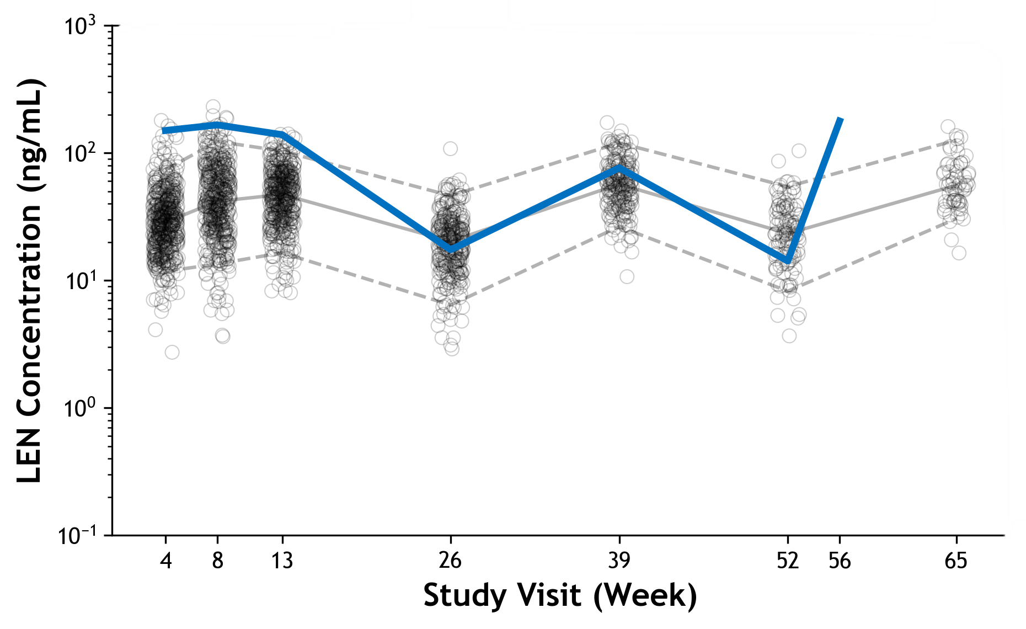
LEN Plasma Concentrations in Participant E with Seroconversion
Young gender-diverse person with history of rectal chlamydia at screening and Week 26 (Day 176), and rectal gonorrhea at Week 26 (Day 176)
Diagnosed with HIV at Week 52 (Day 352)
LEN Concentration
Participant E
Median LEN concentration^{b}
5th and 95th percentiles^{b}
HIV Diagnostics | LEN (Randomized Blinded Phase)
Study visit week | BL | W4 | W8 | W13 | W26 | W39 | W52/ OLE D1
Rapid Ag/Ab | (-) | (-) | (-) | (-) | (-) | (-) | (-)
Central Ag/Ab | (-) | (-) | (-) | (-) | (-) | (-) | (+)
HIV-1/2 Ab diff |  |  |  |  |  |  | Ab (-)
Quantitative RNA, c/mL | ND |  |  |  |  | NDª | 2,020,000
IQ4 (15.5 ng/mL)
HIV diagnosis
LEN concentration at diagnosis: 14.2 ng/mL
LEN SC
BL
HIV diagnosis
Participant E was diagnosed with standard HIV testing at Week 52. This participant received all injections
on time and LEN concentrations were generally within the range of the prespecified subset of participants analyzed for PK^{b}
ªRetrospective. ^{b}In the prespecified subset of participants analyzed for LEN PK at W4 (n = 374), W8 (n = 340), W13 (n = 362), W26 (n = 267), W39 (n = 154), W52 (n = 111), W65 (n = 50). IQ was defined as the protein‑adjusted 95% effective concentration in MT-4 cells, and IQ4 as 4× the protein-adjusted 95% effective concentration, in vitro.¹ The circles in the figure depict LEN concentrations in individual participants included in the prespecified subset.
Ab, antibody; Ag, antigen; BL, baseline; c, copies; D, day; diff, differentiation; IQ, inhibitory quotient; LEN, lenacapavir; ND, not detected; OLE, open-label extension; PK, pharmacokinetics; SC, subcutaneous; W, week.
1. Margot N, et al. Poster O-324 presented at: HIV Glasgow; October 5-8, 2020; Glasgow, UK.

Slide 8
LEN Tolerability Profile Was Similar With Extended follow-up Through the End of the Randomized Blinded Phase
AE, n (%) | Primary Analysis¹ LEN (n = 2183) | End of Randomized Blinded Phase LEN (n = 2183)
Any AE^{a,b} | 1607 (74) | 1721 (79)
Grade ≥ 3 | 91 (4) | 119 (5)
Serious AEs | 71 (3) | 96 (4)
AEs leading to discontinuation of study regimen | 7 (<1) | 7 (<1)
Injection-site reactions^{b} | 1816 (83) | 1851 (85)
Grade 2 | 361 (17) | 390 (18)
Grade 3 | 14 (1) | 14 (1)
Leading to discontinuation of study regimen | 26 (1) | 26 (1)
AEs occurring in ≥ 10% of participants (excluding injection-site reactions)^{c}
Anal chlamydia infection | 289 (13) | 351 (16)
Oropharyngeal gonococcal infection | 283 (13) | 344 (16)
Anal gonococcal infection | 233 (11) | 288 (13)
No new safety concerns with LEN arose through the end of the randomized blinded phase
with additional follow up
ªAEs were treatment-emergent in participants who received at least one dose of study drug and exclude injection-site reactions to study drug. ^{b}At primary analysis AEs were coded according to Medical Dictionary for Regulatory Activities 27.0 and at end of randomized blinded phase they were coded according to Medical Dictionary for Regulatory Activities 28.0. ^{c}AEs are ordered by frequency at end of randomized blinded phase.
AE, adverse event; LEN, lenacapavir. 1. Kelley CF, et al. N Engl J Med. 2025;392:1261-76.

Slide 9
ISR Incidence Was Consistent with the Primary Analysis¹ and Most Were Low-Grade
ISRs occurring in ≥ 100 participants
Pain
Nodule
Erythema
Induration
Swelling
100
80
60
40
20
0
End of
RBP
End of
RBP
End of
RBP
End of
RBP
End of
RBP
After the primary analysis, there were no new discontinuations due to ISRs
through the end of the RBP
ISR, injection-site reaction; RBP, randomized blinded phase. 1. Kelley CF, et al. N Engl J Med. 2025;392:1261-76.

Slide 10


PURPOSE 2 Conclusions
In this analysis through the end of the randomized blinded phase, twice-yearly SC LEN remained highly efficacious for HIV prevention among cisgender men and gender-diverse individuals who have sex with men
Through the end of the randomized blinded phase, one additional participant on LEN acquired HIV-1 compared with two reported at primary analysis, maintaining a low incidence of 0.11 per 100 PY on twice-yearly SC LEN
LEN continued to be well-tolerated
Incidence of ISRs in the LEN group was similar to the primary analysis, with no new discontinuations due to ISRs
Twice-yearly SC LEN for PrEP remained highly efficacious and well tolerated among cisgender men and
gender-diverse individuals who have sex with men, through the end of the randomized blinded phase of PURPOSE 2
ISR, injection-site reaction; LEN, lenacapavir; PrEP, pre-exposure prophylaxis; PY, person-years; SC, subcutaneous.

Slide 11
PURPOSE 2 Acknowledgments
We would like to extend our thanks to all participants, their families and communities,
the investigators and site staff, the global community advisors, and the members of the PURPOSE 2 study team for their insights and support
This study was funded by Gilead Sciences, Inc.
Medical writing support was provided by Thierry Deltheil, PhD of Aspire Scientific Ltd (Manchester, UK), and was funded by Gilead Sciences, Inc.
Correspondence: Lillian Brown, lillian.brown6@gilead.com

