Slide 1

Twice-Yearly Subcutaneous Lenacapavir for PrEP: Updated HIV-1 Incidence and Safety Data in PURPOSE 1 at the
End of the Randomized Blinded Phase
Nkosiphile Ndlovu,¹ Moelo Malahleha,² Yashna Singh,³ Flavia Matovu Kiweewa,⁴ Sarah B Puryear,⁵
Alexander Kintu,⁵ Christoph C Carter,⁵ Priyanka Arora,⁵ Yang Zhao,⁵ Cheryl Louw⁶
1. Wits RHI, Faculty of Health Sciences, University of the Witwatersrand, Johannesburg, South Africa; 2. Synergy Biomed Research Institute, East London, South Africa; 3. The Desmond Tutu HIV Centre, University of Cape Town, Cape Town, South Africa; 4. Makerere University-Johns Hopkins University Research Collaboration, Kampala, Uganda; 5. Gilead Sciences, Inc., Foster City, CA, USA; 6. Madibeng Centre for Research, Brits, South Africa
HIVR4P guidelines:
10 minutes
Upload deadline: 4 October (can be uploaded at the conference venue after this)
Summary slide required
33rd Conference on Retroviruses and Opportunistic Infections (CROI); February 22–25, 2026; Denver, CO, USA

Slide 2
Disclosures
Dr Ndlovu has received support from Gilead Sciences, Inc. (Foster City, CA, US)
All authors contributed to and approved the presentation
Gilead Sciences funded and designed the studies with input from the PIs and G-CAG. The PIs and study staff gathered data; Gilead Sciences monitored the conduct of the trial, received the data, and performed analyses
G-CAG, Global Community Advisory Group; PI, principal investigator.

Slide 3



Adolescent Girls and Young Women in Sub-Saharan Africa Have a Critical Need for Effective HIV Prevention
Globally, 45% of all new HIV infections in 2024 were among girls and women¹
In sub-Saharan Africa, girls and women
accounted for 63% of new HIV infections¹
Twice-yearly SC LEN for PrEP showed
robust efficacy and a favorable safety profile in cisgender adolescents and young women in South Africa and Uganda in PURPOSE 1²
We present longer-term follow-up data on HIV incidence and safety of twice-yearly SC LEN for PrEP through the end of the randomized blinded phase of PURPOSE 1
LEN, lenacapavir; PrEP, pre-exposure prophylaxis; SC, subcutaneous.
1. UNAIDS. Fact sheet - Latest global and regional statistics on the status of the AIDS epidemic (accessed Feb. 4, 2026). 2. Bekker LG, et al. N Engl J Med. 2024;391:1179-92.

Slide 4


PURPOSE 1 is an Ongoing Phase 3, Double-Blind, Active-Controlled Randomized Trial¹
Randomized Blinded Phase
Present analysis End of RBPª
Pre-specified Primary Analysis¹ (conducted when 50% of participants had reached RBP Week 52)
Day 1
Day 2
Week 26
Week 52
LEN SC every 26 weeks (n = 2134^{b})
2
+ F/TDF oral placebo daily
Cisgender adolescent girls and young women
aged 16-25 years
2
F/TAF oral daily (n = 2136^{b})
LEN SC every 26 weeks LEN OLE phase
+ LEN SC placebo every 26 weeks
F/TDF oral daily (n = 1068^{b})
1
n = 1068^{c}
+ LEN SC placebo every 26 weeks
ClinicalTrials.gov: NCT04994509
We report HIV incidence and safety data through the end of the
randomized blinded phase, encompassing an additional 2054 PY of follow-up
ªParticipants who declined LEN OLE were offered up to 78 weeks of open-label F/TDF if they were on blinded LEN in RBP. ^{b}Full analysis set for efficacy analyses.
F/TAF, emtricitabine/tenofovir alafenamide; F/TDF, emtricitabine/tenofovir disoproxil fumarate; LEN, lenacapavir; OLE, open-label extension; PY, person years; RBP, randomized blinded phase; SC, subcutaneous.
1. Bekker LG, et al. N Engl J Med. 2024;391:1179-92.

Slide 5
LEN Efficacy Remained High Through the End of the Randomized Blinded Phase
Primary Analysis¹
End of Randomized Blinded Phaseª
2.02
(1.44-2.76)
1.69
(0.96-2.74)
1.98
(1.48-2.59)
1.94
(1.25-2.86)
0.00
(0.00-0.19)
0.07
(0.01-0.25)
No. participants:
2134
2136
1068
2134
2136
1068
HIV acquisition:
0
39
16
2
52
25
PY of follow-up:
1939
1932
949
2953
2630
1291
There were 77 incident HIV infections in the oral PrEP arms and
2 incident HIV infections in the LEN arm
ªIncludes all data observed during the RBP and follow-up time after the first dose of open-label oral PrEP administered after premature discontinuation of randomized study drug (if applicable) or after stopping any PrEP during the study (if applicable) and on or prior to the first dose of open-label LEN. CI, confidence interval; F/TAF, emtricitabine/tenofovir alafenamide; F/TDF, emtricitabine/tenofovir disoproxil fumarate;
LEN, lenacapavir; PY, person-years. 1. Bekker LG, et al. N Engl J Med. 2024;391:1179-92.

Slide 6
HIV Acquisition in LEN-Randomized Participants During PURPOSE 1 and PURPOSE 2
Study | Presented | Participant
PURPOSE 2 | Previously presented^{1,2} | A
PURPOSE 2 | Previously presented^{1,2} | B
PURPOSE 1 | This presentation | C (new)
PURPOSE 1 | This presentation | D (new)
PURPOSE 2 | Next presentation | E (new)
Randomized Blinded Phase
Open-label F/TDF
Week 13
LEN SC injection
Negative HIV test
Week 26
HIV diagnosis
Week 52
Switched to open-label F/TDF
Missed study visitsª
Week 95
Week 52
Study Week
ªMissed LEN injections.
F/TDF, emtricitabine/tenofovir disoproxil fumarate; LEN, lenacapavir; SC, subcutaneous.
1. Ogbuagu O, et al. Oral O49 presented at: HIV Glasgow; November 10–13, 2024; Glasgow, UK. 2. Kelley CF, et al. N Engl J Med. 2025;392:1261-76.

Slide 7
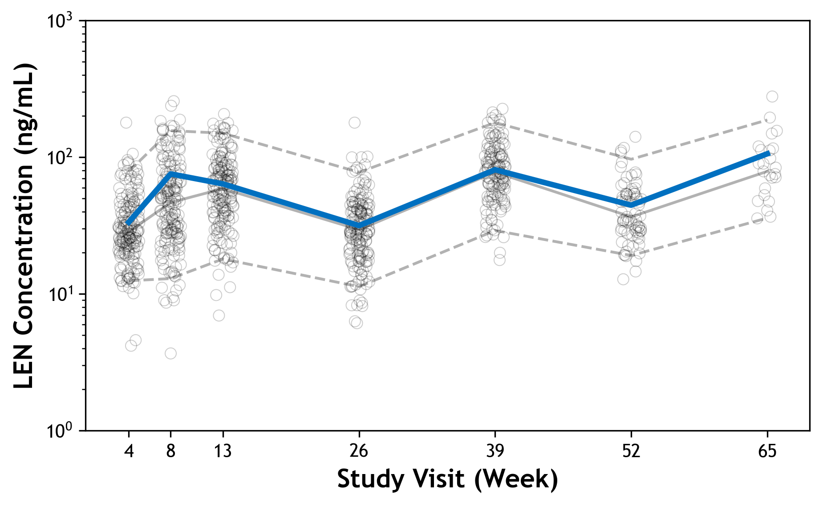
LEN Plasma Concentrations in Participant C
Young woman tested positive for chlamydia at Week 52
HIV diagnosed clinically on-study at Week 65 by typical serologic testing; retrospective RNA test found to be positive at Week 52/OLE Day 1
LEN Concentration
Participant C
Median LEN concentration^{b}
5th and 95th percentiles^{b}
HIV Diagnostics | LEN (Randomized Blinded Phase) |  |  |  |  |  |  | LEN (OLE)
Study visit week | BL | 4 | 8 | 13 | 26 | 39 | 52/ OLE D1 | 65/ OLE W13
Study day | 0 | 30 | 57 | 92 | 183 | 274 | 365 | 456
Rapid Ag/Ab | (-) | (-) | (-) | (-) | (-) | (-) | (-) | (-)
Central Ag/Ab | (-) | (-) |  |  |  | (-) | (-) | (+)
HIV-1/2 Ab diff |  |  |  |  |  |  |  | Ind.
Qualitative RNA |  |  |  |  |  |  |  | (+)
Quantitative RNA, c/mL | (-) |  |  |  |  | (-) | 47ª | 78
LEN Concentration (ng/mL)
IQ4 (15.5 ng/mL)
HIV diagnosis
LEN concentration at diagnosis:
44.6 ng/mL
LEN SC
BL
Participant C received all LEN injections on time and was diagnosed with standard HIV serologic testing;
LEN concentrations were within the range of the prespecified subset of participants analyzed for PK^{b}
ªRetrospective. ^{b}In the prespecified subset of participants analyzed for LEN PK at W4 (n = 165), W8 (n = 158), W13 (n = 163), W26 (n = 156), W39 (n = 129), W52 (n = 73), W65 (n = 23), indicated as circles in the graph. IQ was defined as the protein‑adjusted 95% effective concentration in MT-4 cells, and IQ4 as 4× the protein-adjusted 95% effective concentration, in vitro.¹
Ab, antibody; Ag, antigen; BL, baseline; c, copies; diff, differentiation; Ind, indeterminate; IQ, inhibitory quotient; LEN, lenacapavir; OLE, open-label extension; PK, pharmacokinetics; SC, subcutaneous; W, week.
1. Margot N, et al. Poster O-324 presented at: HIV Glasgow; 5–8 October 2020; Glasgow, UK.
Notes:
Relevant events & factors: The participant was randomized to LEN and received on-time, blinded LEN injections on Day 1 and Day 183 (Week 26). ISRS included nodules. On Day 365, she presented on-time and elected to participate in the LEN open-label extension (OLE). All HIV testing was negative prior to day 365. On Day 365 (OLE Day 1), her rapid HIV Ab/Ag test was negative and open-label LEN was administered; central laboratory Ab/Ag subsequently returned negative. On Study Day 456 (Week 13 visit of LEN OLE) the rapid Ab/Ag was negative, central laboratory Ab/Ag was positive, antibody differentiation was indeterminate, qualitative HIV-1 RNA was positive, and viral load was 78 copies/mL. Retrospective RNA testing from Day 365 was 47 copies/mL. Retrospective HIV viral load testing from Day 274 was negative.
At the time of diagnosis, participant reported approximately 20 condomless sexual encounters with 3 partners since prior visit. She reported symptoms of acute retroviral syndrome in September 2024 (2 months post infection) per questionnaire. Clinical history notable for acute tonsillitis and axillary abscess in July 2024, around time of D365 visit, which may been a manifestation of acute retroviral syndrome.
Summary of laboratory findings & adjudication: All HIV testing negative through D274. On day 456, rapid AB/Ag negative; central Ab/Ag positive, Ab differentiation indeterminate; VL 47c/mL, qualitative RNA reactive. Retrospective VL testing from the prior visit (D365) was positive. Adjudicated as an incident case, D365 DOD, by the committee at the November 12, 2024 meeting
STI History: Chlamydia at on D365 (Week 52/OLE D1). G/C & T. vaginalis negative at screening, D1, W26. No history of syphilis.
Conmeds: No disallowed concomitant medications.
Weight/BMI: At screening, weight 55.3kg, BMI 23.3. On D365, 55.9kg, BMI 23.6.
PK Data: 44.6 ng/mL on D365; 106ng/ml on D456
Substance use: BL reported 2-4 drinks/month; 6 or more drinks on one occasion monthly; alcohol use before or during sex; PNTA cannabis use, denied all other substance use
HIV treatment course: Remains off ART as of D553. Due to negative rapid tests, challenges accessing ART through local health system. Planned to initiate based on recent VL of 22,500.

Slide 8
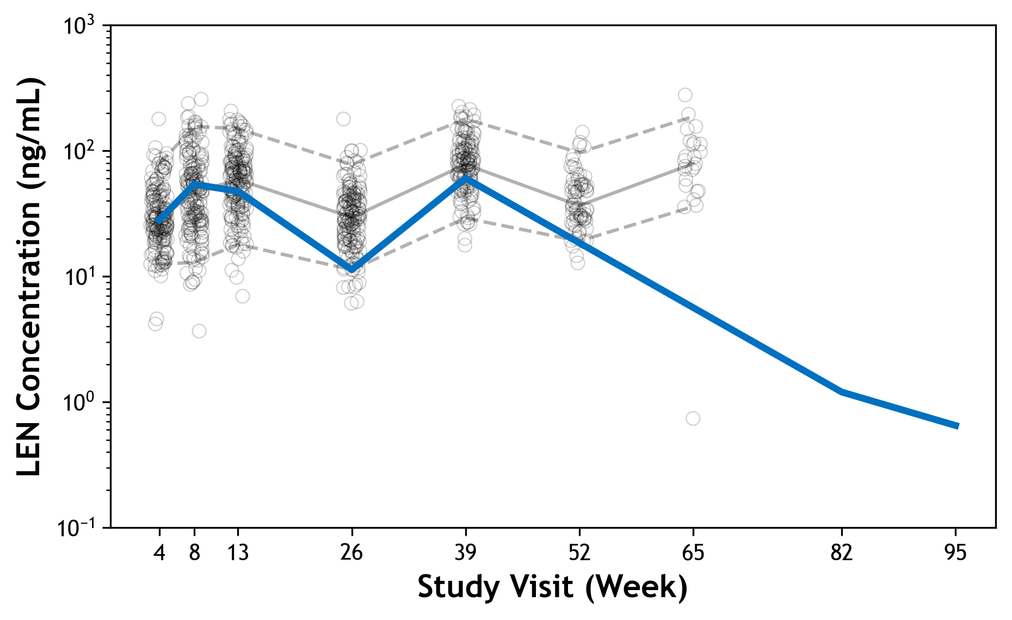
LEN Plasma Concentrations in Participant D
Young woman had last LEN injection at Week 26, then missed Week 52 injection
Transitioned to open-label F/TDF at Week 82; HIV-negative at that time
HIV diagnosed at Week 95, 487 days after last LEN injection
LEN Concentration
Participant D
Median LEN concentration^{b}
5th and 95th percentiles^{b}
HIV Diagnostics | LEN (Randomized Blinded Phase) |  |  |  |  |  |  | Open-label F/TDF
Study visit week | BL | 4 | 8 | 13 | 26 | 39 | 52 | 82 | 95
Study day | 0 | 30 | 57 | 92 | 183 | 271 |  | 579ª | 670
Rapid Ag/Ab | (-) | (-) | (-) | (-) | (-) | (-) | Missed | (-) | (+)
Central Ag/Ab | (-) | (-) | (-) |  |  |  | Missed | (-) | (+)
HIV-1/2 Ab diff |  |  |  |  |  |  |  |  | (HIV-1+)
Qualitative RNA
Quantitative RNA, c/mL | (-) |  |  |  |  |  |  | (-) | 134,000
LEN Concentration (ng/mL)
IQ4 (15.5 ng/mL)
HIV
diagnosis
LEN concentration at diagnosis: 0.65 ng/mL
LEN SC
BL
Started F/TDF
Participant D was diagnosed with HIV-1 after LEN discontinuation, while receiving open-label F/TDF,
approximately 16 months after the last LEN injection
ªParticipant presented at W82 after missing all their protocol-specified visits following W39 and transitioned to open-label oral F/TDF. ^{b}In the prespecified subset of participants analyzed for LEN PK at W4 (n = 165),
W8 (n = 158), W13 (n = 163), W26 (n = 156), W39 (n = 129), W52 (n = 73), W65 (n = 23), indicated as circles in the graph. IQ was defined as the protein‑adjusted 95% effective concentration in MT-4 cells, and IQ4 as 4× the protein-adjusted 95% effective concentration, in vitro.¹ Ab, antibody; Ag, antigen; BL, baseline; c, copies; diff, differentiation; F/TDF, emtricitabine/tenofovir disoproxil fumarate; IQ, inhibitory quotient; LEN, lenacapavir; PK, pharmacokinetics; SC, subcutaneous; W, week. 1. Margot N, et al. Poster O-324 presented at: HIV Glasgow; 5–8 October 2020; Glasgow, UK.
Notes:
Relevant events & factors: Last LEN injection at Week 26 (D183); on time injection. Completed through Week 39 on RBP. Missed Week 52 visit. Presented on study day 579 (396 days from last LEN injection) and started PK tail. PK Tail Week 13 visit (D670) completed on time: Found to be rapid positive with central testing confirmatory. Returned 28 tablets of open-label F/TDF at visit on day of diagnosis.
Stopped RBP due to "participant decision" due to injection site pain. Experienced pain and nodule ISRs at both injection sites at both injections (max grade 2).
Pill count adherence: At D670 (Wk 95 visit—PK tail Week 13), after a 91 day interval, the participant returned 28 of 90 tablets.
Summary of laboratory findings & adjudication: All HIV testing was negative through day 670. Last LEN injection given on study day 183 (Week 26) was given on time. Injection site reactions of pain and nodule were reported at both injection sites. Participant did not attend Week 52 visit in the randomized blinded phase. The participant discontinued the randomized blinded phase due to participant decision due to injection site pain. The participant re-established with the site on study day 579 and entered the open-label oral PrEP Phase; all HIV testing was negative at that time.
Day 670 rapid Ab, ag, central Ab/Ag, and Ab differentiation were positive, VL was 134,000 copies/ml. A second VL result on that date was 200,000 copies/mL Retrospective VL from the prior visit (D579) was negative. Adjudicated as an incident case at the October 2024 meeting with day of diagnosis of D670.
STI History: None. G/C & T. vaginalis negative at screening, D1, Week26, PK tail D1. No syphilis history.
ConMed of note: 10 day course of prednisone (unk dose) from D561 to D571.
Weight/BMI: Screening Wt 62.3kg, BMI 21.6. At Diagnosis: 66.8kg, BMI 23.1
PK Data: 0.7 ng/mL on date of diagnosis (D670)—expectedly low
Substance use: Alcohol less than monthly; endorses alcohol before or during sex. Denies all other substances.
HIV treatment course: ART (DTG+3TC+TDF) was started on 09 July 2024 (D674). VL on D732 was 114 copies/ml and on D876 was 38 c/mL.
Resistance data: No resistance detected on D670

Slide 9
LEN Tolerability Profile Was Similar With Extended follow-up Through the End of the Randomized Blinded Phase
AE, n (%) | Primary Analysis¹ LEN (n = 2138) | End of Randomized Blinded Phase LEN (n = 2140)ª
Any AE^{b,c} | 1631 (76) | 1743 (81)
Grade ≥ 3 | 88 (4) | 114 (5)
Serious AEs | 59 (3) | 81 (4)
AEs leading to discontinuation of study regimen | 5 (<1) | 9 (<1)
Injection-site reactions^{c} | 1470 (69) | 1519 (71)
Grade 2 | 406 (19) | 444 (21)
Grade 3^{d} | 4 (<1) | 4 (<1)
Leading to discontinuation of study regimen | 4 (<1)^{e} | 4 (<1)
AEs occurring in ≥ 10% of participants (excluding injection-site reactions)
Headache | 285 (13) | 327 (15)
Urinary tract infection | 307 (14) | 344 (16)
Genitourinary chlamydia infection | 300 (14) | 352 (16)
Upper respiratory tract infection | 271 (13) | 344 (16)
No new safety concerns with LEN arose through the end of the RBP with additional follow-up
ªEnd of RBP includes safety data from study start through end of RBP, inclusive of primary analysis event. N number differs from published primary analysis data¹ that were based on planned treatment; end of RBP analysis is based on actual treatment given. ^{b}AEs were treatment-emergent in participants who received at least one dose of study drug and exclude injection-site reactions. ^{c}Coded according to the Medical Dictionary for Regulatory Activities, Version 27.0 (primary analysis) and 28.0 (end of RBP analysis) and the Division of AIDS Table for Grading the Severity of Adult and Pediatric Adverse Events, version 2.1. ^{d}Highest grade. ^{e}All due to SC nodules (one participant discontinued due to both an SC nodule and injection-site pain). AE, adverse event; LEN, lenacapavir; RBP, randomized blinded phase; SC, subcutaneous. 1. Bekker LG, et al. N Engl J Med. 2024;391:1179-92.
Notes:
The discrepancy between the 2138 and 2140 is caused by two participants whose planned treatment is different from the actual treatment. For NEJM, planned treatment was used (2138 participants planned to receive LEN in RBP). For later primary analysis, actual treatment was used (2140 participants actually received active LEN during RBP).

Slide 10
ISR Incidence and Severity in the LEN Group Remained Consistent with the Primary Analysis¹
ISRs occurring in ≥ 100 participants
Nodule
Pain
Swelling
100
80
60
Participants (%)
40
20
0
End of RBP
End of RBP
End of RBP
The majority of participants did not report ISRs other than expected injection site nodules;
there were no new discontinuations due to ISRs
ISR, injection-site reaction; LEN, lenacapavir; RBP, randomized blinded phase; SC, subcutaneous.
1. Bekker LG, et al. N Engl J Med. 2024;391:1179-92.

Slide 11



PURPOSE 1 Conclusions
Twice-yearly SC LEN remains highly efficacious for HIV prevention among adolescent girls and young women
Through the end of the RBP, 2 participants in the LEN arm acquired HIV-1, maintaining a low incidence of 0.07 per 100 PY with LEN
Discussions ongoing regarding new photos for these presentations
LEN continued to be well-tolerated
  Incidence of ISRs was similar to the primary analysis, with no new discontinuations due to ISRs
Twice-yearly SC LEN for PrEP remained highly efficacious and well tolerated among cisgender
young women through the end of the randomized blinded phase of PURPOSE 1
ISR, injection-site reaction; LEN, lenacapavir; PrEP, pre-exposure prophylaxis; PY, person-years; RBP, randomized blinded phase; SC, subcutaneous.

Slide 12
PURPOSE 1 Acknowledgments
We would like to extend our thanks to all participants, their families and communities,
the investigators and site staff, the global community advisors, and the members of the PURPOSE 1 study team for their insights and support
This study was funded by Gilead Sciences, Inc.
Medical writing support was provided by Samantha Santangelo, PhD of Aspire Scientific Ltd (Manchester, UK), and was funded by Gilead Sciences, Inc.
Correspondence: Sarah Puryear, sarah.puryear@gilead.com

