Slide 1


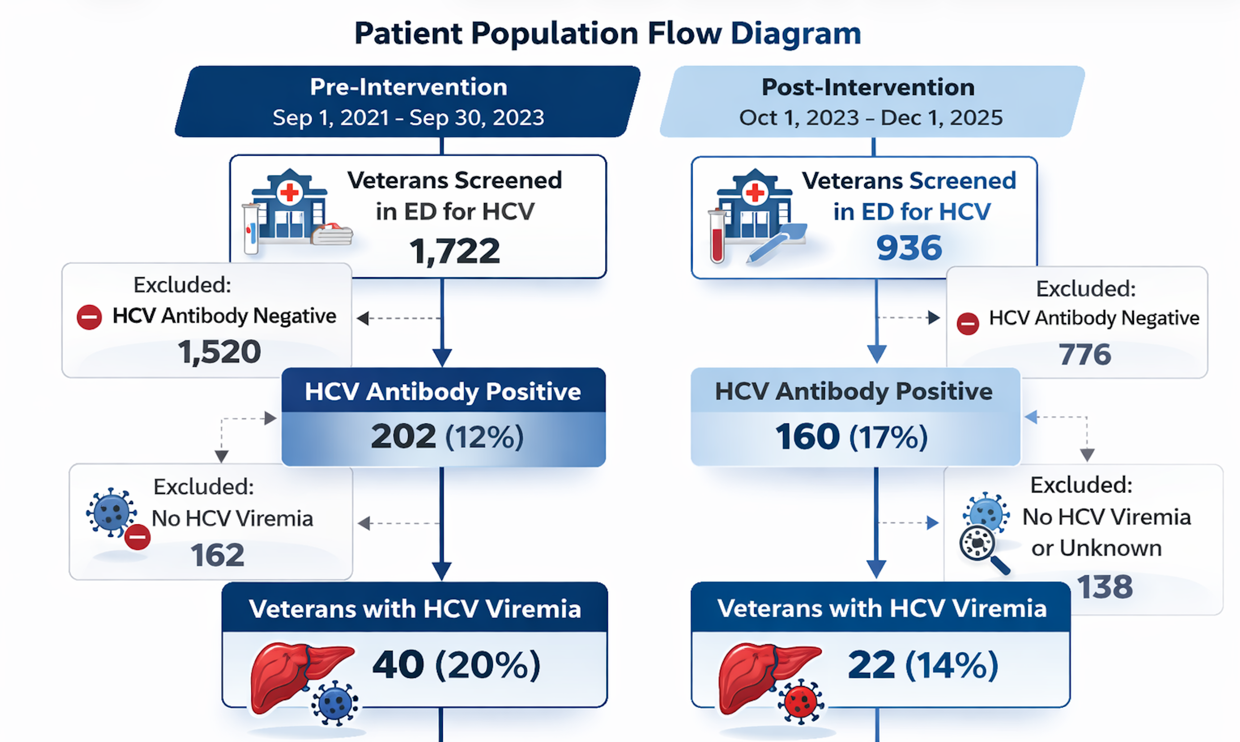
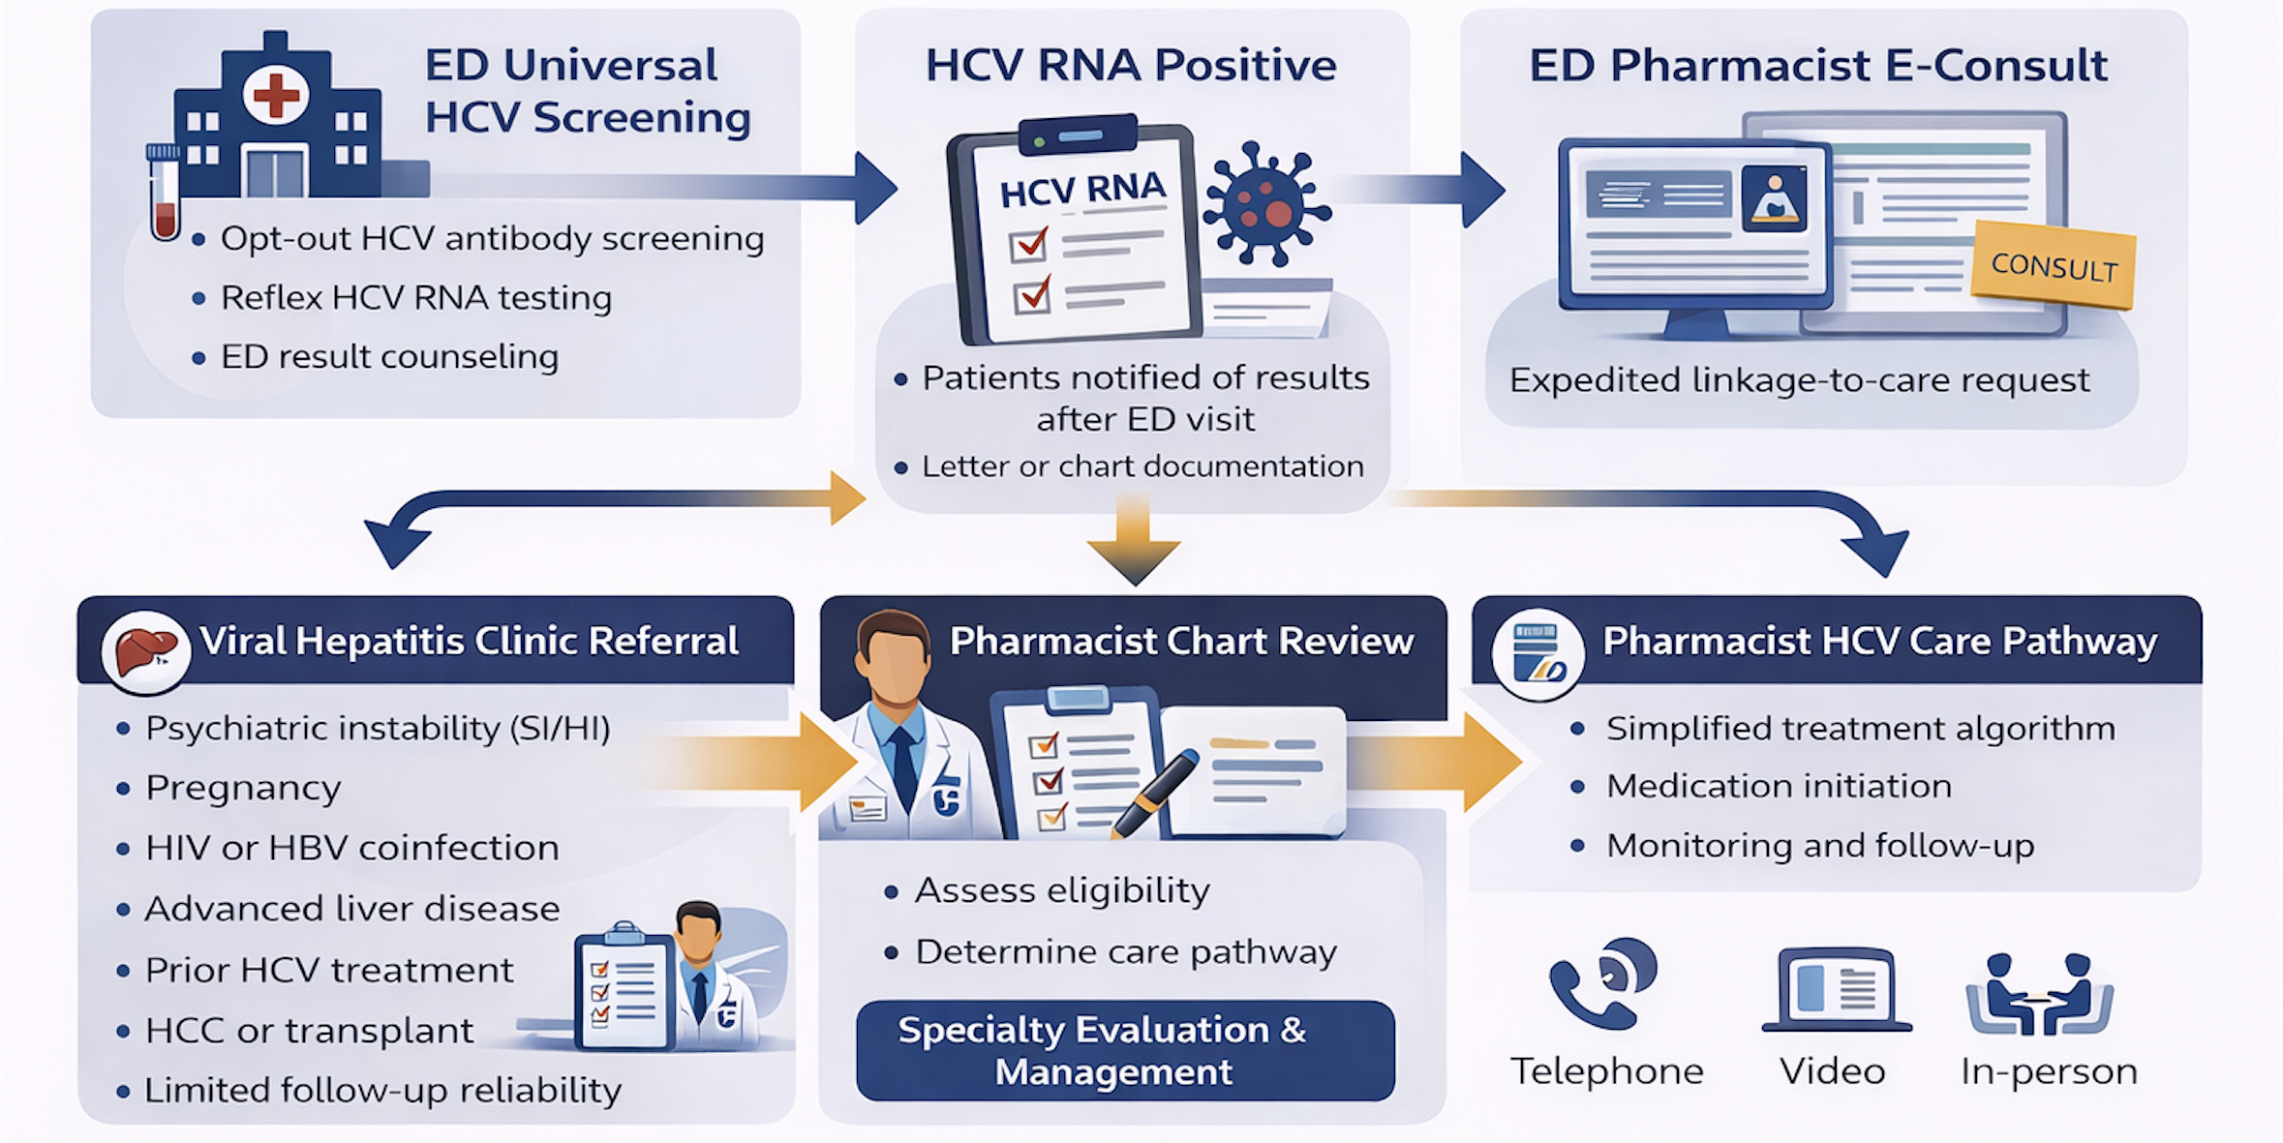
PHARMACIST-LED NAVIGATION HEPATITIS C LINKAGE TO CARE PILOT PROGRAM IN THE EMERGENCY DEPARTMENT
Carolyn Pham, PharmD¹, Jasmine Stinson, PharmD¹, Yash Motwani, BS^{1,2}, Neaka Mohtashemi, BA^{1,3}, Arpan Patel, MD, PhD¹, Manuel Celedon, MD¹; Jenna Kawamoto, PharmD, BCACP¹; Debika Bhattacharya, MD, MSc^{1,3}
1VA Greater Los Angeles Healthcare System, Los Angeles, California; 2Department of Medicine, Biostatistics David Geffen School of Medicine, University of California, Los Angeles, CA
3Division of Infectious Diseases, David Geffen School of Medicine, University of California, Los Angeles, CA
Contact Information:
debika.bhattacharya@va.gov
debikab@mednet.ucla.edu
Pharmacist-led navigation of HCV linkage to care in the emergency department was successful.
Background
Results
Results
In 2020, the CDC recommended universal hepatitis C screening for all adults 18 years and older.
Emergency departments (EDs) can be important settings for HCV screening and linkage to care; prior studies report 32-43% linkage-to-care rates with dedicated navigators.
Pharmacists are well-positioned to support HCV linkage to care due to expertise in medication management.
In October 2023, the VAGLAHCS Viral Hepatitis Program implemented a pharmacist-led HCV linkage-to-care pilot program from the ED.
Objective: Evaluate the impact of a pharmacist-led HCV care navigation program on the HCV cascade of care, comparing the pre- and post-intervention periods and characterize barriers to HCV treatment.
Figure 2. Patient Population Flow Diagram
Figure 3. HCV Care Cascade Outcomes: Pre- vs. Post-Intervention
100%
Methods
Opt-Out HCV Screening Program and Pharmacist-Led Linkage-to-Care Program (Fig.1)
ED physician-driven universal opt-out HCV screening; positive HCV Ab reflexes to HCV RNA
Pharmacist e-consult placed by ED physician for patients with HCV viremia to facilitate linkage to care
Pharmacist-Led Navigation Pilot Program
Pharmacist reviewed e-consult and triaged patients to hepatitis C pharmacist (simplified algorithm) or liver clinic (complex cases: SI/HI, HIV, HBV+, Child-Pugh B/C, prior HCV treatment, prior liver transplant, HCC, no contact info, etc.)
Single-center analysis of a pilot program of a pharmacist-led HCV linkage-to-care program with universal HCV screening in the ED.
Pre-intervention period: Sep 1, 2021 - Sep 30, 2023
Post-intervention period: Oct 1, 2023 - Dec 1, 2025
Statistical Analysis
Descriptive statistics: Bivariate analyses used Fisher's exact test and Wilcoxon Rank Sum
Table 1. Baseline Characteristics of Veterans with HCV Viremia
Characteristic | Pre-Intervention (N = 40) | Post-Intervention (N = 22) | P-value
Age Average (years) | 65 | 66 | NS
Sex Male | 38 (95%) | 21 (95%) | 1.00
Race White Black/African-American Unknown/Not Reported American Indian/Alaska Native Native Hawaiian/Other Pacific Islander | 19 (48%) 14 (35%) 7 (18%) 0 (0%) 0 (0%) | 6 (27%) 10 (45%) 4 (18%) 1 (5%) 1 (5%) | 0.14
Housing Status Stably Housed Homeless Housed through VASH Assisted Living/Domiciliary | 11 (28%) 18 (45%) 5 (13%) 6 (15%) | 4 (18%) 8 (36%) 7 (32%) 3 (14%) | 0.32
Psychiatric History PTSD Depression Anxiety Schizophrenia | 13 (33%) 9 (23%) 5 (13%) 6 (15%) | 5 (23%) 3 (14%) 1 (5%) 2 (9%) | 0.56
Opioid Use Disorder Active Historical (< 12 months) None | 4 (10%) 4 (10%) 32 (80%) | 2 (9%) 0 (0%) 20 (91%) | 0.30
Alcohol Use Disorder Abstinent (no AUD history) Current AUD Lower-risk drinking At-risk drinking Abstinent (AUD history) Unknown | 13 (33%) 8 (20%) 6 (15%) 9 (23%) 2 (5%) 2 (5%) | 11 (50%) 2 (9%) 4 (18%) 2 (9%) 0 (0%) 3 (14%) | 0.30
FIB-4 Score ≥ 3.25 | 6 (15%) | 4 (18%) | 0.73
Pilot Program Figure
Figure 4. HCV Linkage to Care Barriers: Pre- vs. Post-Intervention
Figure 1. Pharmacist-Led Linkage-to-Care Navigation Program
Results
Conclusions
HCV Antibody Prevalence
202/1772 (11.7%) in pre-intervention and 160/936 (17.0%) in post-intervention
HCV Viremia Prevalence
40/202 (19.8%) in pre-intervention and 22/160 (14.2%) in post-intervention
Linkage to Care
12/40 (30%) in pre-intervention and 9/22 (40.1%) in post-intervention
HCV Treatment Initiation
3/12 (25%) in pre-intervention vs 2/9 (22.2%) in post-intervention
Sustained Virologic Response (SVR)
2/3 (66.7%) in pre-intervention vs 2/2 (100%) in post-intervention
Pharmacist-led HCV navigation from the ED was feasible and associated with improved linkage to care (30% to 41%) and SVR (67% to 100%)
The primary barrier to care remained inability to contact Veterans after ED discharge (58% pre-intervention vs. 59% post-intervention)
The pharmacist-led program addressed key process-level barriers: missed viral hep consults, unaddressed HCV viremia at follow-up, and failure of provider evaluation
Future directions include point-of-care RNA testing with same-day treatment initiation, and long-acting antiviral therapies to facilitate test-and-treat models
Limitations:
Single-center, predominantly male Veteran population; small sample size
Funding: Gilead Sciences
Figures 1 & 2 generated by ChatGPT 5.2
Notes:
1

