Slide 1


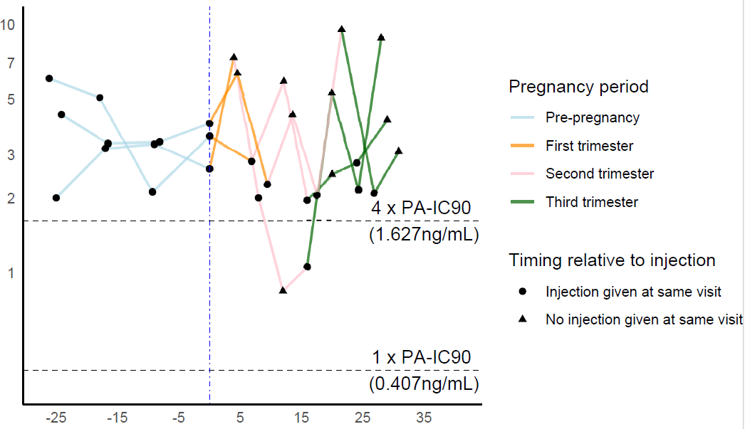
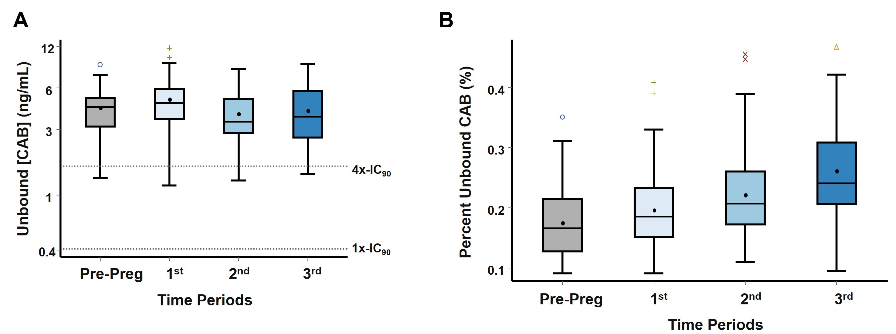
Poster 789
Assessment of Total and Unbound Cabotegravir Pharmacokinetics Among Pregnant Women in HPTN 084
Mark A Marzinke¹, Emily Voldal², Xu Guo², Teresa L Parsons¹, Estelle Piwowar-Manning¹, Yaw Agyei¹, Brett Hanscom², Scott Rose³, Susan L Ford⁴, Alex R Rinehart⁵, James Rooney⁶, Lydia Soto-Torres⁷, Myron S Cohen⁸, Mina Hosseinipour⁹, Sinead Delany-Moretlwe¹⁰, HPTN 084 Study Team
¹Johns Hopkins University School of Medicine, Baltimore, MD, USA ²Fred Hutchinson Cancer Center, Seattle, WA, USA ³FHI 360, Durham, NC, USA ⁴GlaxoSmithKline, Research Triangle Park, North Carolina, USA ⁵ViiV Healthcare, Durham, NC, USA ⁶Gilead Sciences, Foster City, CA, USA ⁷National Institute of Allergy and Infectious Diseases, Rockville, MD, USA ⁸University of North Carolina (UNC) at Chapel Hill, Chapel Hill, NC, USA ⁹UNC Project-Malawi, Lilongwe, Malawi ¹⁰Wits RHI, University of Witwatersrand, Johannesburg, South Africa
BACKGROUND
Unbound (bioavailable) CAB concentrations remain above pharmacologic targets throughout pregnancy, supporting that CAB-LA dose adjustments are not needed during pregnancy.
HPTN 084 found that long-acting cabotegravir (CAB-LA) significantly reduced the risk of HIV acquisition in women compared to tenofovir disoproxil fumarate/emtricitabine (TDF/FTC). In the HPTN 084 open label extension, participants consented to CAB-LA injections during pregnancy. A nested sub-study evaluated the pharmacokinetics of total and unbound (bioavailable) CAB among a subset of participants who continued to receive CAB-LA injections to identify the need for dose adjustments during pregnancy.
RESULTS
From the pre-pregnant period through the 3rd trimester, there was a median 26% reduction (IQR: 2%, 40%) in total CAB C_{trough} concentrations, from 2.3 µg/mL to 1.6 µg/mL. Median unbound CAB C_{trough} concentrations in the 6 months prior to pregnancy and the 1st, 2nd, and 3rd trimesters were 4.39 (IQR: 3.16, 5.08), 4.69 (IQR: 3.56, 5.89), 3.43 (IQR: 2.82, 5.02), and 3.74 (IQR: 2.63, 5.72) ng/mL, respectively (Table 2). Among this cohort, 98% of unbound CAB concentrations remained above the unbound pharmacologic threshold of 1.627 ng/mL, which is the 4x-IC₉₀ for unbound CAB. Within the entire PK cohort, median % unbound CAB C_{trough} increased from 0.16% (IQR: 0.12%, 0.22%) during the pre-pregnant period to 0.24% (IQR: 0.20%, 0.32%) in the 3rd trimester, suggesting an overall increase in the relative amount of bioavailable drug throughout pregnancy (Figure 1). Of the three participants with total CAB concentrations less than the 4x PA-IC₉₀, two maintained unbound CAB concentrations above the 4x-IC₉₀ for the duration of their pregnancies (Figure 2).
METHODS
Seventy-five HIV-negative participants who enrolled in the sub-study between 17 May 2022 and 13 September 2023 and received ≥ 4 CAB-LA injections both in the year prior to and during pregnancy were evaluated (Table 1).
Total and unbound CAB concentrations were measured via liquid chromatographic-tandem mass spectrometric (LC-MS/MS) analysis using validated assays with lower limits of quantitation (LLOQ) of 25 ng/mL and 0.05 ng/mL, respectively.
Total trough (C_{trough}) CAB concentrations were averaged within each participant during the pre-pregnant period and during each pregnancy trimester and then summarized.
Unbound CAB C_{trough} concentrations were evaluated from the 6 months prior to pregnancy through the end of pregnancy.
The percent unbound (% unbound) CAB was calculated by visit and then summarized.
Table 2. Total and Unbound CAB C_{trough} concentrations prior to and throughout pregnancy.
 | Pre-Pregnancy | 1st Pregnancy Trimester | 2nd Pregnancy Trimester | 3rd Pregnancy Trimester
Number of participants (n) | 75 | 74 | 75 | 75
Median Total CAB C_{trough} (µg/mL) (IQR) | 2.3 (1.5, 2.8) | 2.5 (2.1, 3.1) | 1.8 (1.4, 2.3) | 1.6 (1.3, 2.0)
Median Unbound CAB C_{trough} (ng/mL) (IQR) | 4.39 (3.16, 5.08) | 4.69 (3.56, 5.89) | 3.43 (2.82, 5.02) | 3.74 (2.63, 5.72)
Participants with Unbound CAB C_{trough} <4x IC₉₀ | 3/75 (4%) | 3/71 (4%) | 2/75 (3%) | 4/72 (6%)
Median Percent Unbound (%Unbound) (IQR) | 0.16% (0.12%, 0.22%) | 0.18% (0.14%, 0.24%) | 0.20% (0.16%, 0.26%) | 0.24% (0.20%, 0.32%)
Unbound [CAB] (ng/mL)
Time (weeks since pregnancy report date)
Table 1. HPTN 084 Pregnancy PK Cohort Characteristics (N=75).
Figure 2. Unbound CAB concentration profiles for PK sub-study participants (n=3) whose total CAB concentrations fellow below the protocol-specified pharmacologic target (4x PA-IC₉₀; 0.664 µg/mL) during pregnancy.
Median age (years)* (Q1, Q3) | 28 (26, 32)
Median weight (kg)* (Q1, Q3) | 66 (56, 78)
Median Body Mass Index (kg/m2)* (IQR) | 27 (23, 32)
Pregnancy Outcome Full-term live birth Pre-term live birth | 69/75 (92%) 6/75 (8%)
Median number of CAB-LA injections in the year prior to pregnancy (range) | 6 (4-7)
Number of CAB-LA injections during pregnancy 4 5 | 48/75 (64%) 27/75 (36%)
Figure 1. (A) Unbound C_{trough} CAB (ng/mL) concentrations and (B) percent unbound CAB (%) during pre-pregnancy (Pre-Preg), and the 1st, 2nd, and 3rd pregnancy trimesters. 1x-IC₉₀: 0.407 ng/mL; 4x-IC₉₀: 1.627 ng/mL. Each observation in Figure 1A is a within-participant average over the period of interest.
CONCLUSIONS
While declines in total CAB concentrations throughout pregnancy were observed, changes in unbound CAB concentrations were non-clinically relevant, and the % unbound CAB increased from the pre-pregnant period through the 3rd trimester.
These data provide pharmacologic support that CAB-LA dose adjustments are not needed for CAB-experienced women during pregnancy.
ACKNOWLEDGMENTS
*at pregnancy report date
The authors wish to acknowledge the contribution of the participants, their families and communities, and the community advisory boards at the participating sites. We acknowledge the contribution of the HPTN 084 study team. We thank Dr. Sheryl Zwerski for her leadership and support.

