Slide 1

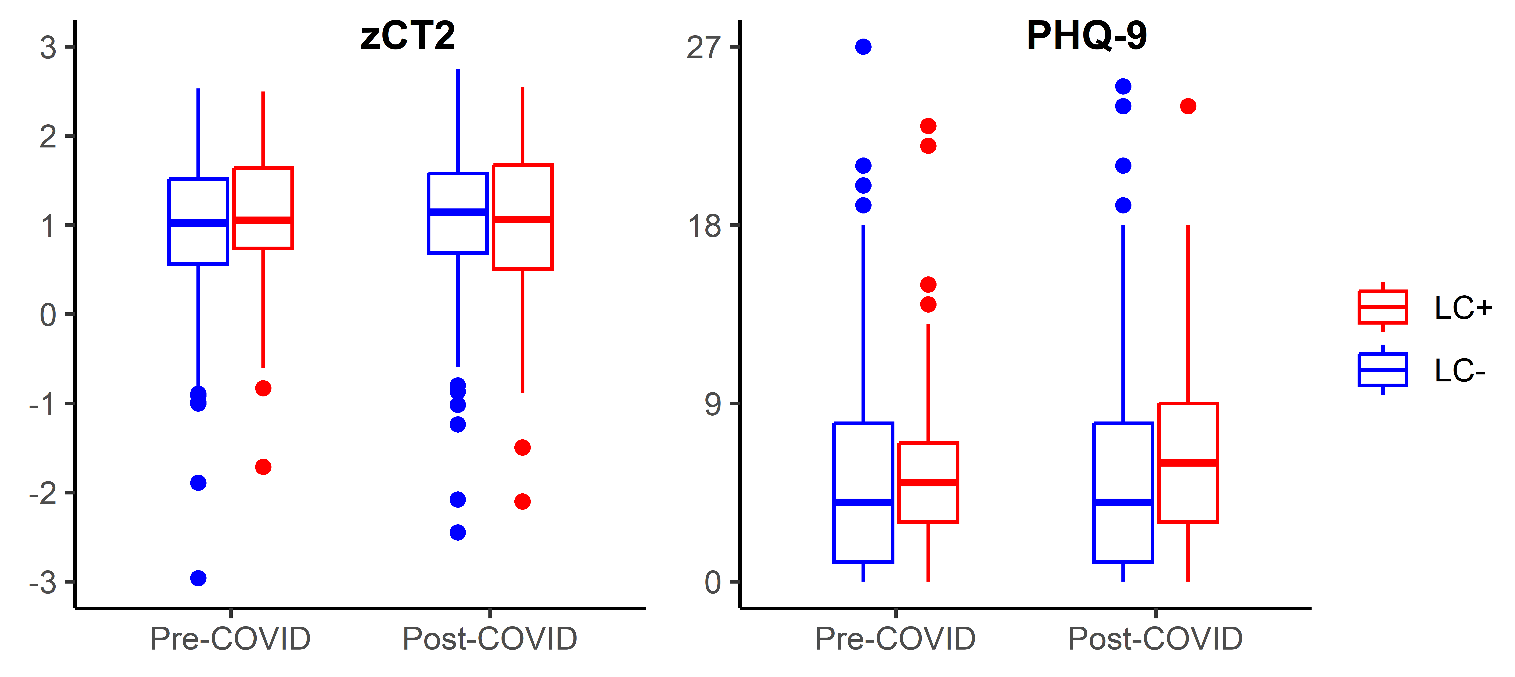






We did not observe association between the development of long COVID and HIV‑related or NP parameters at the pre‑COVID assessment.
Individuals with long COVID showed less improvement on the Color Trails 2 and exhibited a greater increase in depressive symptoms over time.
Neuropsychiatric Changes in People with HIV With or Without Long COVID After SARS-CoV-2 Infection
Abstract # 750
Phillip Chan^{1,2}, Tyler Hamby^{3,4}, Luxe-naree Poonpitak⁵, Ferron Ocampo⁵, Carlo Sacdalan^{5,6}, Pathariya Promsena^{5,6}, Eugène Kroon⁵, Somchai Sriplienchan⁵, Nittaya Phanuphak⁷, Donn Colby^{3,4}, Trevor A. Crowell^{3,4}, Lydie Trautmann^{3,4}, Serena Spudich^{1,2}, Robert Paul⁸ on behalf of the RV254/SEARCH 010 Study Team
1. Department of Neurology, Yale University School of Medicine, New Haven, CT, USA; 2. Yale Center for Brain and Mind Health, Yale University School of Medicine, New Haven, CT, USA; 3. U.S. Military HIV Research Program, CIDR, Walter Reed Army Institute of Research, Silver Spring, MD, USA; 4. Henry M. Jackson Foundation for the Advancement of Military Medicine, Inc., Bethesda, MD, USA; 5. SEARCH Research Foundation, Bangkok, Thailand; 6. Research Affairs, Faculty of Medicine, Chulalongkorn University, Bangkok, Thailand; 7. Institute of HIV Research and Innovation (IHRI), Bangkok, Thailand; 8. Faculty of Psychological Sciences, Missouri Institute of Mental Health, University of Missouri-St. Louis, St. Louis, MO, USA
BACKGROUND
Long COVID (LC) refers to symptoms that persist or emerge >3 months after SARS-CoV-2 infection.
In this analysis of people with HIV (PWH) on stable antiretroviral therapy (ART), we examined whether:
  HIV-related and neuropsychiatric (NP)-related parameters predicted the development of LC
  NP parameter changes after COVID differed by LC status
METHODS
RV254 Acute HIV Infection (AHI) cohort participants initiated and maintained ART from Fiebig stages I–V of AHI. They underwent regular NP assessments (see Table 1) during study visits at weeks 0, 24, 48, and every 48 weeks thereafter.
Since 2020, COVID incidence was systematically recorded. Post-COVID symptoms were screened during study follow-up using a standardized checklist introduced in Jan 2022.
Among those who have been on >48 weeks of ART, we compared their NP changes before and after 1st COVID, stratified by the presence of LC (i.e., LC+ vs. LC-).
Other Findings
LC was observed in 14% (60/427) of participants.
Neurologic symptoms (e.g., headache, insomnia, and cognitive and mood symptoms) were reported in 43% of LC+ individuals.
Additional analyses of changes in cognitive performance using linear mixed models, adjusted for practice effects, yielded similar results (i.e., a significant difference in ΔCT2, p = 0.005).
SUMMARY OF KEY FINDINGS
No association was observed between the development of LC and any HIV‑related or NP parameters at the pre‑COVID assessment (Table 2).
Compared with the LC– group, the LC+ group showed less improvement on the CT2 test (Table 3). However, the actual differences in changes in z‑CT2 between the LC+ and LC– groups were small and may not be clinically meaningful.
Despite the absence of a statistical difference in PHQ‑9 scores between the LC+ and LC– groups at the pre‑COVID assessment, the LC+ group showed a greater increase in PHQ‑9 scores at the post‑COVID visit (Tabe 3). Further, up to one quarter of individuals with LC had PHQ‑9 scores of potential clinical relevance (i.e., PHQ‑9>9) at the follow-up visit.
LIMITATIONS
RV254 participants were young, predominantly male, and mostly without chronic medical conditions other than HIV infection.
Most COVID-19 incidents in RV254 were identified through participant self-report, lacking confirmatory PCR testing.
Most of these COVID-19 events occurred during the Omicron surge periods or were associated with later Omicron-related variants.
Correlation between long COVID status and vaccination was not explored due to the highly heterogeneous COVID‑19 vaccination program in Thailand during the pandemic.
ACKNOWLEDGMENTS
We would like to thank the study participants who committed so much of their time for this study. The participants were from the RV254/SEARCH 010, which is supported by cooperative agreements (WW81XWH-18-2-0040) between the Henry M. Jackson Foundation for the Advancement of Military Medicine, Inc., and the U.S. Department of Defense (DOD) and by an intramural grant from the Thai Red Cross AIDS Research Centre and, in part, by the Division of AIDS, National Institute of Allergy and Infectious Diseases, National Institute of Health (DAIDS, NIAID, NIH) (grant AAI20052001). Antiretroviral therapy for RV254/SEARCH 010 participants was supported by the Thai Government Pharmaceutical Organization, Gilead Sciences, Merck and ViiV Healthcare. This study was supported by NIH grants focused on neurological and cognitive outcomes in RV254/SEARCH010 including R01 MH113560 and by additional funds contributed by the National Institute of Mental Health.
DISCLAIMER
The views expressed are those of the authors and should not be construed to represent the positions of the U.S. Army, the Department of Defense, the National Institutes of Health, the Department of Health and Human Services, or the Henry M. Jackson Foundation for the Advancement of Military Medicine, Inc. The investigators have adhered to the policies for protection of human subjects as prescribed in AR-70-25
Table 1. Neuropsychiatric Assessments
Mood Symptoms | Patient Health Questionnaire 9 (PHQ-9) Distress Thermometer (DT)
4-test Cognitive Battery | Color Trails 1 (CT1) Color Trails 2 (CT2) Trail Making A (TMT) Nondominant Grooved Pegboard Test (GPB)
Table 3. Changes of Neuropsychiatric and HIV Metrics by Long COVID Status
 | LC+ (N=60) |  | LC- (N=367)
Outcome | Pre-COVID | Post-COVID | Pre-COVID | Post-COVID | p
z-CT1 | 1.32 (0.82, 1.92) | 1.53 (0.97, 1.94) | 1.49 (1.04, 1.89) | 1.49 (1.08, 1.89) | 0.948
z-CT2 | 1.05 (0.74, 1.65) | 1.06 (0.48, 1.69) | 1.02 (0.56, 1.52) | 1.14 (0.68, 1.58) | 0.042
Z-TMT | 1.00 (0.22, 1.44) | 0.90 (-0.21, 1.60) | 0.92 (0.32, 1.43) | 0.91 (0.39, 1.38) | 0.235
z-GPB | 0.77 (0.17, 1.19) | 0.67 (0.22, 1.14) | 0.78 (0.09, 1.37) | 0.70 (0.14, 1.34) | 0.500
NPZ-4 | 0.94 (0.62, 1.39) | 0.97 (0.54, 1.38) | 1.01 (0.66, 1.30) | 1.03 (0.63, 1.37) | 0.112
PHQ-9 | 5 (3, 7) | 6 (3, 9) | 4 (1, 8) | 4 (1, 8) | 0.047
DT | 2.45 (1.00, 5.00) | 2.25 (1.00, 5.30) | 2.10 (1.00, 4.10) | 2.00 (1.00, 4.20) | 0.109
CD4 T-cell count | 657 (560, 782) | 687 (555, 818) | 684 (567, 870) | 680 (545, 871) | 0.302
CD8 T-cell count | 600 (453, 760) | 629 (522, 770) | 644 (486, 833) | 649 (476, 841) | 0.148
CD4/CD8 | 1.22 (0.90, 1.35) | 1.15 (0.89, 1.30) | 1.09 (0.88, 1.36) | 1.08 (0.86, 1.35) | 0.341
Medians (interquartile ranges) are presented. P-values were calculated to using the Wilcoxon rank-sum test to compare pre-/post-COVID changes between groups with and without long COVID (bolded for p<0.05).
RESULTS
Table 2. Participants’ Characteristics at pre-COVID Assessment
 | LC+ (n=60) | LC- (n=367) | p-value
Age, year | 32.2 (28.6, 37.6) | 32.3 (28.9, 38.0) | 0.891
Male, n (%) | 57 (95) | 360 (98) | 0.142
#HIV suppression, n (%) | 60 (100) | 363 (99) | 0.416
Weeks post-AHI | 335 (241, 383) | 334 (237, 387) | 0.888
CD4 T-cell count | 657 (560, 781) | 684 (567, 870) | 0.391
CD8 T-cell count | 600 (453, 760) | 644 (486, 833) | 0.178
CD4/CD8 ratio | 1.22 (0.90, 1.35) | 1.09 (0.88, 1.36) | 0.307
z-CT1 | 1.32 (0.82, 1.92) | 1.49 (1.04, 1.89) | 0.243
z-CT2 | 1.05 (0.74, 1.65) | 1.02 (0.56, 1.52) | 0.260
z-TMT | 1.00 (0.22, 1.44) | 0.92 (0.32, 1.43) | 0.948
z-GPB | 0.77 (0.17, 1.19) | 0.78 (0.09, 1.37) | 0.935
*NPZ-4 | 0.94 (0.62, 1.39) | 1.01 (0.66, 1.30) | 0.961
PHQ-9 | 5 (3, 7) | 4 (1, 8) | 0.108
DT | 2.45 (1.00, 5.00) | 2.10 (1.00, 4.10) | 0.578
Median (Interquartile range) is provided unless specified. # Plasma HIV RNA <50 cps/ml; * NPZ-4: Average z-score of the 4-test battery.
33rd Conference on Retroviruses and Opportunistic Infections (CROI 2026) Denver, Colorado, USA; February 22-25, 2026
Notes:
Poster Development Guide
Formatting Notes
To Edit In PowerPoint: Click View > Guides to make editing easier. Keep text within guides
If you wish, you may change the background colors, but use a light color or white for the overall background of the poster and a bold color for the main findings section
Author list: Don’t split names onto two lines (e.g., “John [line break] Smith”). If that happens, use a new line. Bold the name of the presenting author
Font Size: Do not drop below font size 36 in the main information sections (Background, Methods, Results, Conclusions). If you have extra space, increase the font size, but maintain some white space to make it easier for attendees to read your text
Use of Color: To keep attendees focused on your main findings and important details in your graphs and figures, do not use color in the sidebars
Print Size: Using this template, the optimal print size is 54 inches (width) x 36 inches (height) or 60 inches x 40 inches (137.2 cm x 91.4 cm or 152.4 cm x 101.6). Printing the poster in a smaller size may save some cost, but the 54” x 36” size will maintain the suggested font size and layout in the final printed version of the poster (and maintain the effectiveness of the poster design).
Poster Board Dimensions: Regardless of whether you use this template, the size of the board for displaying your poster at CROI is 96 inches (width) x 48 inches (height). The maximum size of a poster is 93 inches (width) x 45 inches (height). The minimum size for a poster is 36 inches (width) x 24 inches (height) so attendees can see the poster at a minimum of 10 feet away
Poster Content Requirements
Poster Number: The poster number should be displayed in the upper right corner (0000 in the template). This is not the abstract number you had during submission but a number you will be assigned and sent to you by email which notes the position of the poster in the poster hall. This number will be sent to you after late-breaking abstracts have been accepted in January
Poster Title: The title should be the same as the title submitted with the abstract
QR Codes are not allowed by CROI

