Slide 1

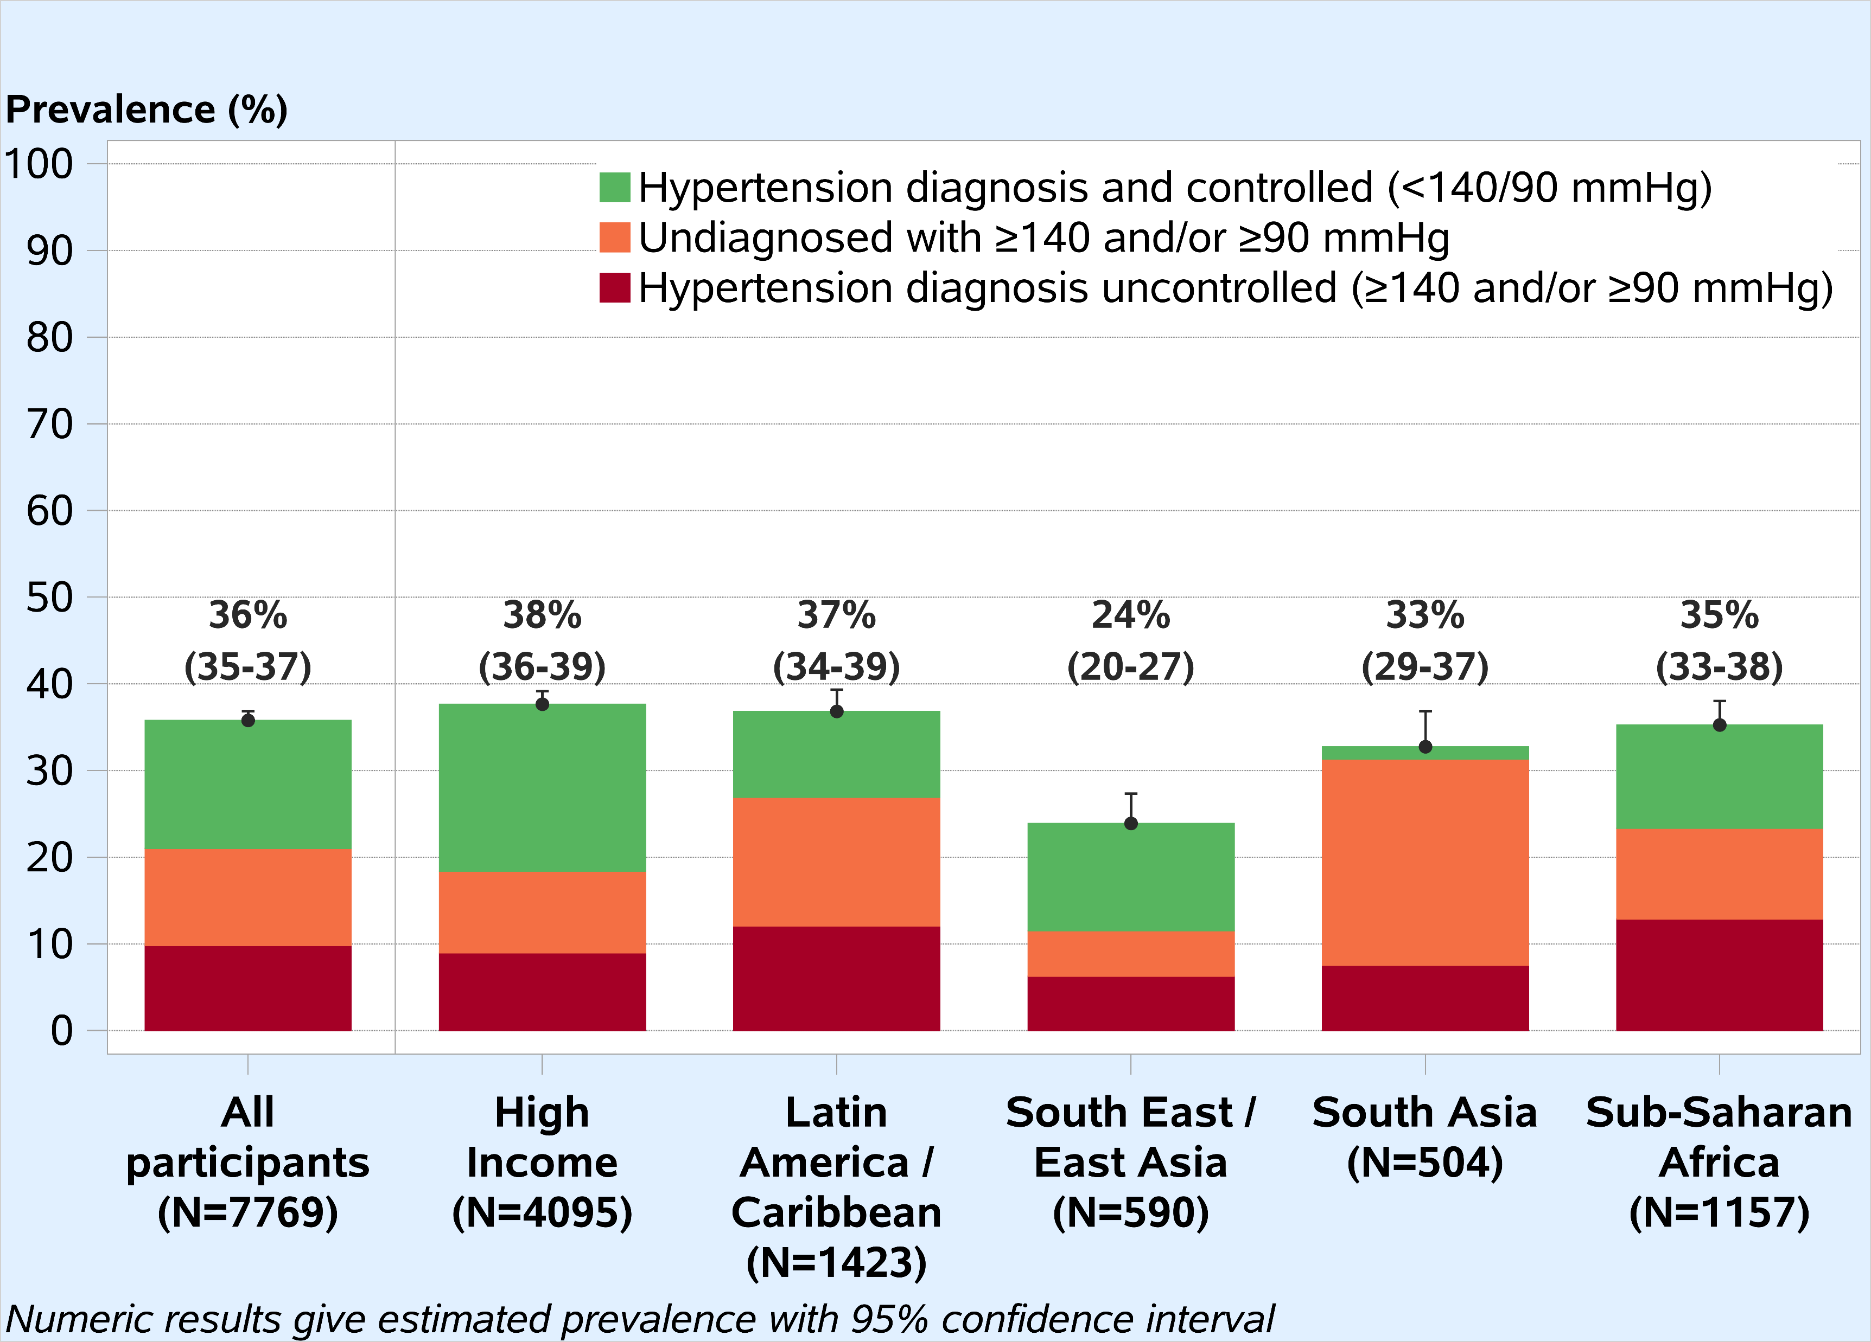
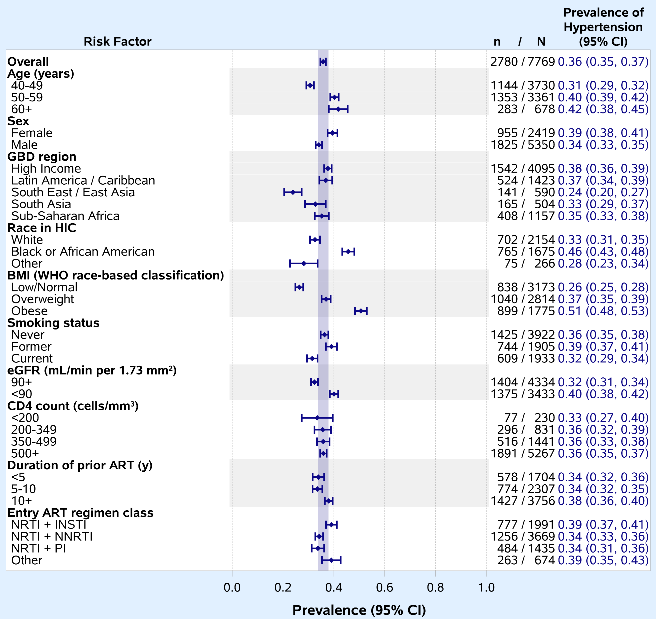


Despite low-to-moderate cardiovascular disease risk, one in three PWH in REPRIEVE had hypertension at baseline; among those with a pre-existing diagnosis, hypertension was frequently suboptimally controlled.
High Baseline Prevalence and Suboptimal Control of Hypertension in the REPRIEVE Trial
676
Risa Hoffman¹, Maya Watanabe², Esteban Martinez^{3,4}, Anton Pozniak^{4,5}, Saate S. Shakil⁶, Sara McCallum⁷, Sarah M. Chu⁷, Alex B. Lu⁷, Michael T. Lu⁸,
Judith S. Currier¹, Markella V. Zanni⁷, Pamela S. Douglas⁹, Heather J. Ribaudo², Steven K. Grinspoon⁷ for the REPRIEVE Study team
¹Division of Infectious Diseases, David Geffen School of Medicine, University of California at Los Angeles, Los Angeles, CA, USA, ²Center for Biostatistics in AIDS Research, Harvard T.H. Chan School of Public Health, Boston, Massachusetts, USA, ³Department of Infectious Diseases, Hospital Clínic, IDIBAPS, University of Barcelona, Barcelona, Spain; CIBER de Enfermedades Infecciosas, Instituto de Salud Carlos III, Madrid, Spain; Reial Acadèmia de Medicina de Catalunya, Barcelona, Spain, ⁴European AIDS Treatment Network (NEAT-ID), ⁵Chelsea and Westminster Hospital and London School of Hygiene and Tropical Medicine, London, UK, ⁶Department of Medicine, University of California, Los Angeles, CA, USA, ⁷Metabolism Unit, Massachusetts General Hospital and Harvard Medical School, Boston, Massachusetts, USA, ⁸Cardiovascular Imaging Research Center, Massachusetts General Hospital and Harvard Medical School, Boston, Massachusetts, USA, ⁹Duke Clinical Research Institute, Duke University School of Medicine, Durham, North Carolina, USA
BACKGROUND
Hypertension is common in people with HIV (PWH)¹, and a major contributor to cardiovascular disease²
Study Objective: Secondary analysis to evaluate baseline hypertension prevalence and control in REPRIEVE, a population with low-to-moderate cardiovascular disease risk and controlled HIV
METHODS
Baseline hypertension prevalence was a composite of: (1) pre-existing hypertension regardless of antihypertensive medication use; or (2) baseline systolic ≥140 mmHg or diastolic ≥90 mmHg without a prior hypertension diagnosis
Estimated prevalence of composite hypertension outcome overall and by demographic and clinical characteristics with 95% Wald confidence intervals (CIs)
Uncontrolled hypertension defined as SBP ≥140 and/or DBP ≥90 mmHg among those with pre-existing hypertension
Differences in control rates explored using global thresholds³ vs American Heart Association (AHA)⁴ thresholds (Table 1)
Figure 2: Hypertension prevalence and control* by region
Figure 1: Prevalence of the composite baseline hypertension outcome
*Control among N=1,882 with pre-existing hypertension
Table 1: Stages of hypertension by global versus AHA thresholds among those with a pre-existing diagnosis (N=1,882*)
RESULTS
7,769 participants enrolled from 5 global burden of disease (GBD) regions: median age 50 years (IQR 45, 55) and 2,419 (31%) women; 88% virologically suppressed (<400 copies/mL)
Prevalence of baseline hypertension: 36% (95%CI 35, 37); varied by GBD region; more common in women (Figure 1)
1,911 participants (69%) had pre-existing hypertension
1,578 were on antihypertensive medications (including 29 started on antihypertensive medications at baseline)
333 not on medications
869 (31%) previously undiagnosed
Hypertension more common with traditional risk factors:
Older age (50+ yrs), Black or African American race in high-income region, higher BMI, reduced renal function (GFR < 90 mL/min) (Figure 1)
Among 1,882 participants with pre-existing hypertension, 39% (95%CI 37, 41) were uncontrolled
Varied by region with control most common in high income countries (Figure 2)
Using AHA thresholds, uncontrolled blood pressure very common: 77% with stage 1 or higher with AHA versus 39% stage 1 or higher with global thresholds (Table 1)
Control Definition | Baseline Blood Pressure Status | N | % (95% CI)
Single value at 140/90 mmHg | Controlled (<140/90) | 1145 | 61% (59%, 63%)
 | Uncontrolled (≥140/90) | 737 | 39% (37%, 41%)
Global Thresholds³ | Normal (SBP <130 and DBP <80) | 426 | 23% (21%, 25%)
 | Elevated (SBP 130-139 or DBP 80-89) | 719 | 38% (36%, 40%)
 | Stage 1 (SBP 140-159 or DBP 90-99) | 571 | 30% (28%, 32%)
 | Stage 2 (SBP 160-179 or DBP 100-109) | 134 | 7% (6%, 8%)
 | Stage 3 (SBP ≥180 or DBP ≥110) | 32 | 2% (1%, 2%)
AHA Thresholds⁴ | Normal (SBP <120 and DBP <80) | 280 | 15% (13%, 16%)
 | Elevated (SBP 120-129 and DBP 80-89) | 146 | 8% (7%, 9%)
 | Stage 1 (SBP 130-139 or DBP 80-89) | 719 | 38% (36%, 40%)
 | Stage 2 (SBP 140-179 or DBP 90-119) | 722 | 38% (36%, 41%)
 | Hypertensive crisis (SBP ≥180 or DBP ≥120) | 15 | 1% (0%, 1%)
*Excludes 29 people started on medications at study baseline
CONCLUSIONS
Despite low-to-moderate traditional cardiovascular disease risk, one in three REPRIEVE participants had hypertension; female sex and traditional risk factors more common among those with hypertension
Suboptimal control common, particularly with AHA thresholds
Findings highlight the need for improved screening and treatment of hypertension in PWH
Funding: REPRIEVE is supported by the NIH, ACTG, Kowa Pharmaceuticals, Gilead Sciences, and ViiV Healthcare.
REFERENCES
1-Xu Y et al. J Am Soc Hypertens 2017; 11(8): 530-40; 2-Collaborators GBDRF. Lancet 2018; 392(10159): 1923-94; 3-WHO, South Africa, and Kenya Treatment Guidelines; 4- J Am Coll Cardiol 2018; 71(19): e127-e248
Notes:
Poster Development Guide
Formatting Notes
To Edit In PowerPoint: Click View > Guides to make editing easier. Keep text within guides
If you wish, you may change the background colors, but use a light color or white for the overall background of the poster and a bold color for the main findings section
Author list: Don’t split names onto two lines (e.g., “John [line break] Smith”). If that happens, use a new line. Bold the name of the presenting author
Font Size: Do not drop below font size 36 in the main information sections (Background, Methods, Results, Conclusions). If you have extra space, increase the font size, but maintain some white space to make it easier for attendees to read your text
Use of Color: To keep attendees focused on your main findings and important details in your graphs and figures, do not use color in the sidebars
Print Size: Using this template, the optimal print size is 54 inches (width) x 36 inches (height) or 60 inches x 40 inches (137.2 cm x 91.4 cm or 152.4 cm x 101.6). Printing the poster in a smaller size may save some cost, but the 54” x 36” size will maintain the suggested font size and layout in the final printed version of the poster (and maintain the effectiveness of the poster design).
Poster Board Dimensions: Regardless of whether you use this template, the size of the board for displaying your poster at CROI is 96 inches (width) x 48 inches (height). The maximum size of a poster is 93 inches (width) x 45 inches (height). The minimum size for a poster is 36 inches (width) x 24 inches (height) so attendees can see the poster at a minimum of 10 feet away
Poster Content Requirements
Poster Number: The poster number should be displayed in the upper right corner (0000 in the template). This is not the abstract number you had during submission but a number you will be assigned and sent to you by email which notes the position of the poster in the poster hall. This number will be sent to you after late-breaking abstracts have been accepted in January
Poster Title: The title should be the same as the title submitted with the abstract
QR Codes are not allowed by CROI

