Slide 1

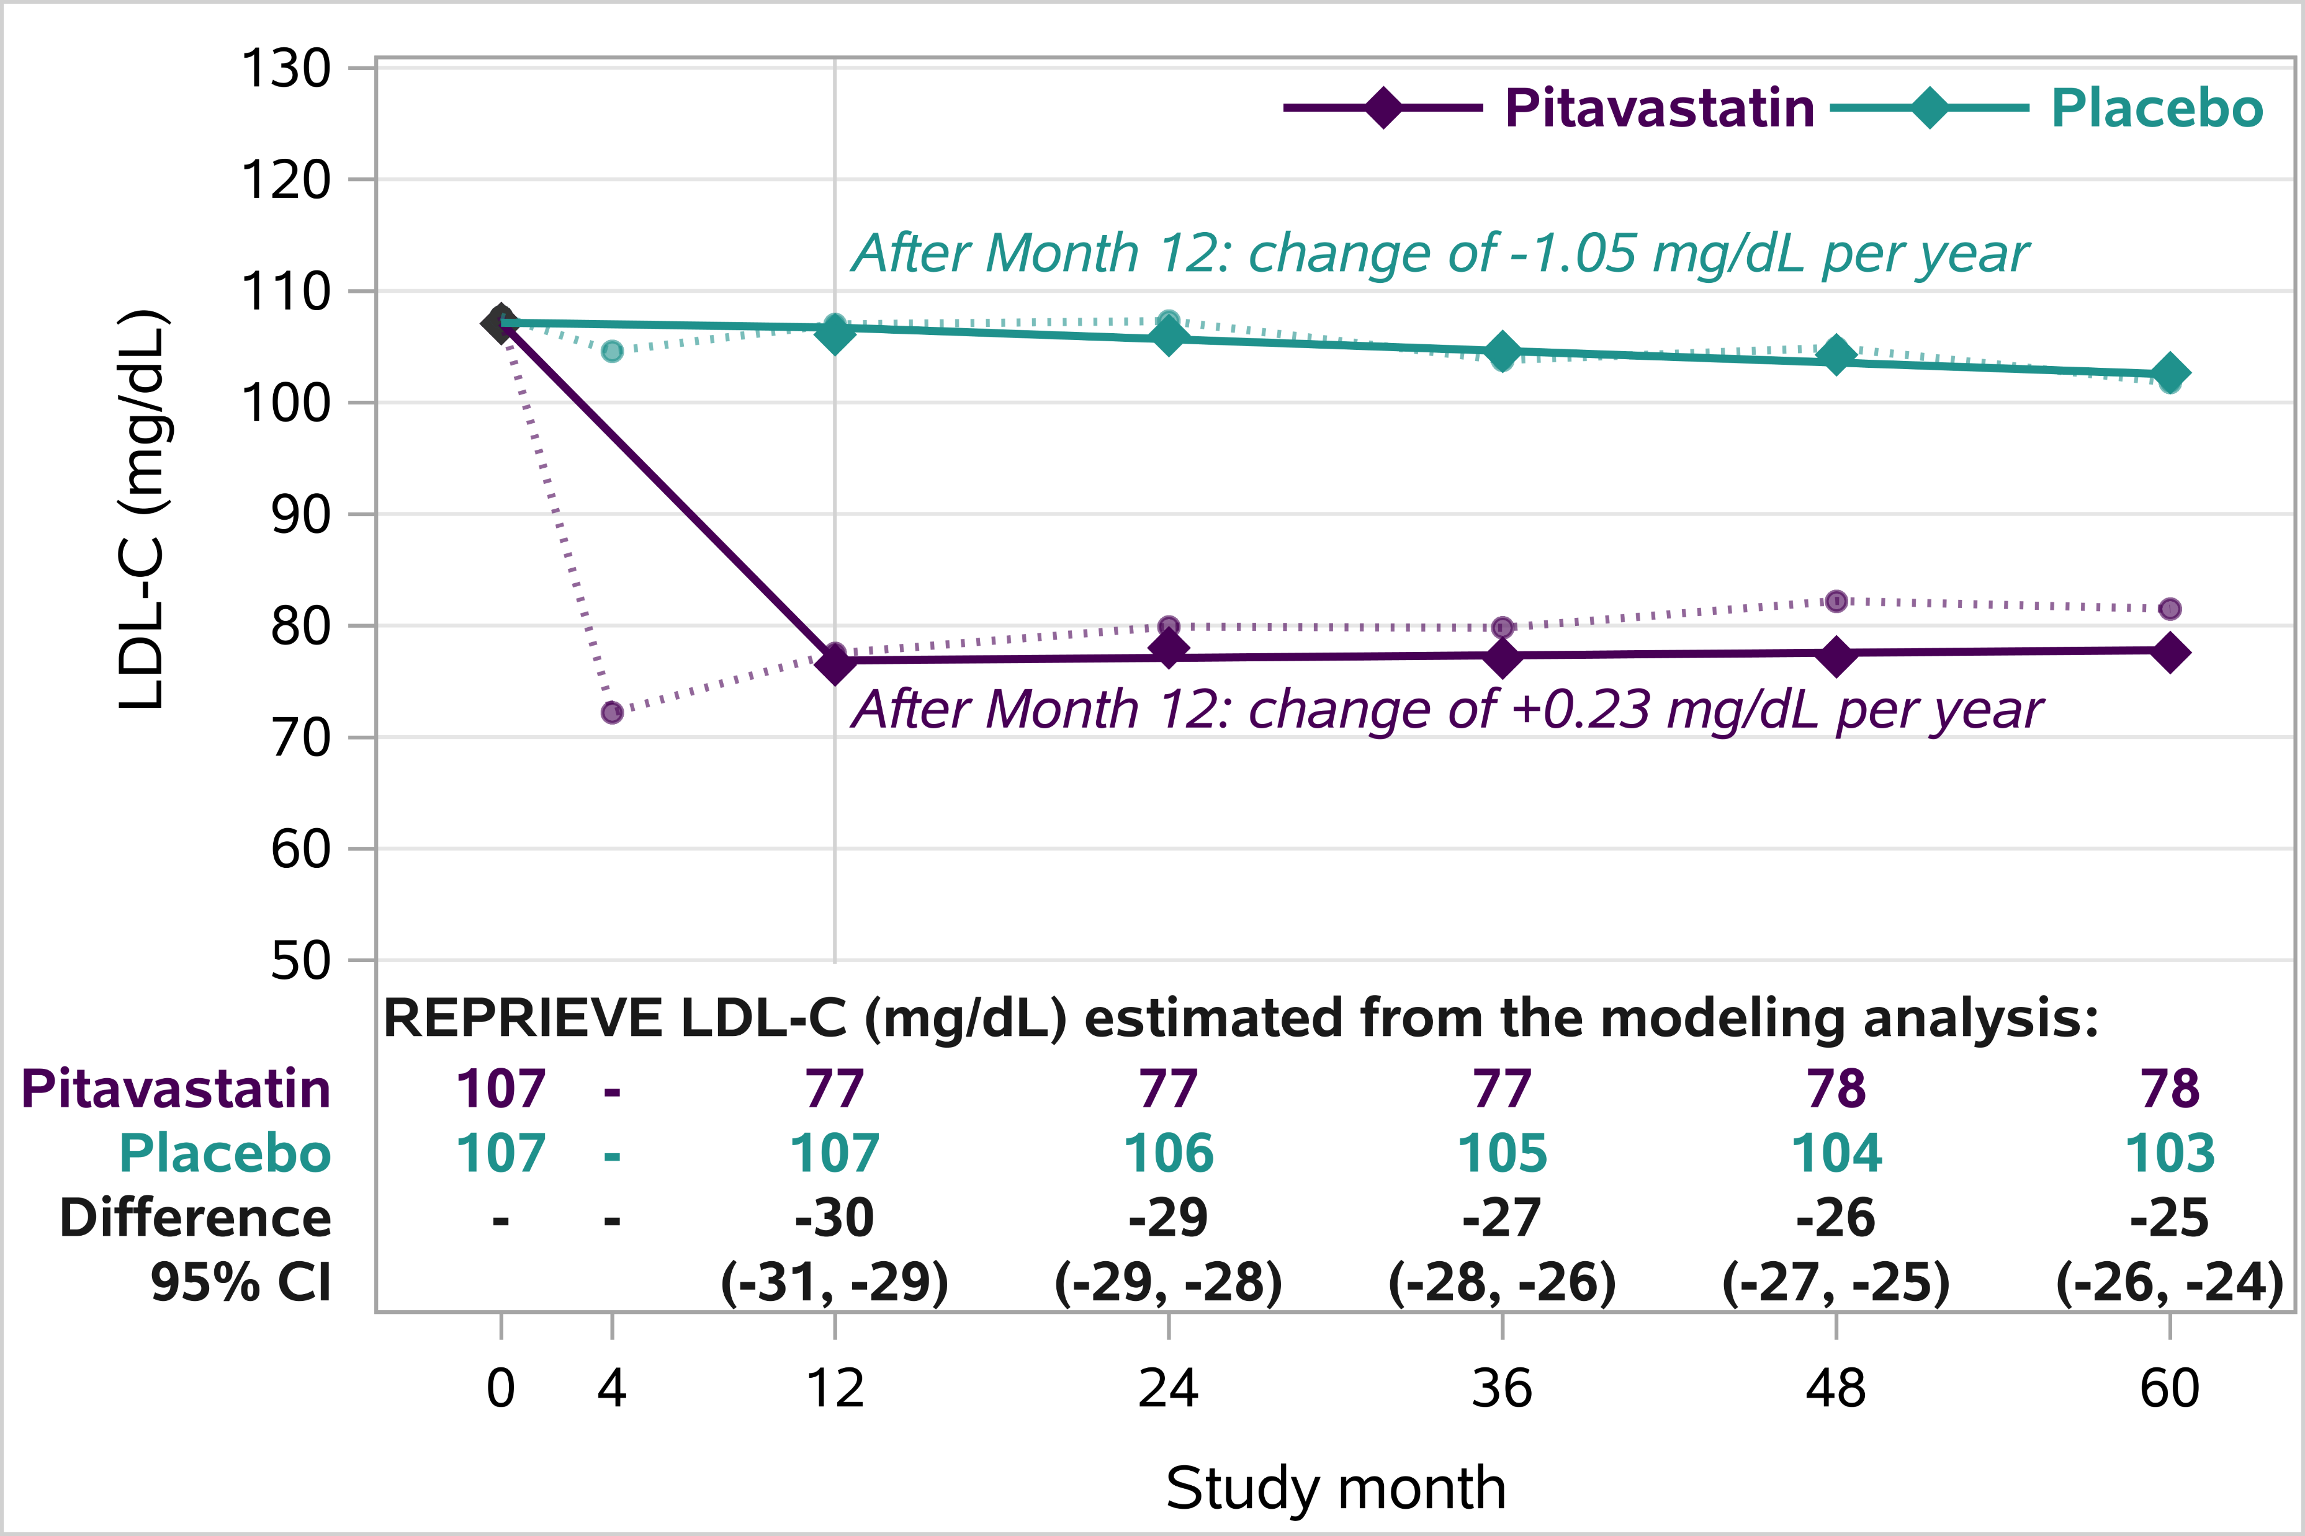
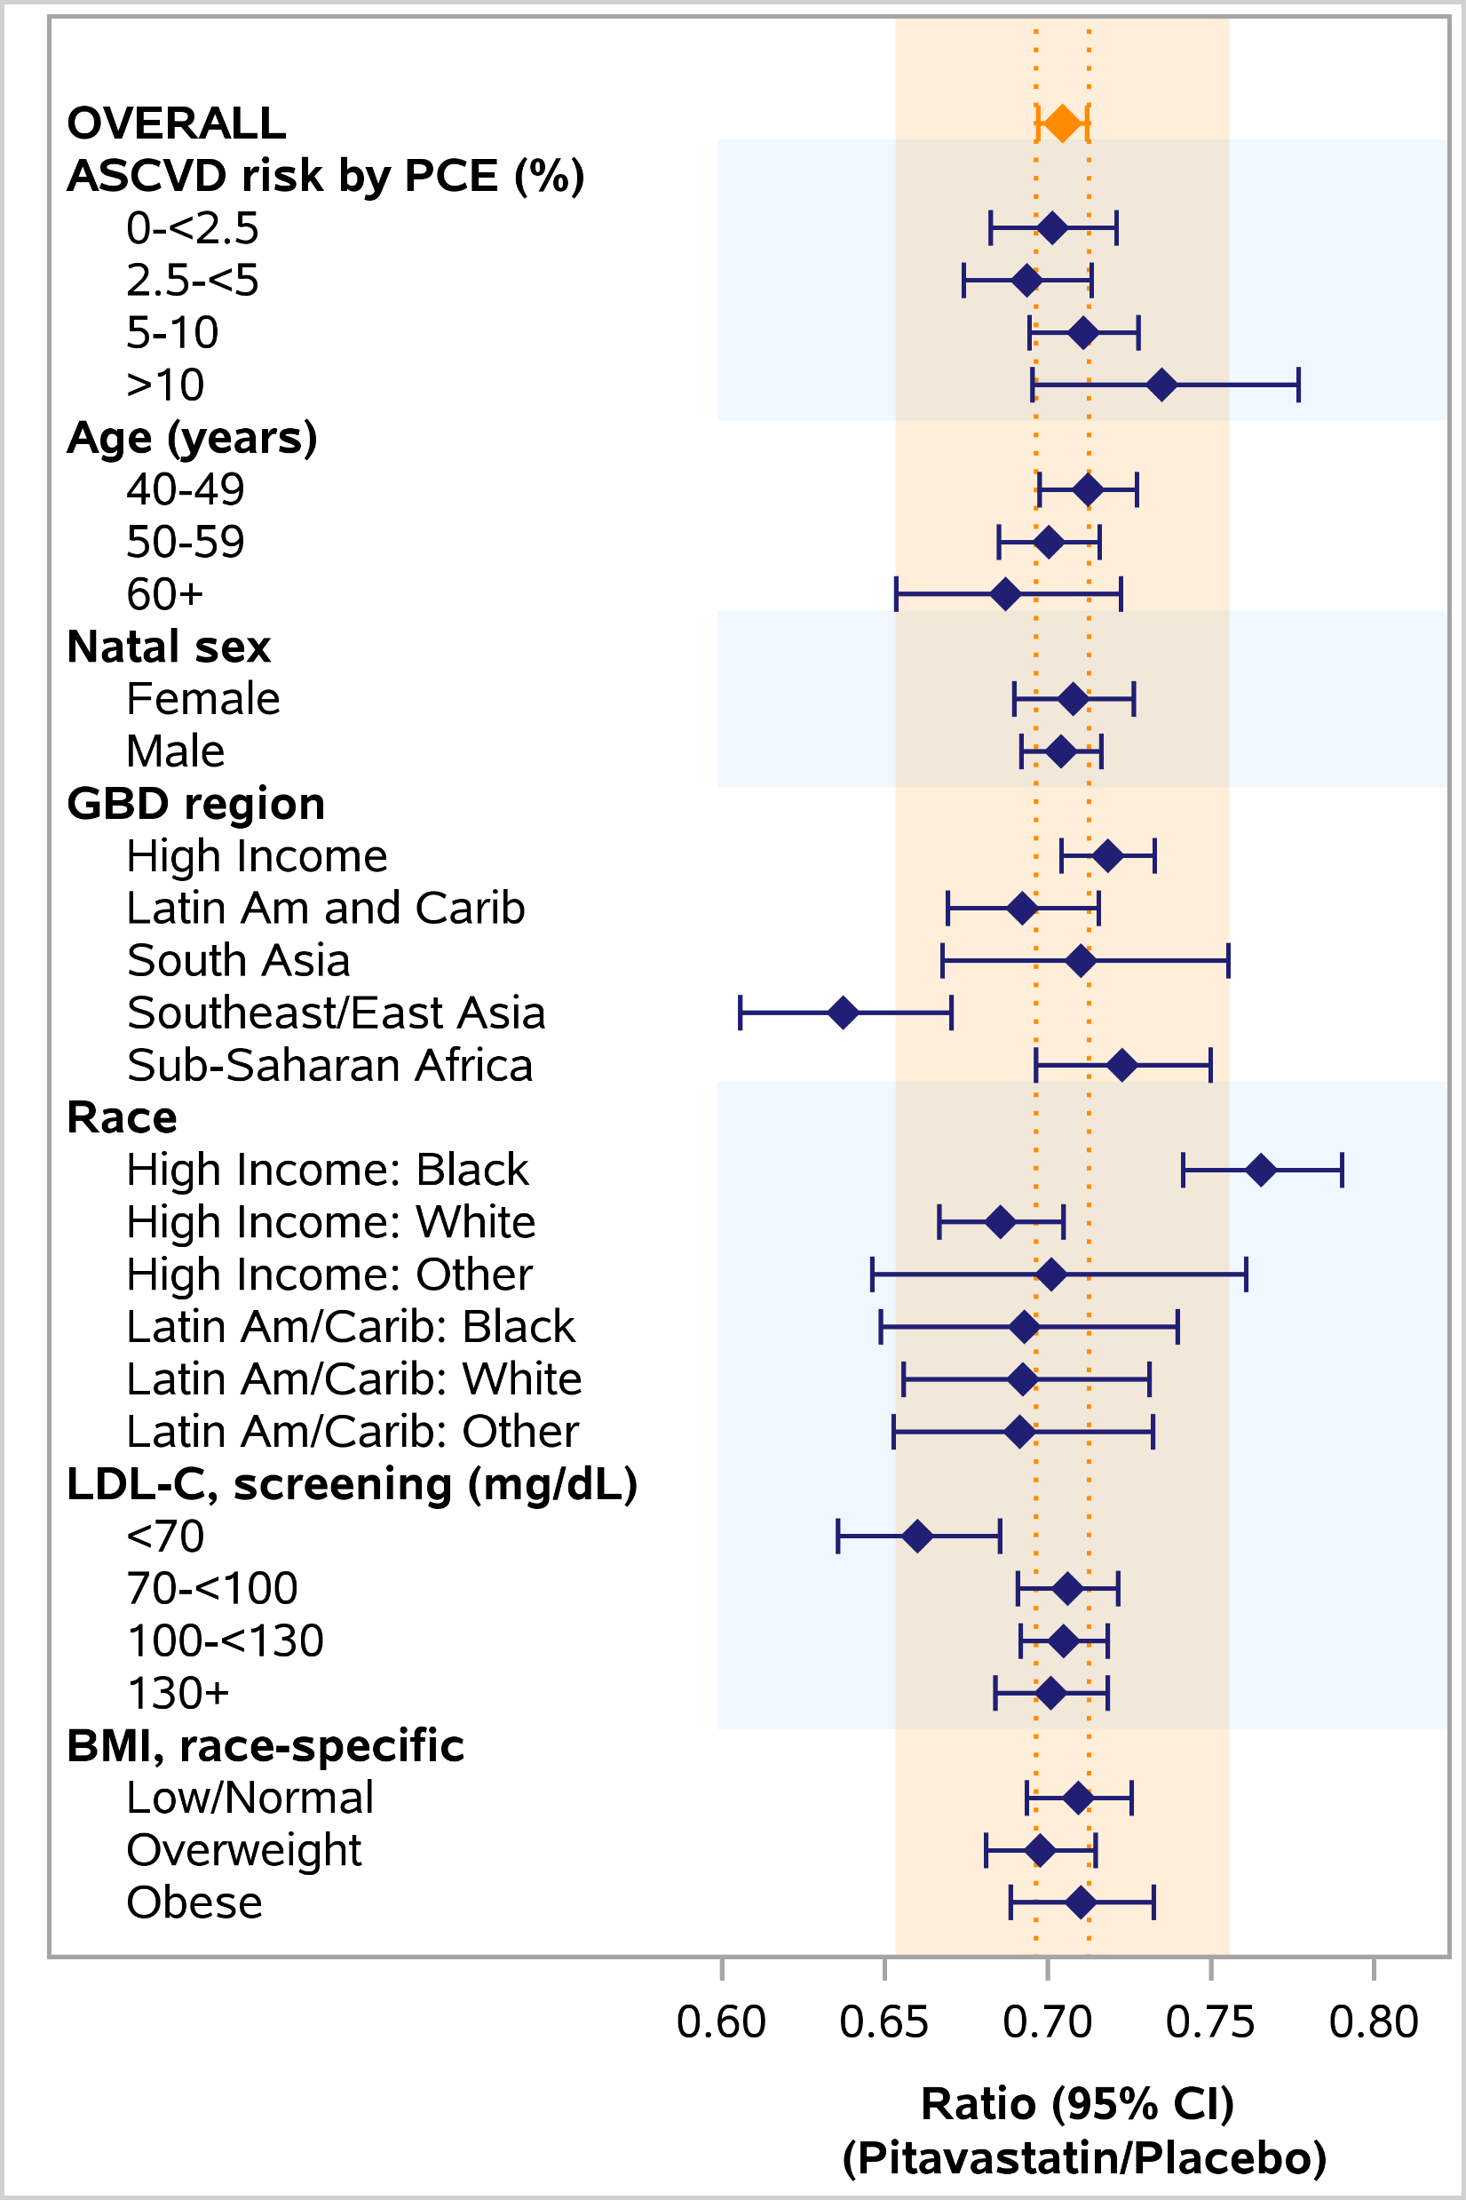
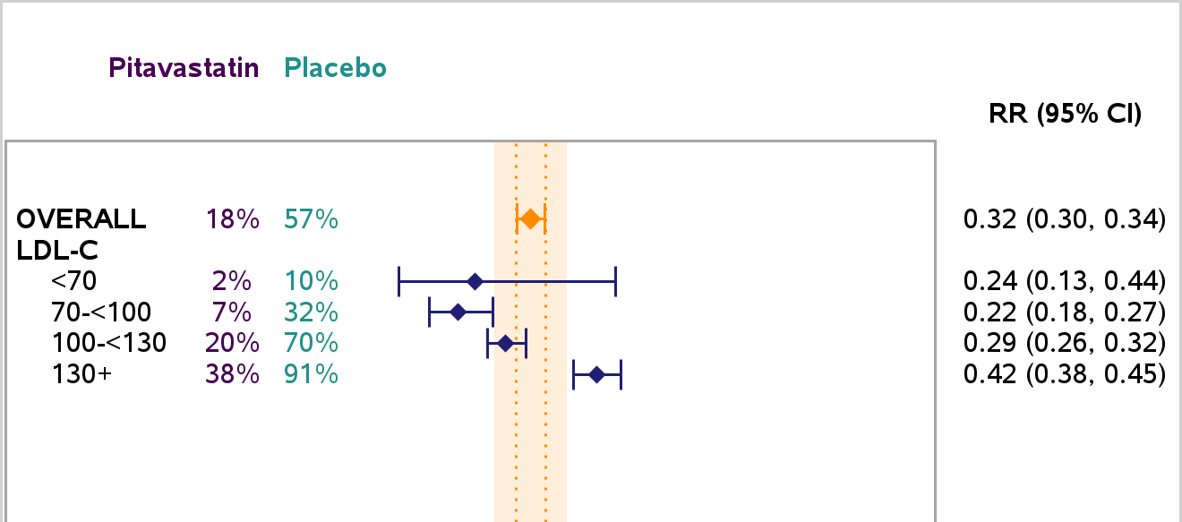
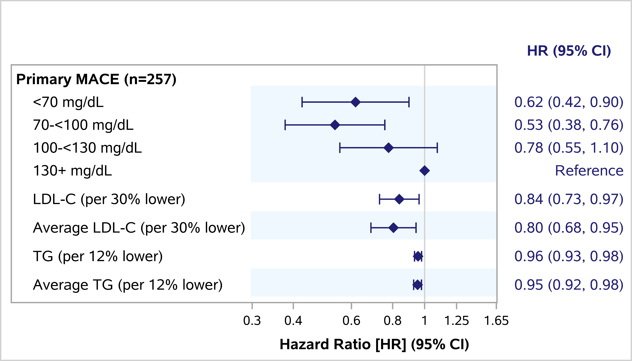

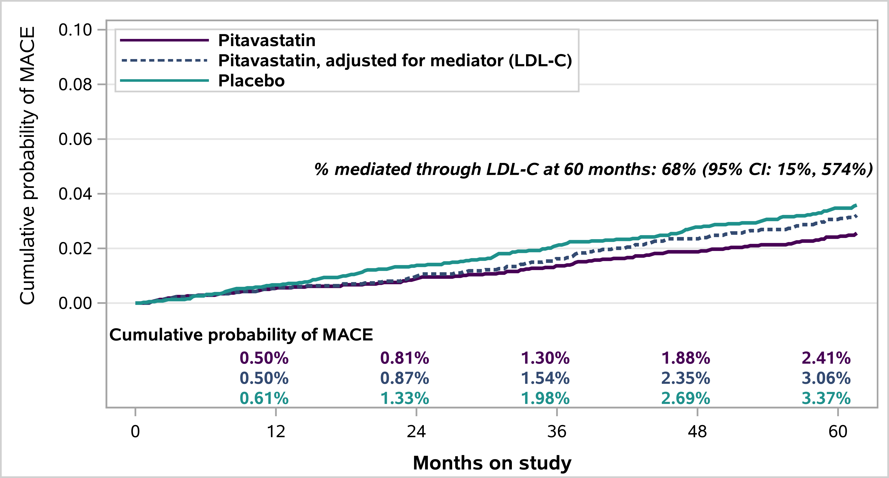
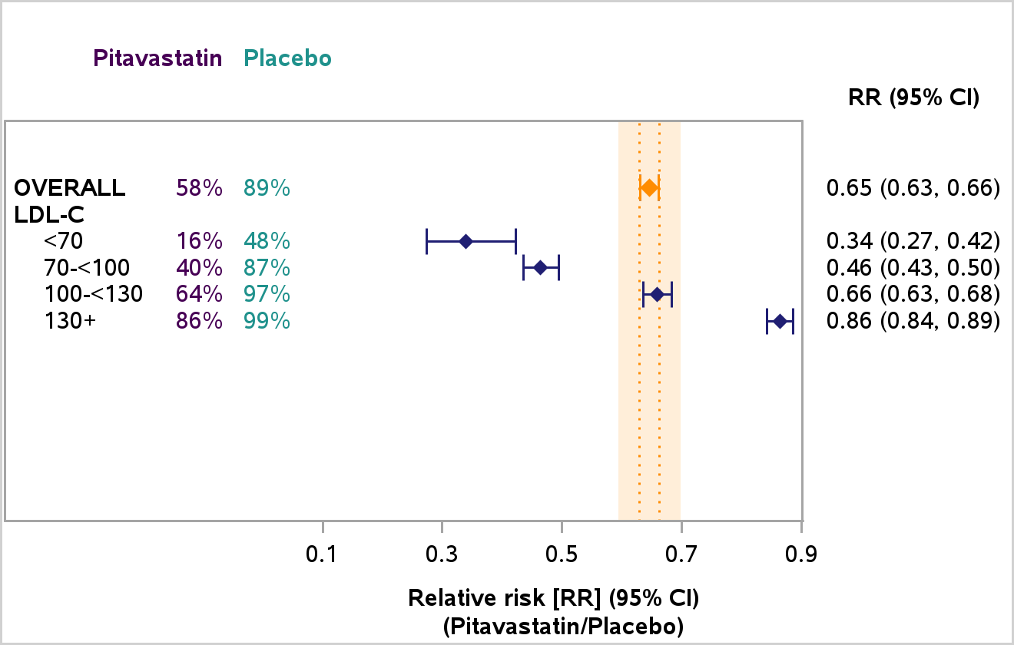


LDL-C reductions with pitavastatin strongly relate to MACE in PWH with minimally elevated LDL-C
Title:
Pitavastatin Effects on Lipids in Relation to MACE: a REPRIEVE Secondary Analysis
655
Triin Umbleja¹, Mohammad U. Zafar², Sara McCallum³, Arijeet K. Gattu³, Markella V. Zanni³, Marshall J. Glesby⁴, Jack T. Stapleton⁵, Michael Frank⁶, Kim-Lien Nguyen⁷, Rachel A. Bender Ignacio^{8,9}, Win Min Han^{10,11},
Pamela S. Douglas¹², Judith A. Aberg¹³, Heather J. Ribaudo¹, Steven K. Grinspoon³ on behalf of the REPRIEVE Study Team
¹Center for Biostatistics in AIDS Research, Harvard T.H. Chan School of Public Health, Boston, MA, USA; ²Atherothrombosis Research Unit, Mount Sinai Fuster Heart Hospital, Icahn School of Medicine at Mount Sinai, New York, NY, USA; ³Metabolism Unit, Massachusetts General Hospital and Harvard Medical School, Boston, MA, USA; ⁴Division of Infectious Diseases, Department of Medicine, Weill Cornell Medicine, New York, NY;
⁵The University of Iowa and The Iowa City VA Healthcare System, Iowa City, IA, USA; ⁶Division of Infectious Diseases, Medical College of Wisconsin, Milwaukee, WI, USA; ⁷Division of Cardiology, David Geffen School of Medicine at UCLA and VA Greater Los Angeles Healthcare System, Los Angeles, CA, USA; ⁸Division of Allergy and Infectious Diseases, University of Washington, Seattle, WA, USA;
⁹Vaccine and Infectious Disease Division, Fred Hutch Cancer Center, Seattle, WA, USA; ¹⁰HIV-NAT, Thai Red Cross AIDS and Infectious Diseases Research Centre, Bangkok, Thailand; ¹¹The Kirby Institute, UNSW Sydney, Sydney, Australia; ¹²Duke Clinical Research Institute, Duke University School of Medicine, Durham, NC, USA; ¹³Division of Infectious Diseases, Icahn School of Medicine at Mount Sinai, New York, NY, USA
BACKGROUND
The Randomized Trial to Prevent Vascular Events in HIV (REPRIEVE) demonstrated a 36% reduction in major adverse cardiovascular events (MACE) with pitavastatin among people with HIV (PWH). Little is known about the relationship between lipid-lowering and MACE in PWH.
We evaluated pitavastatin effects on lipids, relationship of lipid levels to MACE, and examined mediation of pitavastatin effects on MACE through lipid-lowering.
METHODS
REPRIEVE was a prospective, double-blind, placebo-controlled (1:1) trial evaluating pitavastatin (4mg/day) for primary prevention of MACE among PWH.
PWH on stable ART with CD4 count >100 cells/mm³, at low-moderate ASCVD risk by combination of PCE score and LDL-C were followed for a median of 5.6 years.
Centrally-tested fasting lipids were evaluated at baseline and annually thereafter.
LDL-C derived using Friedewald formula (at TG≤400 mg/dL) or direct LDL-C (at 400<TG<500 mg/dL).
Pitavastatin effect on LDL-C (outcome) was estimated using linear mixed effects models and GEE.
Relationship between lipid levels (time-updated covariate) and time to first MACE (outcome) was assessed using Cox regression models.
Mediation of pitavastatin effect on MACE via LDL-C-lowering was examined using Vansteelandt method.
RESULTS
Time-updated average LDL-C was associated with risk of MACE [Fig. 4].
20% lower MACE risk per 30%-lower LDL-C
Time-updated average TG was associated with risk of MACE [Fig. 4].
5% lower MACE risk per 12%-lower TG
Robust to adjustment for LDL-C
In an exploratory mediation analysis, 68% of the total pitavastatin effect on MACE was estimated to have been mediated through LDL-C, although with low precision [Fig. 5].
CONCLUSIONS
Among the cohort of PWH with minimally elevated LDL-C, LDL-C levels strongly related to MACE.
This underscores the importance of LDL-C-lowering as a goal in primary CVD prevention in PWH.
Pitavastatin (4 mg/day) demonstrated a robust 30% reduction in LDL-C.
Higher-intensity statin therapy or additional agents may be needed to achieve LDL-C targets for primary CVD prevention among PWH with LDL-C levels ≥130 mg/dL.
Pitavastatin effects on LDL-C strongly related to MACE but may not fully account for all the MACE reduction, leaving the possibility of contributions from other pathways.
In the PWH population with residual MACE risk related to inflammation and immune activation, these mechanisms may warrant further study.
Interpretation of findings is subject to the REPRIEVE eligibility criteria which required lower LDL-C at higher ASCVD risk, and LDL-C <70 mg/dL among diabetics.
Figure 1: Pitavastatin Effect on LDL-C over Time
Pitavastatin effects were primarily observed on LDL-C [Fig. 1].
At month 12, LDL-C was 30 mg/dL lower with pitavastatin
Corresponds to a 30% reduction [Fig. 2]
Relatively stable levels thereafter in both treatment groups
Consistent effects on non-HDL-C and TC (not shown)
Modest reduction in TG (pitavastatin vs. placebo)
Median change from baseline to month 12: -11 vs. 1 mg/dL
No effect on HDL-C (1 vs. 0 mg/dL)
Relative LDL-C-lowering from baseline with pitavastatin was generally consistent across the prespecified baseline subgroups, including by baseline LDL-C [Fig. 2].
Slightly larger reduction in Southeast/East Asia (36%) and slightly smaller among Black PWH in High Income countries (23%)
No differences by CD4, HIV-1 RNA or ART duration (not shown)
Pitavastatin lowered the risk of having elevated LDL-C above the clinical care targets [Fig. 3].
Risk of LDL-C ≥100 mg/dL was 68% lower with pitavastatin:
82% met target with pitavastatin vs. 43% with placebo
Risk of LDL-C ≥70 mg/dL was 35% lower with pitavastatin:
42% met target with pitavastatin vs. 11% with placebo
Those with higher baseline LDL-C were less likely to meet the targets, reflective of the observed 30% reduction with pitavastatin.
Among those with baseline LDL-C ≥130 mg/dL:
62% vs. 9% met target LDL-C below 100 mg/dL
14% vs. 1% met target LDL-C below 70 mg/dL
Dotted lines show Mechanistic substudy means including
a month 4 lipid assessment
Figure 2: Pitavastatin Effect on LDL-C Levels at Month 12 Relative to Baseline
0.70 (95% CI: 0.70, 0.71)
Participant Characteristics | Pitavastatin (N=3888) | Placebo (N=3881)
Age (years) | 50 | 50
Female sex | 31% | 31%
Black or African American | 40% | 42%
10-yr ASCVD risk by PCE (%) | 4.5 | 4.5
HIV-1 RNA <400 copies/mL | 88% | 87%
CD4 (cells/mm³) | 620 | 622
Screening TC (mg/dL) | 186 | 184
Screening HDL-C (mg/dL) | 48 | 48
Screening TG (mg/dL) | 115 | 114
Screening LDL-C (mg/dL) | 109 | 108
Median for continuous measures, percentage of participants for categorical measures. HDL-C, LDL-C and TC denote HDL, LDL and total cholesterols; TG triglycerides.
Figure 3: Risk of Not Meeting LDL-C Target at Month 12
% not meeting LDL-C target
Figure 4: LDL-C and TG Effects on MACE Outcomes
Figure 5: Mediation of Pitavastatin Effect on MACE via LDL-C
Funding:
REPRIEVE is supported by
the NIH, ACTG,
Kowa Pharmaceuticals,
Gilead Sciences, and
ViiV Healthcare.
LDL-C target: 100 mg/dL
Outcome: LDL-C ≥100 mg/dL
LDL-C target: 70 mg/dL
Cox models, adjusted for PCE, GBD region, race; the most recent level and the average of levels prior to MACE were used as time-updated covariates
Pitavastatin adjusted for LDL-C as a mediator represents the estimated effect of pitavastatin on MACE under the counterfactual condition of no pitavastatin effect on LDL-C
Notes:
Poster Development Guide
Formatting Notes
To Edit In PowerPoint: Click View > Guides to make editing easier. Keep text within guides
If you wish, you may change the background colors, but use a light color or white for the overall background of the poster and a bold color for the main findings section
Author list: Don’t split names onto two lines (e.g., “John [line break] Smith”). If that happens, use a new line. Bold the name of the presenting author
Font Size: Do not drop below font size 36 in the main information sections (Background, Methods, Results, Conclusions). If you have extra space, increase the font size, but maintain some white space to make it easier for attendees to read your text
Use of Color: To keep attendees focused on your main findings and important details in your graphs and figures, do not use color in the sidebars
Print Size: Using this template, the optimal print size is 54 inches (width) x 36 inches (height) or 60 inches x 40 inches (137.2 cm x 91.4 cm or 152.4 cm x 101.6). Printing the poster in a smaller size may save some cost, but the 54” x 36” size will maintain the suggested font size and layout in the final printed version of the poster (and maintain the effectiveness of the poster design).
Poster Board Dimensions: Regardless of whether you use this template, the size of the board for displaying your poster at CROI is 96 inches (width) x 48 inches (height). The maximum size of a poster is 93 inches (width) x 45 inches (height). The minimum size for a poster is 36 inches (width) x 24 inches (height) so attendees can see the poster at a minimum of 10 feet away
Poster Content Requirements
Poster Number: The poster number should be displayed in the upper right corner (0000 in the template). This is not the abstract number you had during submission but a number you will be assigned and sent to you by email which notes the position of the poster in the poster hall. This number will be sent to you after late-breaking abstracts have been accepted in January
Poster Title: The title should be the same as the title submitted with the abstract
QR Codes are not allowed by CROI

