Slide 1
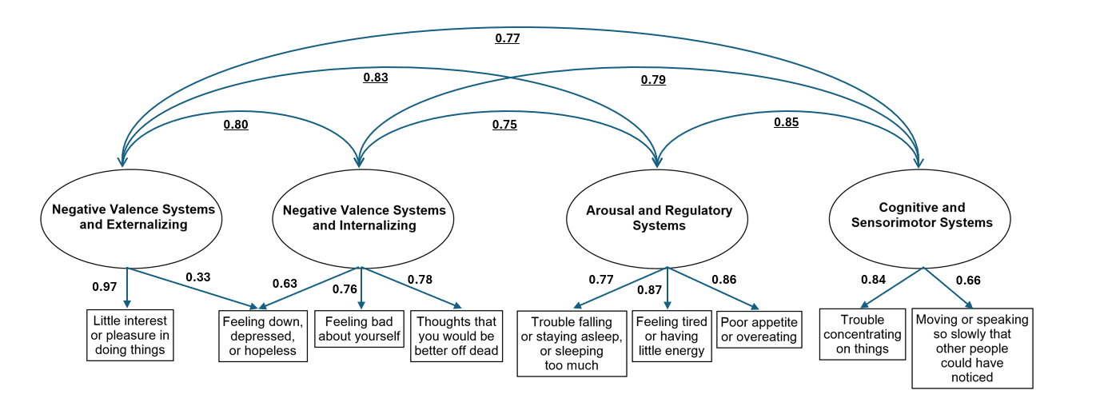
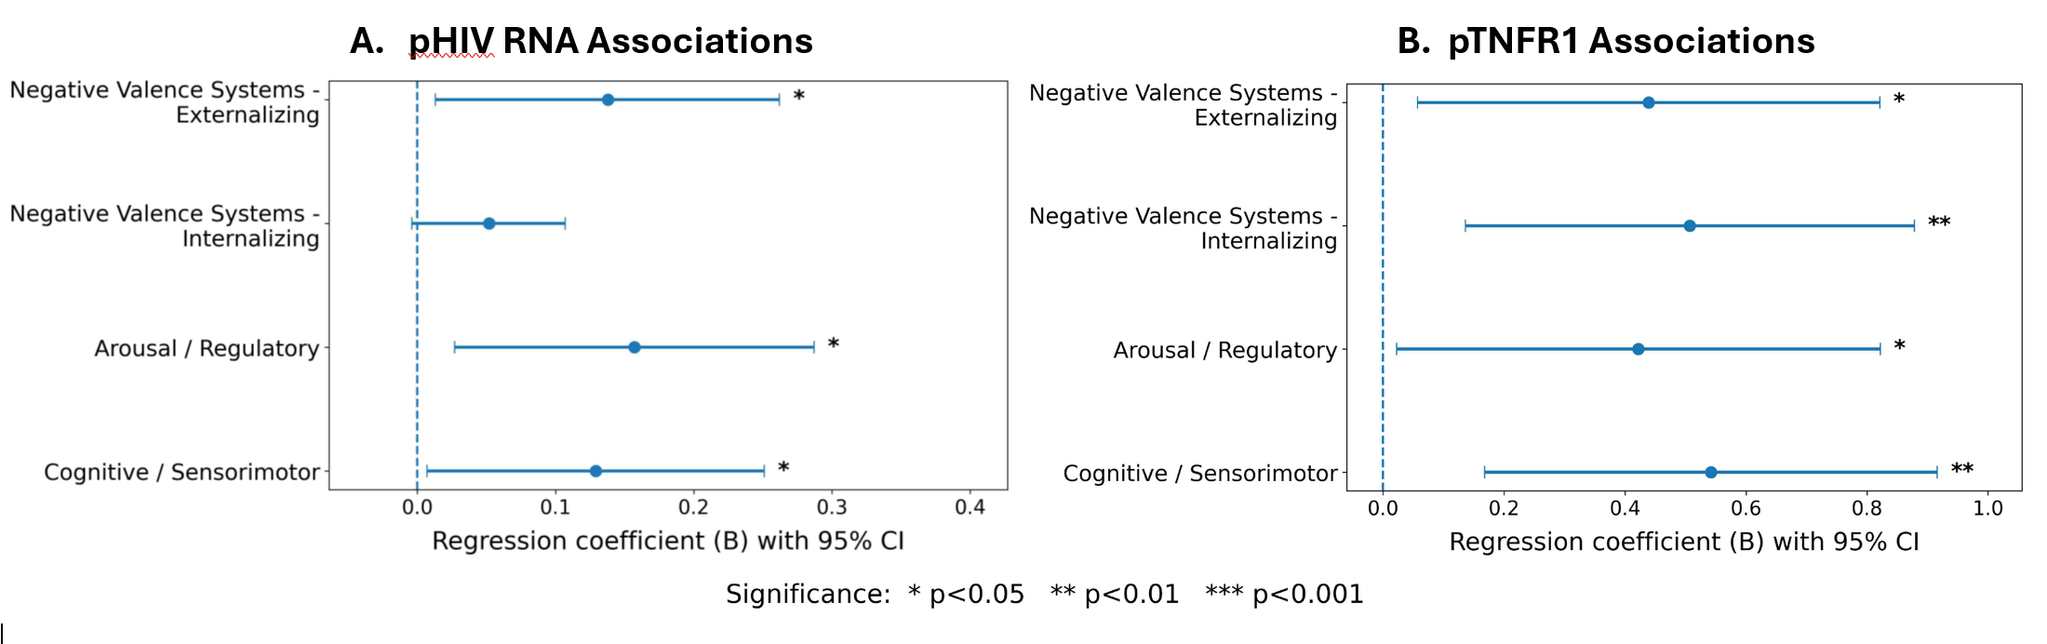

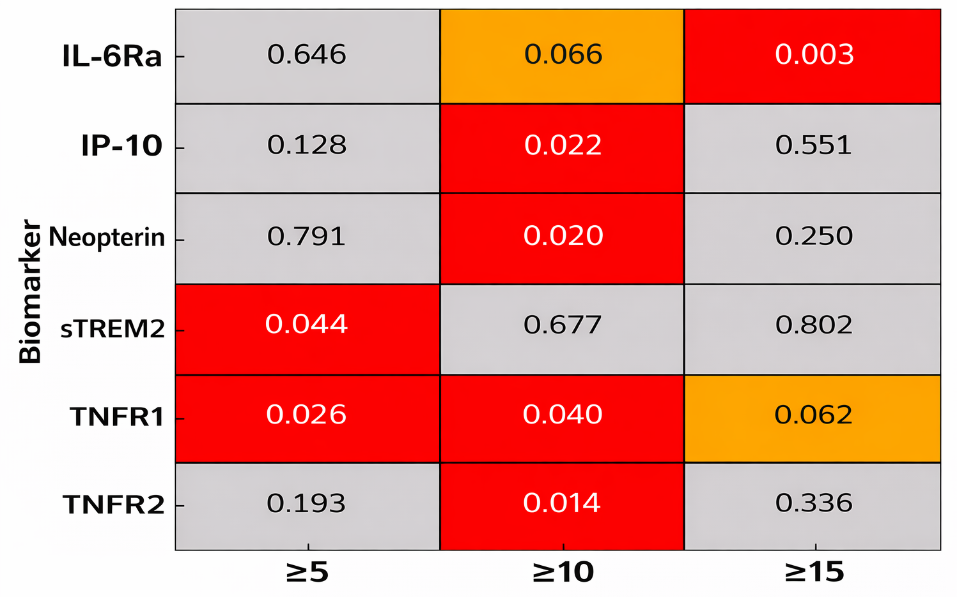
Depression and Inflammation in Acute HIV: An RDoC-Based PHQ-9 Factor Analysis Veronica Wright^{1,2}, Carlo Sacdalan^{3,4}, Suteeraporn Pinyakorn^{5,6}, Luxe-naree Poonpitak³, Nitiya Chomchey³, Suwanna Puttamaswin³, Serena Spudich⁷, Somchai Sriplienchan³, Nittaya Phanuphak^{3,4}, Lydie Trautmann^{5,6}, Brian K. Agan^{6,8}, Robert Paul⁹, Trevor A. Crowell^{5,6} ¹ Kimbrough Ambulatory Care Center, Fort Meade, MD, USA; ² Walter Reed National Military Medical Center, Bethesda, MD, USA; ³ SEARCH Research Foundation, Bangkok, Thailand; ⁴ Faculty of Medicine, Chulalongkorn University, Bangkok, Thailand; ⁵ U.S. Military HIV Research Program, Walter Reed Army Institute of Research, Silver Spring, MD, USA; ⁶ Henry M. Jackson Foundation for the Advancement of Military Medicine, Bethesda, MD, USA; ⁷ Yale University School of Medicine, New Haven, CT, USA; ⁸ Infectious Disease Clinical Research Program, Department of Preventive Medicine and Biostatistics, Uniformed Services University of the Health Sciences, Bethesda, MD; ⁹ Department of Psychological Sciences, University of Missouri–St. Louis, St. Louis, MO, USA
477
INTRODUCTION
RESULTS
Depression is common in HIV and may relate to neuroinflammation, but symptoms are heterogeneous.¹⁻⁹
The Research Domain Criteria (RDoC) supports dimensional phenotyping aligned with neurobiological systems.¹⁰
We used an RDoC-based PHQ-9 factor model¹¹ to test inflammatory biomarker associations in acute HIV before initiation of antiretroviral therapy.
Participants (N=721): Median age 26, 97.6% male, largest group Fiebig Stage III (45.6%), median HIV-1 RNA 5.99 log10 copies/mL (IQR 5.19–6.73), 79.8% with PHQ-9 ≥ 5
CFA – Good Fit
Root Mean Square Error of Approximation 0.052, Comparative Fit Index 0.996, Tucker-Lewis Index 0.992
Multivariable Regression Associations with RDoC Domains:
TNFR1 → all 4 domains (β 0.42–0.54, p<0.05)
HIV RNA → 3 domains (Externalizing, Arousal, Cognitive; β 0.13–0.16; p<0.05)
PHQ-9 Severity and Inflammatory Biomarkers:
PHQ-9 ≥ 10: ↑ TNFR2, IP-10, neopterin
PHQ-9 ≥ 15: ↑ IL-6Ra
TNFR1 elevated at ≥5 and ≥10; trend at ≥15
OBJECTIVE
FIGURE 1. Confirmatory factor analysis model of PHQ-9 symptom domains mapped to RDoC-relevant systems.
Values shown are standardized CFA estimates: single-headed arrows indicate standardized factor loadings, and curved double-headed arrows indicate correlations between latent factors.
To evaluate an RDoC-aligned PHQ-9 factor model in acute HIV and examine associations between symptom domains, HIV RNA, and plasma/CSF inflammatory biomarkers.
METHODS
N=721 acute HIV participants from RV254 cohort (Thailand), PHQ-9 and biomarkers at enrollment prior to ART
Confirmatory Factor Analysis (CFA) 4-Factor Model (RDoC-aligned) with PHQ-9 ≥5
Neg Valence Externalizing (Anhedonia, Depressed Mood)
Neg Valence Internalizing (Guilt, Suicidality)
Arousal/Regulatory (Sleep, Fatigue, Appetite)
Cognitive/Sensorimotor (Concentration/Psychomotor)
Multivariable Regressions (Adjusted for Age and Fiebig Stage): Factor Scores with HIV RNA + 30 plasma/CSF biomarkers; Mann-Whitney comparisons by PHQ thresholds ≥5/10/15
CONCLUSION
CFA supports a 4-factor PHQ-9 model aligned with RDoC domains in acute HIV.
Depression symptom burden is associated with higher inflammatory biomarkers in acute untreated HIV. Plasma TNFR1 may function as a cross-RDoC domain inflammatory correlate, while plasma HIV RNA may only relate to externalizing, arousal, and cognitive symptom domains.
Future studies needed to evaluate persistence beyond acute infection and RDoC/biomarker correlations with more severe PHQ-9 thresholds.
FIGURE 2. Multivariable regression coefficients (β) with 95% CI for plasma HIV RNA and TNFR1 across depressive symptom domains (PHQ-9 ≥5)
STUDY SUMMARY
In people with early untreated HIV, different patterns of depressive symptoms were linked to inflammation and viral burden. TNFR1 was associated with all symptom domains, while HIV RNA levels were linked to specific domains involving mood, energy, and cognition.
KEY REFERENCES
[1] Mudra Rakshasa-Loots A, Naidoo S, Hamana T, Fanqa B, van Wyhe KS, Lindani F, et al. Multi-modal analysis of inflammation as a potential mediator of depressive symptoms in young people with HIV: The GOLD depression study. PLoS One. 2024;19(2). doi: 10.1371/journal.pone.0298787.
[11] Gunzler D, Sehgal AR, KauƯman K, Davey CH, Dolata J, Figueroa M, Huml A, Pencak J, Sajatovic M. Identify depressive phenotypes by applying RDOC domains to the PHQ-9. Psychiatry Res. 2020 Feb 19;286:112872. doi: 10.1016/j.psychres.2020.112872. Epub
ahead of print. PMID: 32151848; PMCID: PMC7434666.
Full list available upon request.
⬜ Gray = Not significant (NS)
🟧 Orange = Trend (p < 0.1)
🟥 Red = Significant (p < 0.05)
FIGURE 3. Inflammatory Biomarkers by PHQ-9 Severity Threshold

