Slide 1


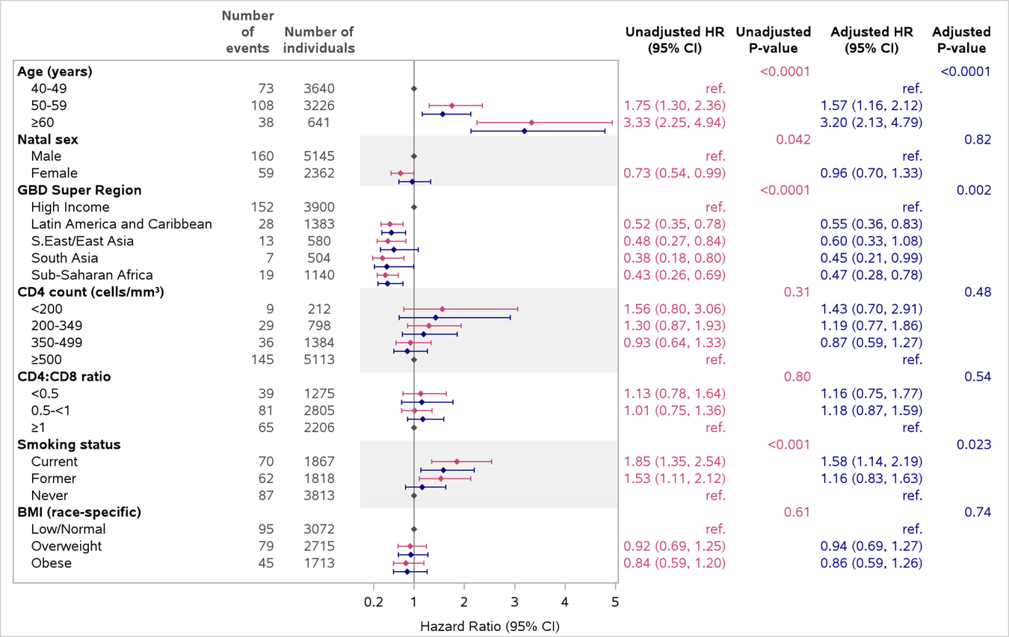
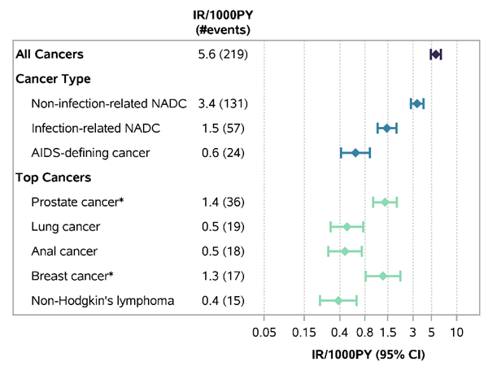


In a global cohort of PWH on effective ART, cancer remains an important comorbidity. Prevention strategies, including smoking cessation and age- and region- specific cancer screening approaches are critical to reduce the cancer burden in this population.
Title:
Cancer Incidence and Risk Factors Among People with HIV in REPRIEVE
620
Sophia Zhao¹, Sara McCallum¹, Aya Awwad¹, Phillip E. Castle², Marissa R. Diggs¹, Markella V. Zanni¹, Sarah M. Chu¹, Alex B. Lu¹, Judith S. Currier³, Judith A. Aberg⁴, Carl F. Fichtenbaum⁵, Gerald S. Bloomfield⁶, Carlos D. Malvestutto⁷, Pamela S. Douglas⁸, Heather J. Ribaudo⁹, Steven K. Grinspoon¹ for REPRIEVE investigators
¹Metabolism Unit, Massachusetts General Hospital and Harvard Medical School, Boston, USA,²Divisions of Cancer Prevention and Cancer Epidemiology and Genetics, National Cancer Institute, Bethesda, MD, USA, ³Division of Infectious Diseases, David Geffen School of Medicine, University of California at Los Angeles, Los Angeles, USA, ⁴Division of Infectious Diseases, Icahn School of Medicine at Mount Sinai, New York, USA, ⁵Division of Infectious Diseases, University of Cincinnati College of Medicine, Cincinnati, USA, ⁶Department of Medicine, Duke Global Health Institute and Duke Clinical Rese, Duke University School of Medicine, Durham, USA, ⁷Division of Infectious Diseases, Ohio State University Medical Center, Columbus, USA, ⁸Duke Clinical Research Institute, Duke University School of Medicine, Durham, USA, ⁹Center for Biostatistics in AIDS Research, Harvard T.H. Chan School of Public Health, Boston, USA
BACKGROUND
Cancer is a leading cause of morbidity and mortality among people with HIV (PWH).
With the advent of highly effective antiretroviral therapy (ART), the distribution of cancer types among PWH has shifted from acquired immune deficiency syndrome (AIDS)-defining cancers (ADCs) towards non-AIDS-defining cancers (NADCs).
Cancer incidence vary across geographic regions and are significantly affected by population characteristics.
Enhanced understanding of cancer incidence and contributing risk factors is needed, particularly among those well -treated on ART.
RESULTS
CONCLUSIONS
Analyses included 7,507 participants with 39,011.8 person-years (PY) of follow-up, and their demographics are shown in Table 1.
Overall cancer incidence is shown in Figure 1. Among those with cancer, 160 were male (incidence 6.1 per 1,000 PY) and 59 were female (4.5 per 1,000 PY).
The most common cancer among female was breast cancer (n=17 [28.8%] cases), and the most common cancer among male was prostate cancer (n=36 [22.5%] cases).
High income GBD region had the higher cancer incidence (n=152, 7.6 per 1,000 PY), compared to Low or Mid Income GBD region (n=67, 3.5 per 1,000 PY).
Cancer risk were higher for older individuals (50-59 vs 40-49, HR 1.6, 95% CI 1.2-2.1; ≥60 vs 40-49, HR 3.2, 95% CI 2.1-4.8), current smoking (HR 1.6, 95% CI 1.1-2.2). GBD regions of Latin America and Caribbean (HR 0.6, 95% CI 0.4-0.8), South Asia (HR 0.5, 95% CI 0.2-1.0), and Sub-Saharan Africa (HR 0.5, 95% CI 0.3-0.8) were associated with lower risk of cancer (Figure 2).
Cancer remains a major comorbidity in a global cohort of PWH with effective ART treatment,
Non-infection-related NADCs are the most common cancer type in the whole population and across sex and GBD regions.
Risk are highest among those with older age, current smoking, and high income GBD region residence.
Prevention strategies, including smoking cessation and age- and region- specific cancer screening approaches are critical to reduce the cancer burden in this population.
METHODS
Population: REPRIEVE participants without a history of cancer at study entry.
Cancer classification: ADCs, Infection-related NADCs, Non-infection-related NADCs
Risk factors:
Traditional: age, sex, Global Burden of Disease (GBD) region, body mass index (BMI), smoking
HIV-related: CD4 count, CD4/CD8 ratio
Analysis: Incidence rates per 1,000 person-years and Cause-specific Cox regression for risk factors
Figure 2. Effects of Risk Factors on Cancer
Figure 1. Incidence Rates of All Cancers and Cancer Types
Table 1. Participant Demographics
Demographics | N=7,507
Age (years), median (Q1, Q3) | 50 (45, 55)
Female sex (%) | 2,362 (31%)
Low or Mid Income GBD region, % | 3,607 (48%)
Current or former smoking, % | 3,685 (49%)
HIV-1 viremia suppressed, % | 88%
CD4 count (cells/mm³), median (Q1, Q3) | 622 (449, 828)
Years since HIV diagnosis, median (Q1, Q3) | 12 (7, 19)
CD4:CD8 ratio, median (Q1, Q3) | 1 (1, 1)
BMI obese, % | 1,713 (23%)
Table 1: Duration of HIV is defined as years since first positive HIV test. HIV-1 RNA was captured if available through standard of care. The assays used for testing varied, including assays with lower limits of quantitation (LLQ) between 20 and 400 copies/mL
Abbreviations: GBD, Global Burden of Disease; Q1, 1st quartile; Q3, 3rd quartile
Figure 1: Abbreviations: IR: incidence rate; PY, person years; ADC, AIDS-defining cancer; NADC, Non-AIDS-defining cancer; PY, person years; *Restricted to male and female sex, respectively
Figure 2: Unadjusted Model; Adjusted Model
Abbreviations: BMI, body mass index; GBD, Global Burden of Disease; HR, hazard ratio; ref, reference
Funding: REPRIEVE is supported by the NIH, ACTG, Kowa Pharmaceuticals, Gilead Sciences, and ViiV Healthcare.
Notes:
Poster Development Guide
Formatting Notes
To Edit In PowerPoint: Click View > Guides to make editing easier. Keep text within guides
If you wish, you may change the background colors, but use a light color or white for the overall background of the poster and a bold color for the main findings section
Author list: Don’t split names onto two lines (e.g., “John [line break] Smith”). If that happens, use a new line. Bold the name of the presenting author
Font Size: Do not drop below font size 36 in the main information sections (Background, Methods, Results, Conclusions). If you have extra space, increase the font size, but maintain some white space to make it easier for attendees to read your text
Use of Color: To keep attendees focused on your main findings and important details in your graphs and figures, do not use color in the sidebars
Print Size: Using this template, the optimal print size is 54 inches (width) x 36 inches (height) or 60 inches x 40 inches (137.2 cm x 91.4 cm or 152.4 cm x 101.6). Printing the poster in a smaller size may save some cost, but the 54” x 36” size will maintain the suggested font size and layout in the final printed version of the poster (and maintain the effectiveness of the poster design).
Poster Board Dimensions: Regardless of whether you use this template, the size of the board for displaying your poster at CROI is 96 inches (width) x 48 inches (height). The maximum size of a poster is 93 inches (width) x 45 inches (height). The minimum size for a poster is 36 inches (width) x 24 inches (height) so attendees can see the poster at a minimum of 10 feet away
Poster Content Requirements
Poster Number: The poster number should be displayed in the upper right corner (0000 in the template). This is not the abstract number you had during submission but a number you will be assigned and sent to you by email which notes the position of the poster in the poster hall. This number will be sent to you after late-breaking abstracts have been accepted in January
Poster Title: The title should be the same as the title submitted with the abstract
QR Codes are not allowed by CROI

