Slide 1




Charlotte Charpentier,¹ Thomas Montrouge,¹ Marc Wirden,² Véronique Avettand-Fenoel,³ Camille Tumiotto,⁴ Pantxika Bellecave,⁴ Audrey Rodallec,⁵ Elisabeth Garnier,⁵ Djeneba Fofana,⁶ Sidonie Lambert-Niclot,⁶ Brigitte Montès,⁷ Marie-Laure Chaix,⁸ Enagnon Kazali Alidjinou,⁹ Pauline Coulon,⁹ Agnès Beby-Defaux,¹⁰ Elodie Alessandri-Gradt,¹¹ Alice Moisan,¹¹ Quentin Le Hingrat,¹ Constance Delaugerre,⁸ Anne-Geneviève Marcelin,² Gilles Peytavin,¹² Philippe Flandre,¹³ Vincent Calvez,² and Diane Descamps¹
A French national real-world observatory of people initiating a lenacapavir-based treatment during the post-approval period
1. Service de Virologie, AP-HP, Hôpital Bichat-Claude Bernard, Université Paris Cité, INSERM, IAME, Paris, France; 2. Service de Virologie, Sorbonne Université, INSERM, UMR-S 1136, Institut Pierre Louis d'Epidémiologie et de Santé Publique, AP-HP, Hôpitaux Universitaires Pitié Salpêtrière - Charles Foix, Paris, France; 3. CHU d’Orléans, Service de Virologie, Université d’Orléans, Orléans, France; 4. CHU de Bordeaux, Service de Virologie, Bordeaux, France; 5. CHU Nantes, Service de Virologie, Nantes, France; 6. Santé Sorbonne Université, INSERM, Institut Pierre Louis d'Epidémiologie et de Santé Publique APHP, Hôpital Saint-Antoine, Département de Virologie, Paris, France; 7. CHU de Montpellier, Service de Virologie, Montpellier, France; 8. Service de Virologie, INSERM UMR 1342, AP-HP, Hôpital Saint-Louis, Université Paris Cité, Paris, France; 9. CHU de Lille, Service de Virologie, Lille, France; 10. CHU de Poitiers, Service de Virologie, Poitiers, France; 11. CHU de Rouen, Service de Virologie, Univ Rouen Normandie, Normandie Univ, Rouen, France; 12. Service de Pharmacologie, AP-HP, Hôpital Bichat-Claude Bernard, INSERM, IAME, Paris, France; 13. INSERM, Sorbonne Université, Institut Pierre Louis d'Epidémiologie et de Santé Publique, Paris, France

Slide 2

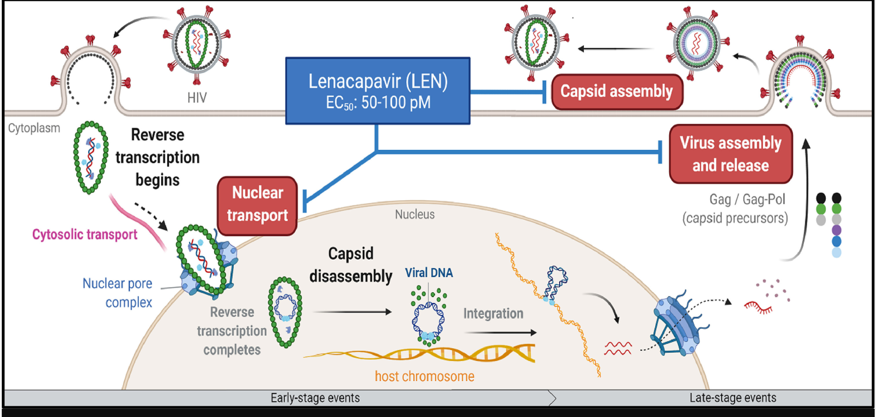
BACKGROUND
Lenacapavir (LEN) is the first compound of the new drug class of capsid inhibitors, that targets multiple steps of the HIV replication cycle
The CAPELLA trial has shown the efficacy of LEN added to an optimized background treatment (OBT) in highly ARV-experienced PWH (n = 72) in failure having multi-drug resistant viruses with 61.4 % of virological suppression at Week 156 (missing = excluded, 84.6%)
Segal-Maurer S, et al, N Eng J Med 2022; Margot N et al., EMHH 2025, Abst. 7
Among the 72 participants of the CAPELLA trial, emergence of LEN resistance mutations was observed in 9 of them at W52 and in 14 at W104 and W156 Margot N et al., EMHH 2025, Abst. 7
Outside of clinical trials, little real-world data are available on the use of LEN
Hitchcock AM et al., Int J Antimicrob Agents, 2024

Slide 3
OBJECTIVE
To describe the characteristics of the population and the virological outcome of PWH who initiate a LEN-based treatment in a real-world setting

Slide 4
METHODS
A French national retrospective observational study including PWH, initiating a LEN-based treatment in a center of the ANRS | MIE virology and PK network after LEN approval in France (December 22th 2022)
All were highly treatment-experienced with prior genotypic resistance tests showing drug resistance mutations to at least one ARV of two major drug classes
A virological failure (VF) was defined as two consecutive plasma viral loads (VL) ≥ 50 c/mL
A non-virological response was defined as a VL decrease <1 log₁₀ c/mL or failure to achieve virological suppression (< 50 c/mL) at W24
Cumulative genotypic resistance tests (GRT) were interpreted using the ANRS | MIE algorithm (https://hivfrenchresistance.org)

Slide 5
RESULTS – POPULATION CHARACTERISTICS
94 PWH, from 13 centers, who have received a LEN-based treatment were included in this study
49 (52 %) participants were in virological suppression at LEN + OBT initiation
Among participants in treatment failure at initiation (n = 45, 48 %), median VL was 2.5 log₁₀ c/mL (IQR = 2.0-3.6)
Participants characteristics
ARV treatment prior to LEN*
Variables | n = 94
Age, years, median (IQR) | 57 (42-62)
Men, n (%) | 58 (61)
CD4 cells nadir, /mm³, median (IQR) | 66 (13-142)
VL zenith, log₁₀ c/mL, median (IQR) | 5.6 (5.2-5.9)
CD4 cells at baseline, /mm³, median (IQR) | 395 (163-636)
HIV-1 subtype, n (%) B CRF02_AG Others | 55 (59) 16 (17) 23 (24)
HIV-1 tropism (missing data n = 35), n (%) R5 X4 | 31 (53) 28 (47)
n
* only reported those received by at least 3 participants
Prior ARV regimens were heterogeneous

Slide 6
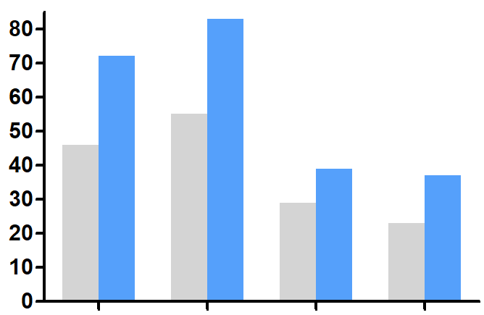
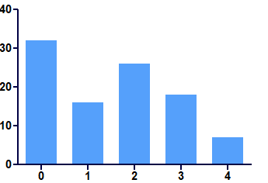
RESULTS – BASELINE RESISTANCE ANALYSIS
Percentage of PWH with resistant viruses (resistance and possible resistance)
Number of fully exhausted ARV classes
%
82 %
% of PWH
71 %
32 %
54 %
28 %
45 %
39 %
36 %
17 %
29 %
16 %
22 %
7 %
NRTI
NNRTI
PI
INSTI
None
1
2
3
4
Mean of DRM, n
Range
4
0-9
3
0-6
2
0-6
1
0-5
52 % of the participants have > 2 fully exhausted ARV classes

Slide 7
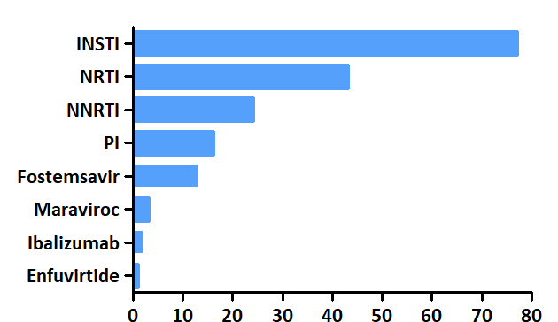
RESULTS – OBT AND GSS
OBT composition
Genotypic susceptibility score based on cumulative genotypes
81 %
n
53 %
45 %
24 %
16 %
14 %
3 %
20 %
2 %
9 %
4 %
3 %
4 %
6 %
1 %
n
1 %
Median number of ARV in the OBT = 2 (IQR = 1-3)
Most frequently used ARV class: INSTI
24 (26 %) participants receiving CAB + LEN
57 (61 %) participants with GSS <1

Slide 8
RESULTS – VIROLOGICAL OUTCOME
Median follow-up on LEN-based treatment: 13 months (IQR = 8-18)
12 PWH discontinued (12.6 %): 3 lost to follow-up, 4 virological failures, 1 for cutaneous side effects, 1 participant's decision, and 3 deaths unrelated to the drug
Virological outcome at last follow-up visit depending on baseline VL
 | Baseline VL < 50 c/mL n = 49 | Baseline VL ≥ 50 c/mL n = 45 | Overall n = 94
< 50 c/mL | 46 (94 %) | 29 (64 %) | 75 (80 %)
Virological failure | 3 (6 %) | 4 (9 %) | 7 (7 %)
Non-virological response | 0 (0 %) | 12 (26 %) | 12 (13 %)
Resistance analysis
A genotype was available for 8 PWH (5 non virological response and 3 VF)
Emergence of LEN resistance mutation in 1 case: N74D
No emergence of new DRMs to the ARV of the OBT
Switch from R5 to X4 tropism observed in one participant receiving MVC in the OBT
PK analysis
LEN plasma levels were available for 11 of the 19 PWH in VF or non-virological response
Adequate plasma LEN concentrations (i.e. > 15 ng/mL) were observed at least once in 10 individuals and in 27 out of the 35 assessable samples

Slide 9
RESULTS – PARTICIPANT WITH LEN RESISTANCE EMERGENCE
Description of HIV VL, CD4 cell count, drug concentrations and resistance
HIV VL log₁₀ c/mL
CD4 /mm³
CA: N74D
LEN: 24 ng/mL
DRV: < LOQ
Unique Recombinant form (URF)
NRTI: T215I
NNRTI: V106I-E138K-H221Y
PI: no major mutation
INSTI: E138K-Q148K-E157Q
Prior regimen: TDF/FTC + DRV/r
50 c/mL
Weeks
TDF/3TC + DRV/r + LEN
Suboptimal adherence to background regimen leading to LEN functional monotherapy
Participant was lost to follow-up after W9

Slide 10
CONCLUSION
This observational study of real-world LEN use among 85 PWH showed that
Half of the participants were virologically-suppressed at LEN baseline, and virological suppression was maintained in 94 % of cases
Among PWH in failure at LEN + OBT initiation, Virological suppression was achieved in 65 % of cases, which is similar to the results observed in clinical trials
Among the 19 participants in VF, LEN resistance was observed in only one case (5.3 %) with a rapid resistance selection associated with functional LEN monotherapy (non adherence to active oral ARV) Wirden M et al., J Antimicrob Chemother, 2024; Margot N et al., J Infect Dis, 2025
This national retrospective observational study is still ongoing, which allows for an increased number of participants and a longer follow-up period
Segal-Maurer S, et al, N Eng J Med 2022; Margot N et al., EMHH 2025, Abst. 7

Slide 11

We thank all the ANRS|MIE HIV virology and PK network, the study participants, and the clinicians
Funding: ANRS I MIE & Gilead Science

