Slide 1

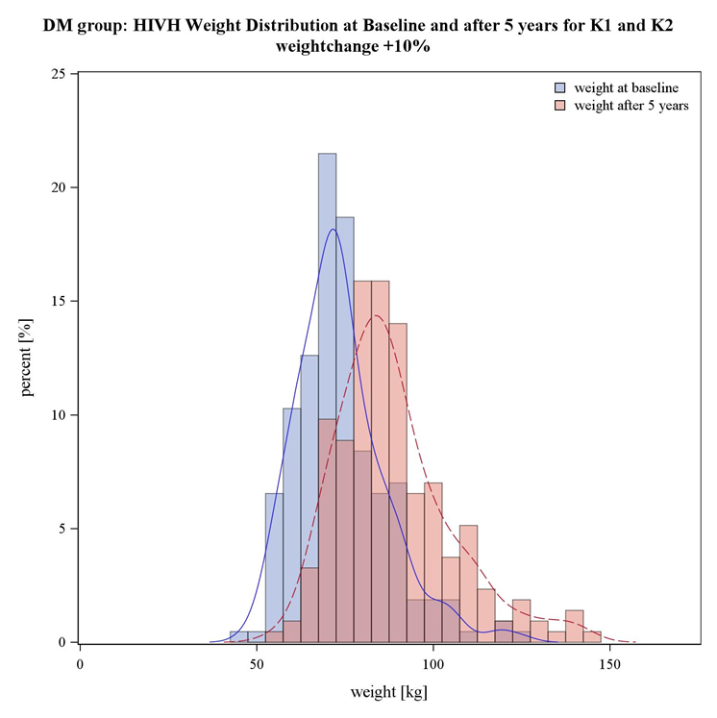
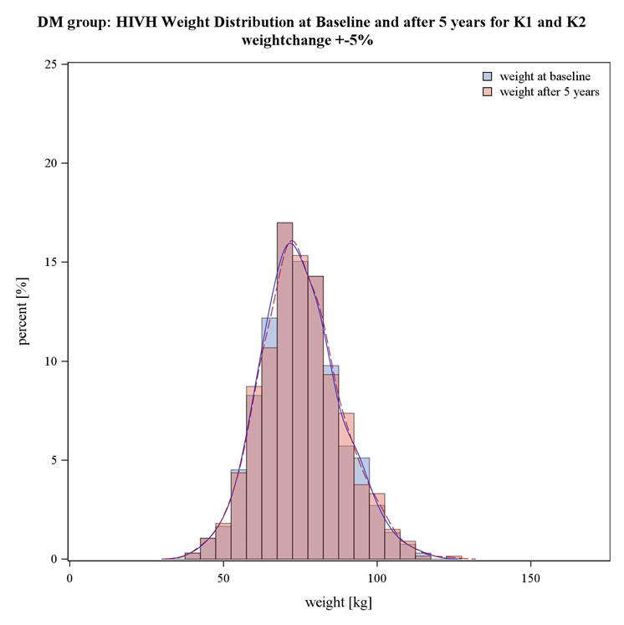

Effect of extreme weight gain within 5 years in people living with HIV on upcoming incident diabetes mellitus
Abstract Code
eP257
L. Mavarani¹, S. Albayrak-Rena², S. Sammet², F. Maischack², A. Potthoff³, M. Hower⁴, A, Schönfeld⁵, D. Schadendorf², B. Schmidt¹, S. Esser² on behalf of the HIV HEART AGING Study Group
¹ Institute for Medical Informatics, Biometry and Epidemiology (IMIBE), University Hospital Essen, University Duisburg-Essen, Essen, Germany, ² Department of Dermatology and Venereology, HIV Outpatient Clinic, University Hospital Essen, University Duisburg-Essen, Essen, Germany, ³Interdisciplinary Immunological Outpatient Clinic, Center for Sexual Health and Medicine, Department of Dermatology, Venereology and Allergology, Ruhr University Bochum, Bochum, Germany, ⁴Department of Pneumology, Infectious Diseases and Internal Medicine, Klinikum Dortmund, Hospital University Witten/Herdecke, Dortmund, Germany, ⁵Department of Infectious Diseases, West German Center of Infectious Diseases University Hospital Essen, University Duisburg-Essen, Essen, Germany, ⁶Institute for Translational HIV Research, University Hospital Essen, University Duisburg-Essen, Essen, Germany
Group A
Table 1: Characteristics of PWH from the HIVH cohort during study baseline (BL), 5 year follow-up (5YFU) and last follow-up (LFU)
Purpose
Prevalence of obesity increased globally within the last decades¹ also in people living with HIV (PWH)²
Weight change is a multifactorial process → associated with diet, exercise, demographics, psychological and clinical comorbidities, and co-medications
Here: Evaluation of the impact of extreme weight gain over 5 years in PWH on the occurrence of incident diabetes mellitus (DM) in the Ruhr-area of Germany
Methods
The HIV HEART Aging study (HIVH) is a prospective observational study assessing cardiovascular risk of PWH in the Ruhr area of Germany since 2004
Participants with weight measurements at baseline (BL; years 2004-2011) and after 5 years were categorized as A) extreme weight gain group (weight gain ≥10% in 5 years) and B) stable weight group (weight change ±5% within 5 years) (see figure 1)
DM definition: Medical reports (“diabetes mellitus yes/no”), antidiabetic medication, and/or Hba1c ≥6.5%
Both groups were monitored over all follow-up times starting from BL for incident DM (excluding persons with prevalent DM before and at BL)
Cox regression models were used, adjusted for age at BL and sex, to calculate hazard ratios (HR) and corresponding 95% confidence limits (Cl) for the effect of extreme weight gain on incident DM.
Group B
Table 2: Cox Regression Models for the effect of extreme weight gain within 5 years of PWH from the HIVH cohort on incident DM until last follow-Up; HR=Hazard Ratio, LCL= lower confidence limit, UCL= upper confidence limit
Figure 1: Histograms of the weight distribution in group A (extreme weight gain) and B (stable weight) during 5 years
Cox Regression model | HR | LCL | UCL | P value
crude effect: extreme weight gain vs. stable weight on incident DM | 1.07 | 0.72 | 1.61 | 0.731
age and sex adjusted effect: extreme weight gain vs. stable weight on incident DM | 1.27 | 0.82 | 1.95 | 0.221
Results
879 participants were included in the analysis, with 214 (24.4%) persons in group A. There were 98 incident DM in total, 44 (20.6%) in group A and 54 (8.1%) in group B. The mean follow-up time was 13.8±3.6 years (see Table 1)
In regression models, group A showed weak indication for an increased risk for incident DM compared to group B (HR 1.3 [95%Cl 0.8-1.9]) (see Table 2)
7 (3.3%) participants from group A received treatment for DM after 5 years, going up to 31 participant (16.8%) until last follow-up observed. In group B, 10 (1.5%) received medication for DM after 5 years and 37 (7.1%) at last follow-up observed.
Conclusions
In the HIVH cohort, there was weak indication of an increased risk for incident DM among PWH with extreme weight gain, but wide confidence limits reflect the uncertainty in the estimate. The proportion of PWH receiving antidiabetic medication among those with diabetes mellitus could be optimized in regards to the current research and guidelines for antidiabetic medication.
ADDITIONAL KEY INFORMATION
Acknowledgement: We want to thank all patients and the whole study team who participated in the HIV HEART Aging Study. The HIV HEART Aging study was supported by Gilead Sciences and ViiV Health Care. The HIV HEART Aging study was registered in ClinicalTrials.gov (NCT04156048) and has been approved by the local ethics committee of the Medical Faculty of the University Duisburg-Essen number 14-5874-BO.
References:
https://www.who.int/news-room/fact-sheets/detail/obesity-and-overweight
Koethe JR, Jenkins CA, Lau B, et al.: Rising obesity prevalence and weight gain among adults starting antiretroviral therapy in the United States and Canada. AIDS research and human retroviruses 2016;32:50-8.
CORRSPONDING AUTHOR
M.D. Stefan Esser
University HIV/STD Center Essen, University Hospital Essen, Hufelandstrasse 55, 45122 Essen, Germany
(e-mail: stefan.esser@uk-essen.de)

